Slide 1
Implementation Training
for
Level I: We All Have Mental Health Classroom Program
Notes:
Welcome to the implementation training for the Level I: We All Have Mental Health classroom education program. We’re glad you could join us.

Slide 2
LEVEL I IMPLEMENTATION TRAINING AGENDA
Erika’s Lighthouse Core Messages
Level I Objectives & Components
Addressing Sensitive Topics
Level I Content
Tips for a Successful Teaching
Notes:
The Level I implementation training will review the core messages of Erika’s Lighthouse, Level I program objectives and components, how to address sensitive topics, Level I content and tips for successful teaching and implementation.

Slide 3
Classroom Education Programs
Use Together or Standalone. All are fully bilingual in English & Spanish
Level I: We All Have Mental Health (Ideal for gr. 4-6)
Introduction to mental health by understanding everyday feelings vs. overwhelming feelings with a strong focus on help-seeking and good mental health.
Level II: Depression Awareness (Ideal for gr. 5-9)
Introduction to depression by recognizing signs and symptoms with a strong focus on help-seeking and good mental health.
Level III: Depression Education & Suicide Awareness (Ideal for gr. 8-12)
Introduction to depression and suicide with a strong focus on help-seeking and good mental health.
Notes:
Erika’s Lighthouse offers 3 classroom programs that are designed to educate students about mental health, depression, suicide, good mental health and help-seeking behaviors. This implementation training is focused on We all Have Mental Health, our Level I program. This specific program, is recommended for students in grades 4-6 and is fully bilingual in English and Spanish. This program consists of lessons that focus on understanding that mental health is just as important as physical health, the difference between everyday and overwhelming feelings, how to reach out for help from a trusted adult, as well identifying good mental health behaviors. The lesson plans are built around a 5 minute animated video which tells the story of friends, Sasha and Andre. Throughout the lessons, students play Charades, participate in coping strategy stations set up around a classroom, roleplay talking to a trusted adult, play a game of Kahoot and more.

Slide 4
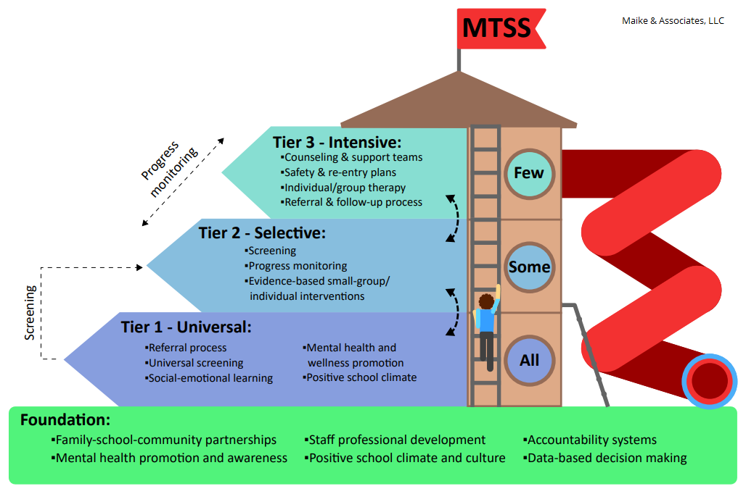
MTSS AREA OF FOCUS
What more can we do here?
What can we do better?
Notes:
When we look at the multi-tiered system of supports (MTSS), there are foundational, tier-one, tier-two, and tier-three levels. Erika’s Lighthouse fits into the tier-one, foundational level of MTSS. We want all students to be educated on mental health, signs and symptoms of depression, positive coping mechanisms, help-seeking skills and good mental health behaviors. That being said, we know that these topics are sensitive.

Slide 5
Representation Matters
Addressing Sensitive Topics
In order for students to feel safe and be fully engaged in the lessons, there are some important things to do when this program is introduced to students.
Establish Group Norms
Answer Difficult Questions
Be Sensitive & Trauma Informed
Notes:
In order for students to feel safe and be fully engaged in the lessons, there are some important things to do when introducing the program to students. On the coming slides, we will review how to establish group norms, answer difficult questions that may arise and provide provide reminders about the important of being sensitive and trauma informed.

Slide 6
Representation Matters
Establishing Group Norms
Here are some guidelines you may find useful in helping students come up with them:
Everyone should be involved in creating the group norms.
Use guiding questions to help students identify the norms that will achieve a safe and caring classroom:
Some examples of group norms that are brainstormed may include:
Listen to others’ perspectives
Maintain confidentiality
Participate
Right to pass
Respect differences
Notes:
it is important to establish group norms. Group norms are ways that groups of people can work together in a thoughtful, respectful, safe and productive way. Here are some guidelines you may find useful in helping students come up with group norms:
Everyone should be involved in creating the group norms.
Use guiding questions to help students identify the norms that will achieve a safe and caring classroom: Some examples of guiding questions are:
How can we be sure that people will be able to safely share private information and feelings?
How can we be sure that everyone has a chance to freely share and that they are heard?
How can we be sure that people are not forced to say or do something that makes them feel uncomfortable or unsafe?
Some examples of group norms that are brainstormed may include:
Listen to others’ perspectives
Maintain confidentiality
Participate
Right to pass
Respect differences

Slide 7
Representation Matters
Answering Difficult Questions
It may be helpful to follow this protocol when responding to difficult questions:
Affirm that the student’s question is legitimate. Restate it for clarification and acknowledge that others might also wonder about this. “Thanks for asking that. I am sure other people would like to know about...”
Identify if there is a belief/value that is inherent in the question. Point out anything about the question that might be opinion-related. It is important to express the range of opinions without identifying that any single opinion is the right one. “Some people might believe…while others believe…”
Answer the factual part of the question. “Here is what is known to be true…”
Refer to a trusted adult. “This would be a great question to ask your (aunt, dad, caregiver, etc.)”
Check back. “Did I answer your question?”
Leave the door open. “If you have any other related questions, I hope you will feel free to ask.”
Notes:
Sometimes when covering sensitive content such as emotions, social influences, and personal topics, questions may arise that are difficult to answer. Sometimes, the question may relate to personal values that are not universally shared. Or the question might have more than one answer depending on a person’s values, beliefs, and personal history.
It may be helpful to follow this protocol when responding to difficult questions:
Affirm that the student’s question is legitimate. Restate it for clarification and acknowledge that others might also wonder about this. “Thanks for asking that. I am sure other people would like to know about...”
Identify if there is a belief/value that is inherent in the question. Point out anything about the question that might be opinion-related. It is important to express the range of opinions without identifying that any single opinion is the right one. “Some people might believe…while others believe…”
Answer the factual part of the question. “Here is what is known to be true…”
Refer to a trusted adult. “This would be a great question to ask your (aunt, dad, caregiver, etc.)”
Check back. “Did I answer your question?”
Leave the door open. “If you have any other related questions, I hope you will feel free to ask

Slide 8
Representation Matters
Being Sensitive & Trauma-Informed
Students:
Come to the classroom with many different values, cultural and religious beliefs, and ideas about these topics.
May have experienced trauma of some sort in their life, it may have an impact on their ability to thrive and be healthy.
May have difficulty sharing ideas and discussing these issues with their peers.
Educators should:
Infuse language and guidelines to support sensitive and personal discussions in classrooms.
Seek opportunities to instill hope, resilience, safety.
Switch your mindset-”remember the student who has experienced trauma is not trying to push your buttons.
Notes:
Any time a sensitive topic is addressed in the classroom, it is important to ensure that all students are protected from potential trauma. We need to approach the topic with sensitivity and from the lens of being trauma informed. So what does that mean to be trauma-informed?
Students:
Come to the classroom with many different values, cultural and religious beliefs, and ideas about these topics.
May have experienced trauma of some sort in their life, it may have an impact on their ability to thrive and be healthy.
May have difficulty sharing ideas and discussing these issues with their peers.
Educators should:
Infuse language and guidelines to support sensitive and personal discussions in classrooms.
Create routines to promote a feeling of stability and comfort. Kids who have been through trauma, worry about what’s going to happen next. Create routines to promote a feeling of stability and comfort.
Create a classroom community that builds connections with students and let them know you are here to help them succeed.
Seek opportunities to instill hope, resilience, and safety.
Greeting your students in the hall, offering praise, listening non-judgmentally all help to foster resiliency in your students.
Talk to the student 1 on 1. Ask gently what going on in their life and what you can do to support them-maybe listening to music, taking a walk, or having a snack will help them get through the day.
Switch your mindset-”remember the student who has experienced trauma is not trying to push your buttons. Positive interactions might seem small but they can build resilience.”

Slide 9
Level I Core Messages
Mental Health:
Everyday feelings
Overwhelming feelings
Coping Skills
Help seeking
Everyone deserves good mental health.
You are not alone, there is hope.
Notes:
We want students to understand that everyone has mental health and deserves good mental health. We also want students to learn what is an everyday feeling vs an overwhelming feeling. Equally important, is that we want students to come away from the program having learned help-seeking skills as well as coping strategies to take care of their mental health. The messages of “Everyone deserves good mental health” and “You are not alone, there is hope” are themes and messages that run throughout all three classroom programs.

Slide 10
Level I: We All Have Mental Health
teaches young people the skills to seek help through mental health education that is factual, hopeful and centered around youth.
EMPOWERING
Students can find their voice
ACCESSIBLE
Flexible and ready to use
HOPEFUL
Not fear-based; comes from the heart
Notes:
Our mental health education programs provide educators with youth-oriented materials that raise awareness, teach skills, encourage conversation, promote early identification and prevention, and help show our youth that they are never alone. So many young people do not seek help they need. By raising awareness of mental health and depression and reducing the stigma that surrounds it through education that is youth-centered, factual and hopeful, we can change that. The Level I classroom program is a tier one, early intervention, and early identification program. It is easy to download and implement and is available at no cost. The messages that come from Erika’s Lighthouse are hopeful, never dark, sensational or fear based. We focus on good mental health. Absolutely everyone can learn to take care of themselves.
This program can serve as your school’s mental health education teaching tool or can be used to supplement the education you’re already providing your students through your own lesson plans, textbooks, other curricula and/or guest speakers. Student education can be delivered in whatever class makes the most sense - health class or advisory, and can be taught by a health teacher, social worker, and/or counselor in conjunction with another classroom teacher. Know that when you use our classroom programs as part of your mental health education -we support you. We are committed to partnering with you as you teach this program. Please let us know how we can best support you.

Slide 11
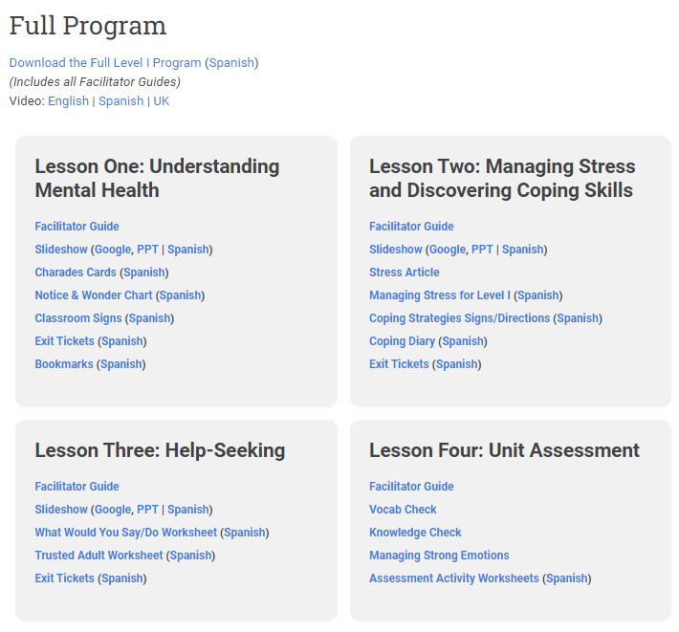
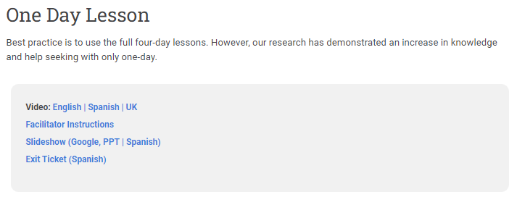
Choose Your Path for Level I
Determine which version you will be teaching:
Full Program:
Made up of 4 lessons
Each lesson is 35-40 minutes
Meets National Health Education Standards
1-Day Lesson:
One lesson that is a condensed version of the Full Program.
The lesson is 35-40 minutes
Notes:
One of the first steps to take as you prepare to teach the Level I program is to choose your path. Two versions of the Level I program are available to teach - the Full version or the 1-Day version. The full version is made up of 4 lessons, each running about 35-40 minutes in length. Teaching the full version of Level I meets National Health Education Standards. The 1-day lesson is made up of one lesson, running about 35-40 minutes in length and this is a condensed version of the full program.

Slide 12
Objectives of Level I: Full Program (4 lessons)
Lesson 1: Understanding Mental Health
Identify that mental health is as important as physical health
Explore activities that are emotionally/mentally healthy
Distinguish between everyday feelings and overwhelming feelings
Lesson 2: Coping Skills
Describe stress
Demonstrate a variety of health practices and behaviors to cope with stress
Lesson 3: Help-Seeking
Identify characteristics of trusted adults
Respond with help-seeking behaviors to situations involving overwhelming feelings
Lesson 4: Student Skills Check
Vocabulary and knowledge checks
Managing strong emotions
Notes:
Each lesson of the Full program has objectives. In Lesson one, students will identify that mental health is as important as physical health, explore activities that are emotionally and mentally healthy and distinguish between everyday feelings and overwhelming feelings. Lesson 2 has students being able to describe stress and demonstrate a variety of health practices and behaviors to cope with stress. In Lesson 3, students will identify characteristics of trusted adults and respond with help-seeking behaviors to situations involving overwhelming feelings. And lastly, lesson 4 is a Student Skills Check.

Slide 13
Objectives of Level I: One-Day Lesson
This one-day version of the program consists of an engaging and interactive lesson designed to be taught to provide students with increased:
knowledge of key concepts related to good mental health
Knowledge of the difference between everyday feelings and overwhelming feelings
self-advocacy and peer-to-peer intervention to promote help-seeking
ability to identify and access valid and reliable sources of information
awareness of how they can support their own mental health and well-being and contribute to a positive mental health culture in their school & community
Notes:
The 1-day version of the Level 1 classroom program consists of an engaging and interactive lesson designed to be taught to provide students with increased
knowledge of key concepts related to good mental health
Knowledge of the difference between everyday feelings and overwhelming feelings
self-advocacy and peer-to-peer intervention to promote help-seeking
ability to identify and access valid and reliable sources of information
awareness of how they can support their own mental health and well-being and contribute to a positive mental health culture in their school & community

Slide 14
Components of Level I Program
Video
Facilitator Instructions
Student-facing Slides
Student-facing Materials
Exit Tickets
Student Bookmarks
Pre- and Post-Tests
Notes:
Everything you need to teach the Level I program is on the Resource Portal. The Level I program is a video-based program that includes a facilitator guide, student-facing slides and other materials, exit tickets, student bookmarks and pre and post tests. Each lesson has specific resources that pair with it and they are all listed by lesson on the resource portal.

Slide 15
Plan & Implementation for Teaching Level I
Step 1: Prior to teaching every lesson
Read through the Facilitator’s Guide
Watch the video
Review the slides
Prep classroom materials & pre/post tests
Step 2: Remind the school mental health team that you are teaching this programming
Step 3: Teach program
Step 4: Complete the required Erika’s Lighthouse Report on Impact form
Step 5: Complete the Educator Evaluation Survey
Notes:
Here are some steps to take before you teach each lesson: review the Facilitator Guide, watch the video, review the student-facing slides and prep any classroom materials and/or pre and post test for your students. We recommend informing the school mental health team that you are teaching this program, especially if you will be using the exit tickets. The final exit ticket is a self-referral card. Once you have completed the first two steps you are ready to teach the program. After you teach, please complete the required Report on Impact for letting Erika’s Lighthouse know you have taught the program and then complete the Educator Evaluation Survey.

Slide 16
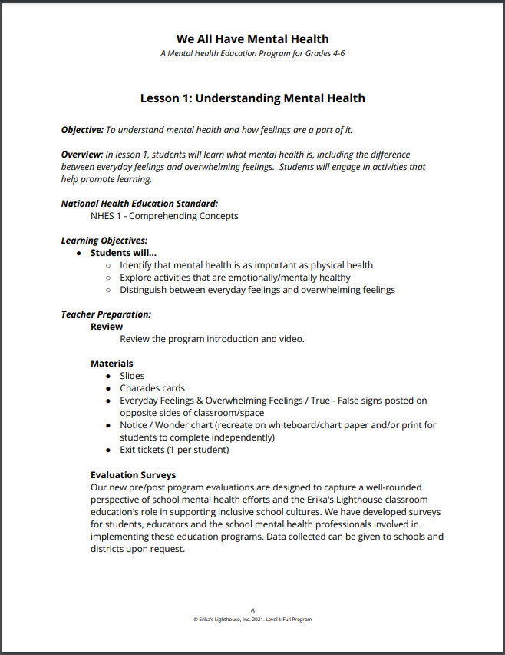
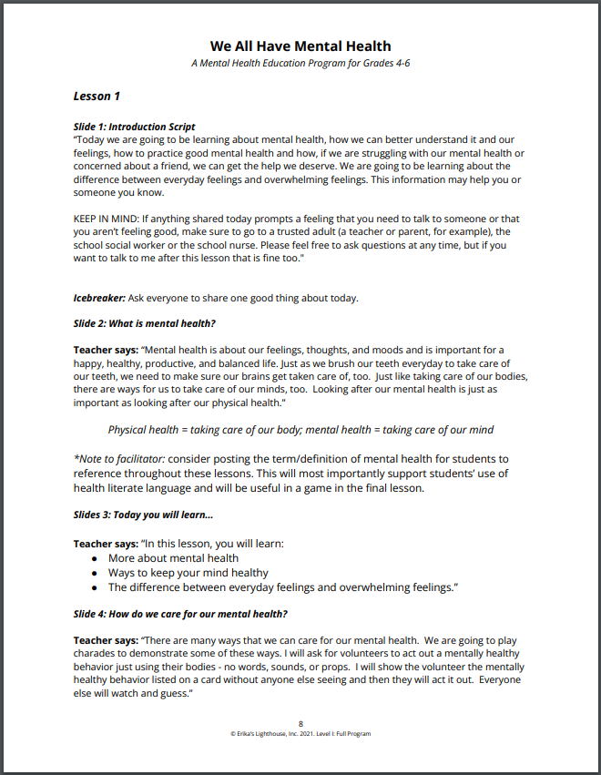
Representation Matters
Level I Facilitator Guide
Notes:
Both versions of the Level I program have a complete facilitator's guide for you to use. The facilitator’s guide lists all of the materials that you will need to teach the program. It also includes a full teaching script that pairs with the student facing slide deck.

Slide 17
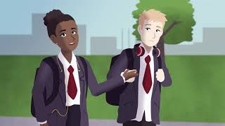
Notes:
Let’s now meet Sasha and Andre. We hope this gives you a nice overview of the messages in the Level I program.

Slide 18
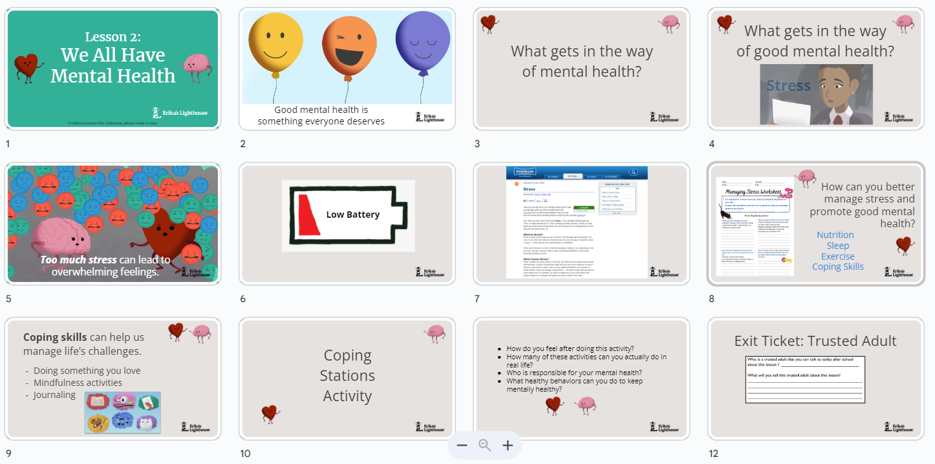
Level I Slides
Representation Matters
Notes:
Each lesson has its own student facing slide deck. Here is a sample of one of the slide shows. We encourage you to take a look at each deck prior to showing them to students.

Slide 19
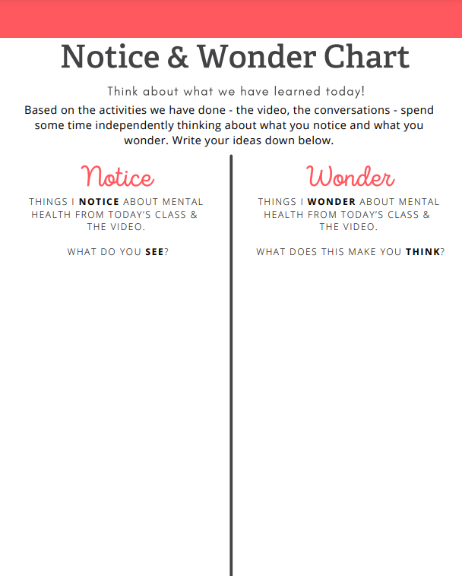
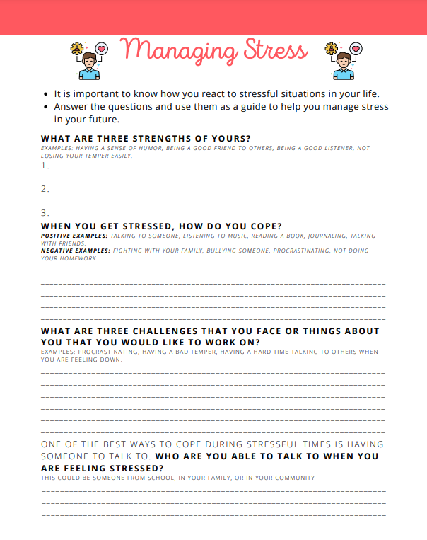
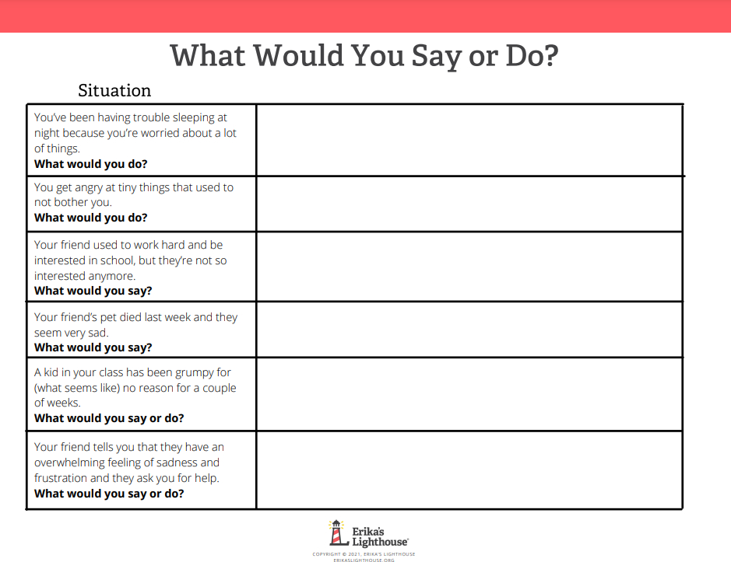
Level I Student Materials
Notes:
There are various student materials for the Level I program that help to engage participation and learn skills. We recommend either printing a copy for each student or using the fillable form.

Slide 20
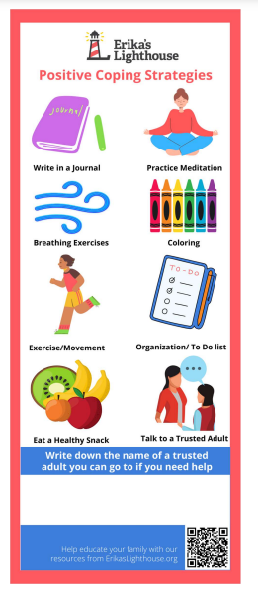
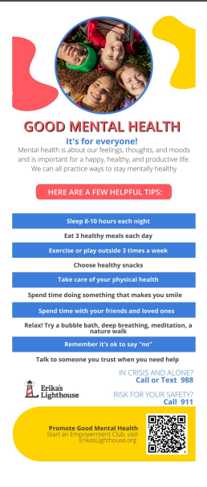
Student Bookmarks
Ideas of trusted adults:
Parent/Guardian
Aunt/Uncle/Grandparent
School Counselor
Coach
Teacher
Religious Leader
Therapist
Notes:
We want to ensure that students know where they can access at trusted adult at school. So, the student bookmarks have a blank space for you or the students to write down the name of the school counselor or school social worker. We encourage you to also include their office number so that students know where they can locate them in the building. If your school does not have an onsite counselor or social worker, you can encourage the students to write down who they identify as a trusted adult. That could be a family member, coach, someone in their community, or YOU!
You will notice, that on one side the student bookmark lists positive coping strategies and on the other side, there are tips for taking care of their mental health.

Slide 21
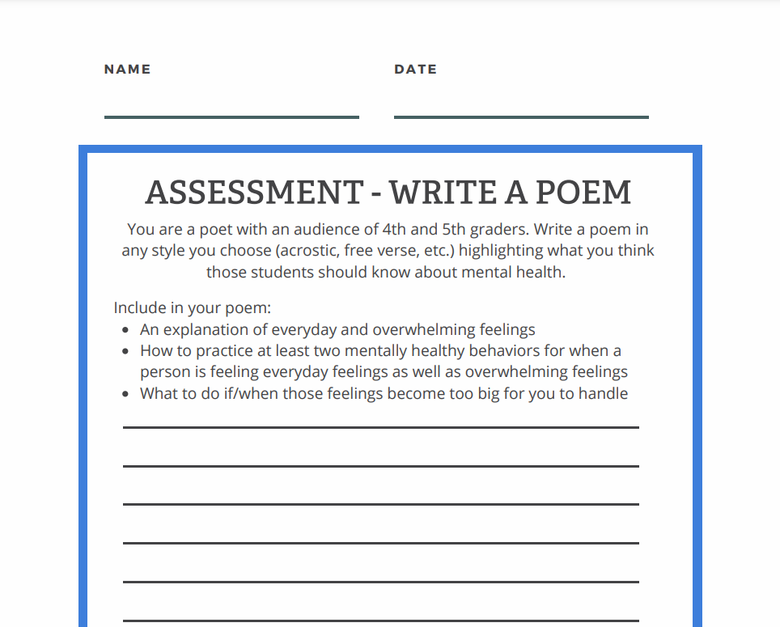
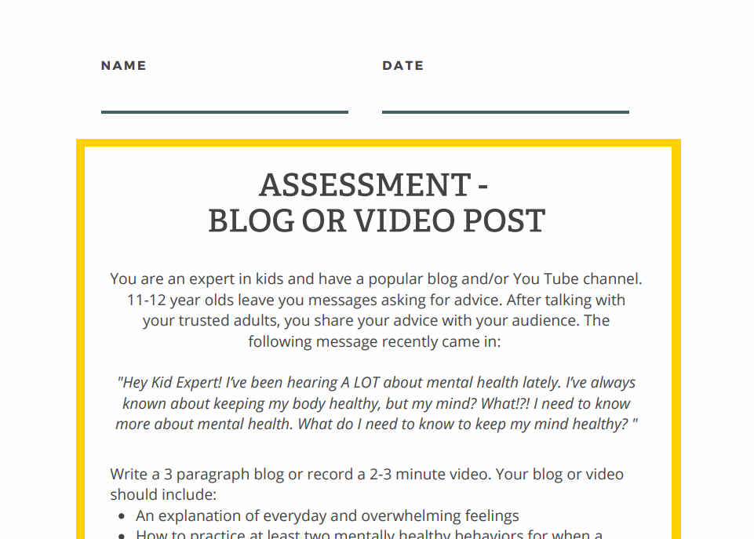
Student Skills Check - Lesson 4
Notes:
Lesson 4 is a skills check. There are quizzes available from Kahoot as well as various skills assessments available. These assignments are optional and just ideas, if you have an idea that feel more appropriate for your students you are welcome to use something different.

Slide 22
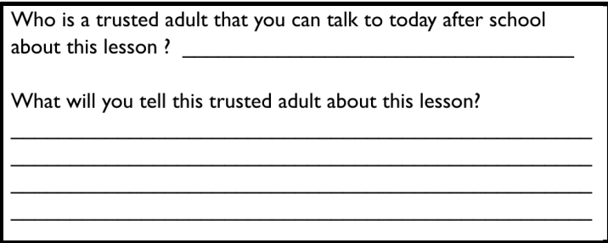
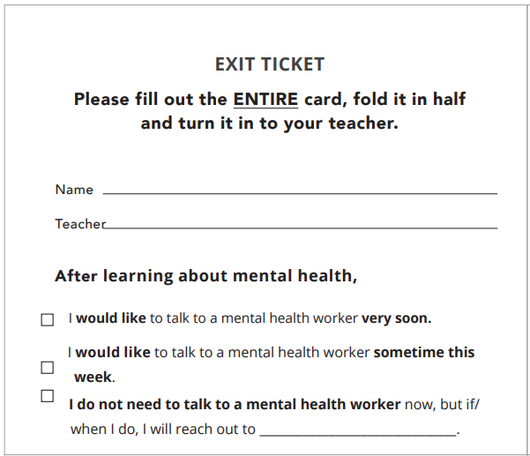
Exit Tickets
Work with the school counselor(s) or other mental health professionals in the school for this process.
Notes:
The Level I program has three different exit tickets, given to students after Lesson 1, 2 and 3. The final exit ticket is a self-referral card. On this card, it says I would like to speak to a mental health worker in 24 hours, in 7 days, I do not need to speak to someone. If you will be using the self-referral cards, please ensure that every student turns one in at the end of the lesson. Like everything else in our program, you have flexibility and choice about using the self- referral cards. However, if you are planning to use them please makes sure to collaborate with the mental health professionals in your building as they may see an uptick in the number of students who need support.

Slide 23
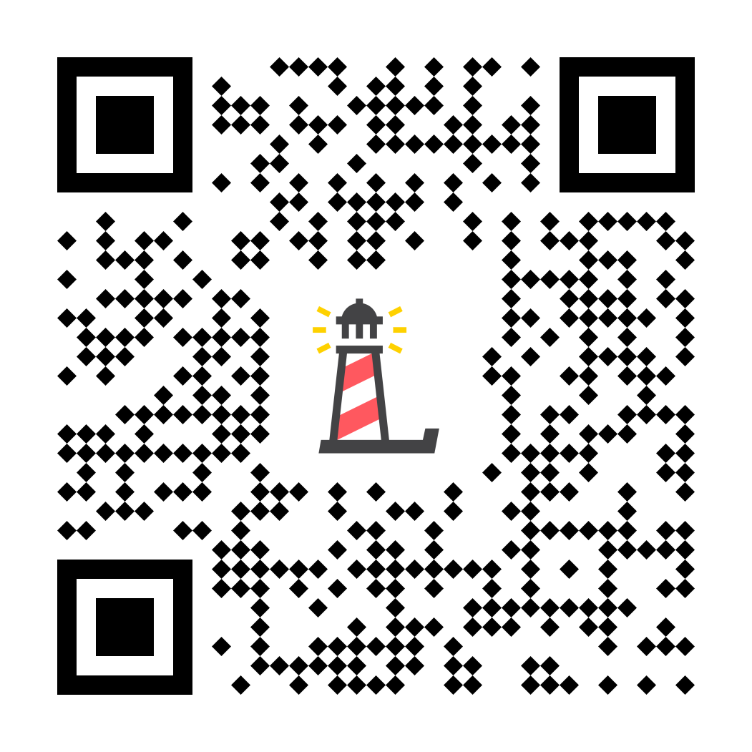
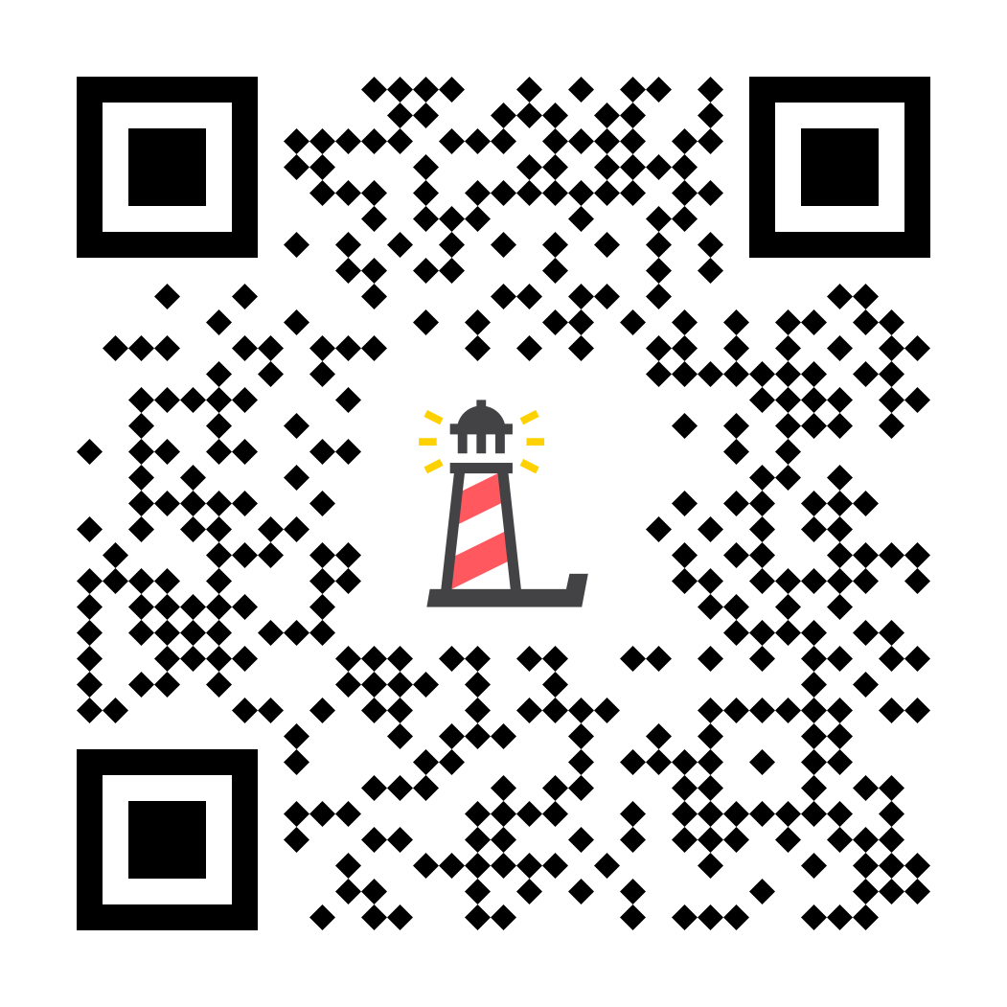
Level I Pre/Post Test
Notes:
We ask you to have students complete the pre and post tests as part of teaching the Level I program. If teaching the full program, students will complete the pre-test before Lesson 1 and will complete the post-test after Lesson 3. If teaching the 1-day lesson, students will complete the pre test before the lesson and the post-test after the lesson. The results of the pre and post tests can be found on the Data Center, which is updated daily.

Slide 24
TIPS FOR A SUCCESSFUL PROGRAM
Our programs are extremely FLEXIBLE- if you need more time or to cut something from a lesson, you are welcome to do so.
Best practice is to teach this program at the classroom-level, not auditorium-style due to the sensitive & personal nature of the topic.
You know your students best. You know what content they are ready for and how to continue the conversation in meaningful ways.
Best practice is to NOT deliver program on a Friday or before an extended break - especially with the self-referral cards.
Pick a day with extra support
Have a plan for self-referrals and who is going to support that process (admin, mental health staff, nurses etc.)
Notes:
After our many years working with schools, we can tell you that meeting with school staff prior to implementation to engage them can be helpful. It’s all about buy-in. We teach students to seek out trusted adults and some of those staff members may be called upon as a student’s trusted adult. If you feel like you need help with buy-in, see if you can present at professional development meetings. The more you do ahead of time before you actually launch the program in a classroom, the more stability and legs this program will have. You’ll want to engage your teachers and get their support. Best practice is to not to deliver this program at the end of a day or on a Friday and to make sure there is extra mental health support on the days the programs are taught. And lastly, a plan should be in plan for how to handle self-referrals and who will be supporting that process.
‹#›

Slide 25
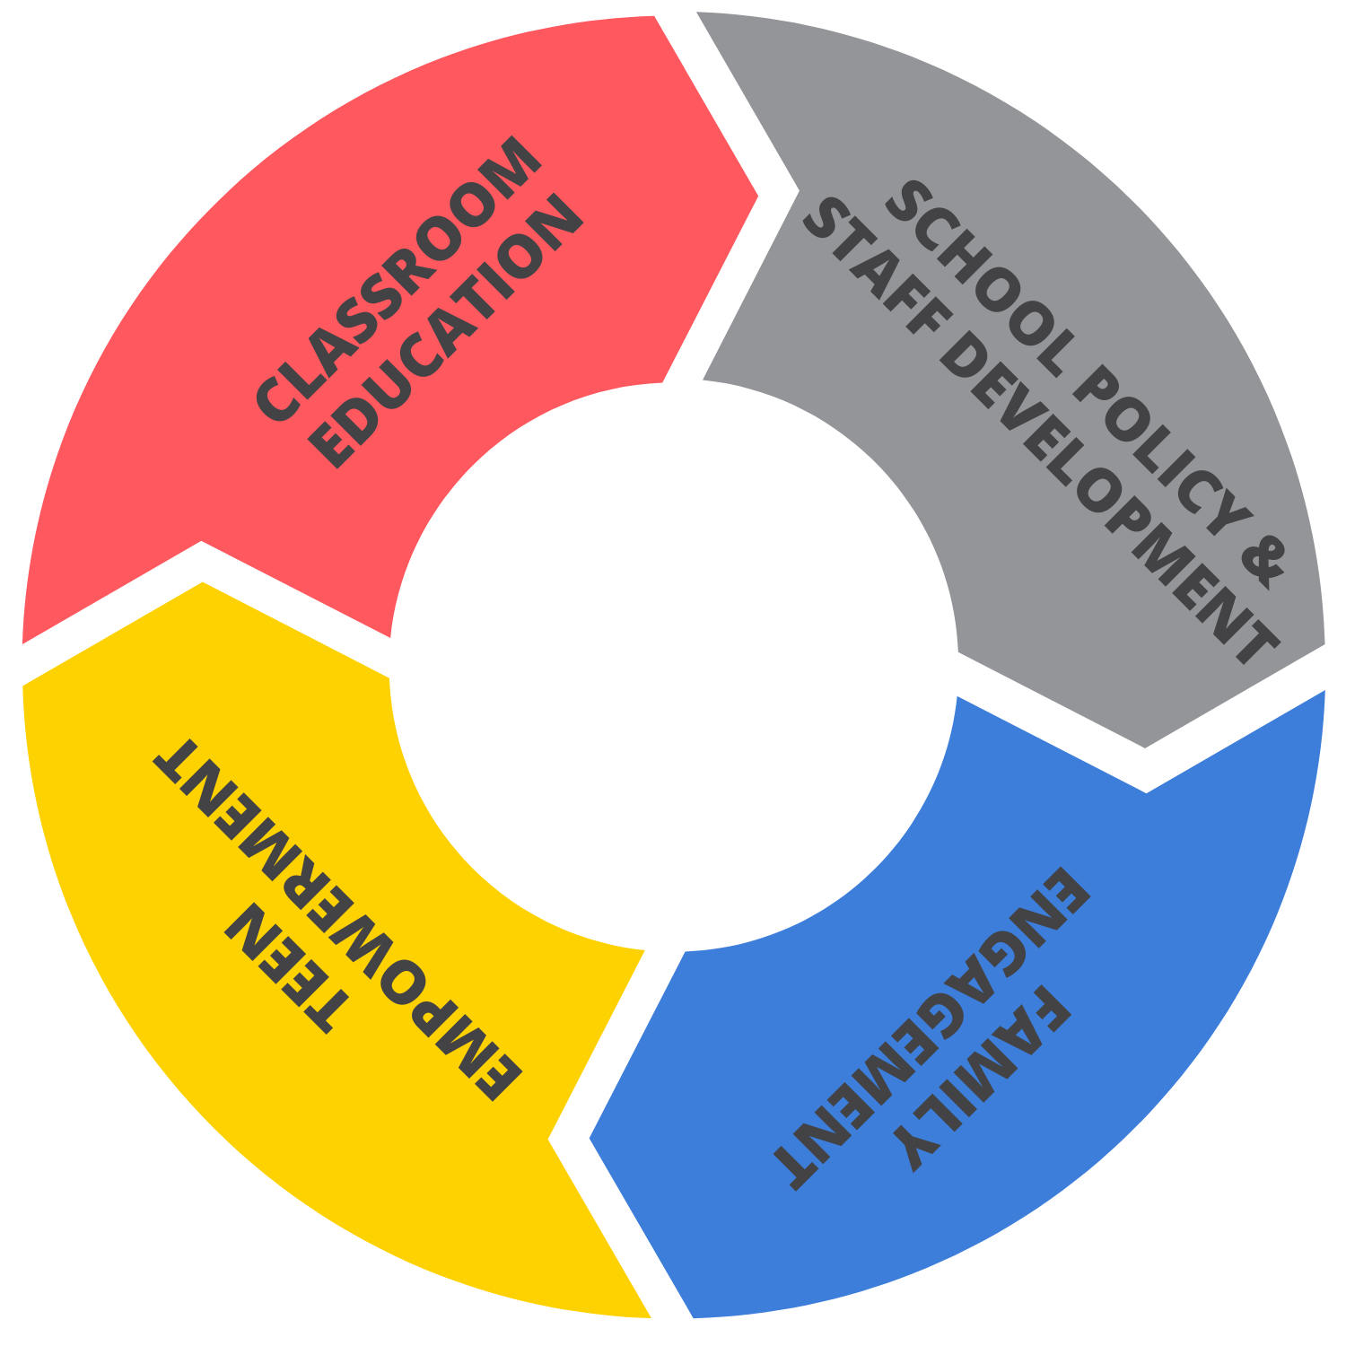
OUR FREE PROGRAMS
Level I: We All Have Mental Health
All Staff Training
Culture Change Framework
Level II: Depression Awareness
Strategic Partnerships
Level III: Depression Education & Suicide Awareness
On-Demand Support
Empowerment Clubs
EMPOWERMENT
CLUBS
Family Workbook Series
Affiliate Clubs
Family Workshops
Awareness into Action Activities
Family Activities for Home
School Wide Activities: Mental Health RECHARGE | Give Voice | Positivity Pledge
Notes:
“As an organization, Erika’s Lighthouse promotes inclusive school cultures around mental health by using a four-pillar approach to impact every stakeholder in a young person’s life. These four pillars include classroom education, student-led empowerment clubs, family engagement and school policy & staff training.”

Slide 26
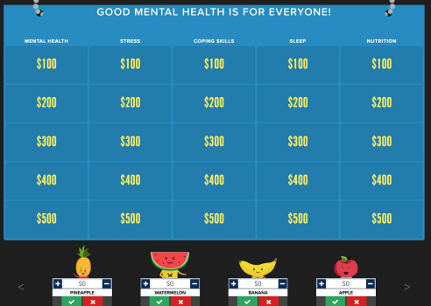
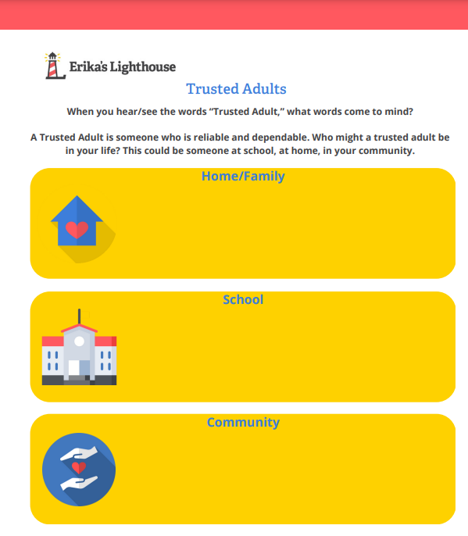
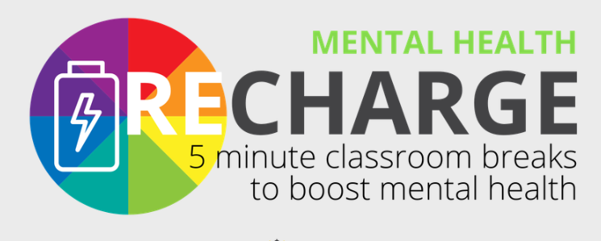
Optional Program Additions
Notes:
If you are interested and time allows, we offer many extension lessons to continue this important conversation with students. There’s a mental health jeopardy game that you can play, mental health Recharge, or worksheets to help students identify trust adults. There are many resources that can help you continue the conversations with students.

Slide 27
ErikasLighthouse.org
We’re here to support you!
Program Support
ilana@erikaslighthouse.org
katie@erikaslighthouse.org
Notes:
Erika’s Lighthouse is here to support you. If you have any questions or thoughts, please feel free to reach out to us.

