Slide 1
Lesson 3:
We All Have Mental Health
To edit/customize this slideshow, please make a copy.

Slide 2
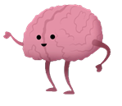
Where you are on the feeling thermometer?
How are you feeling today?

Slide 4
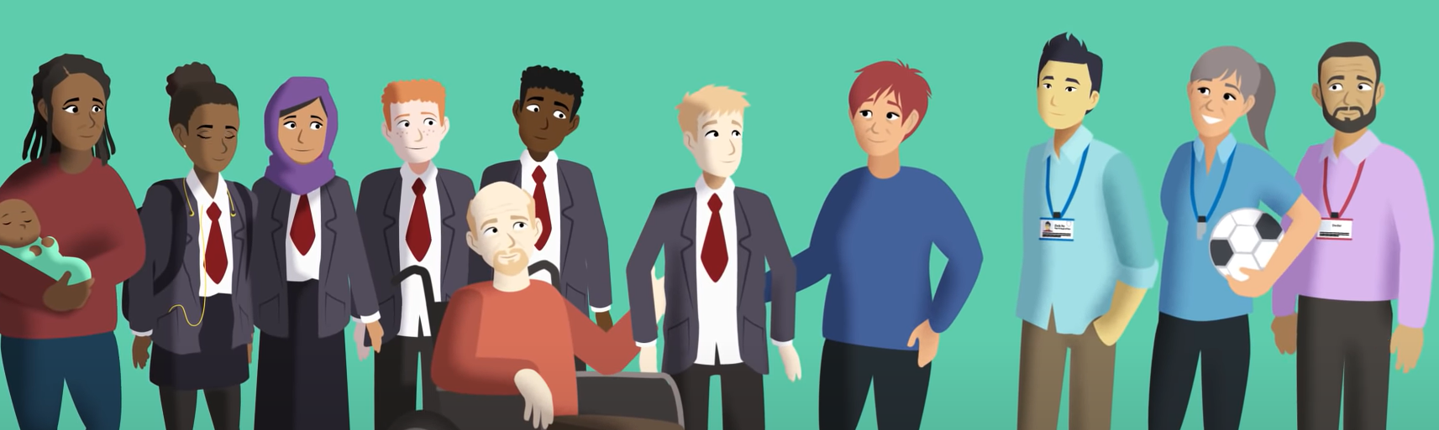
If you are concerned about yourself or a friend, talk to a Trusted Adult - someone who is reliable and dependable.

Slide 5
What does each characteristic look like in an adult?
Reliable - Dependable - Trustworthy

Slide 6
Who are they?
Identify Trusted Adults at:
HOME
COMMUNITY
SCHOOL

Slide 7
What would you do?
What would you say?

Slide 8
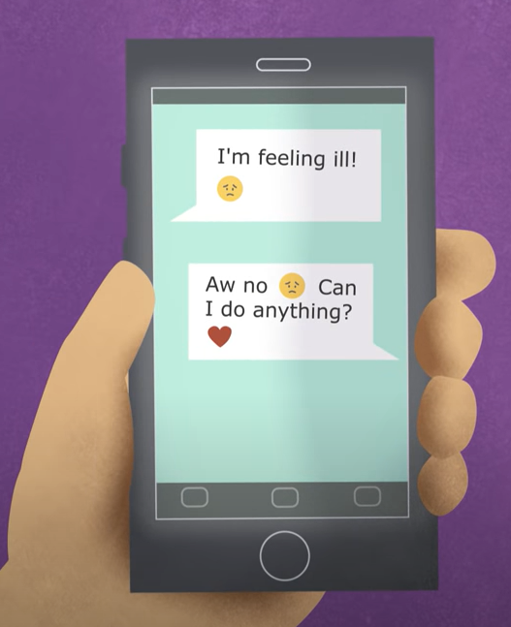
Sometimes people feel ashamed to ask for help.
How do you ask for help?
Tell a Trusted Adult:
How you Feel
What you’ve Tried
What they can do to Help

Slide 9
Sometimes people feel ashamed to ask for help.
How do you help a friend?
Tell them:
I’ve noticed changes in you.
I care for you.
How can I help you?
Be a good friend by listening, showing you care and helping them find help.

Slide 10
Plan & perform a role play of one of the scenarios.
You can add characters & details to make it more interesting and realistic!

Slide 11
Resources

Slide 12
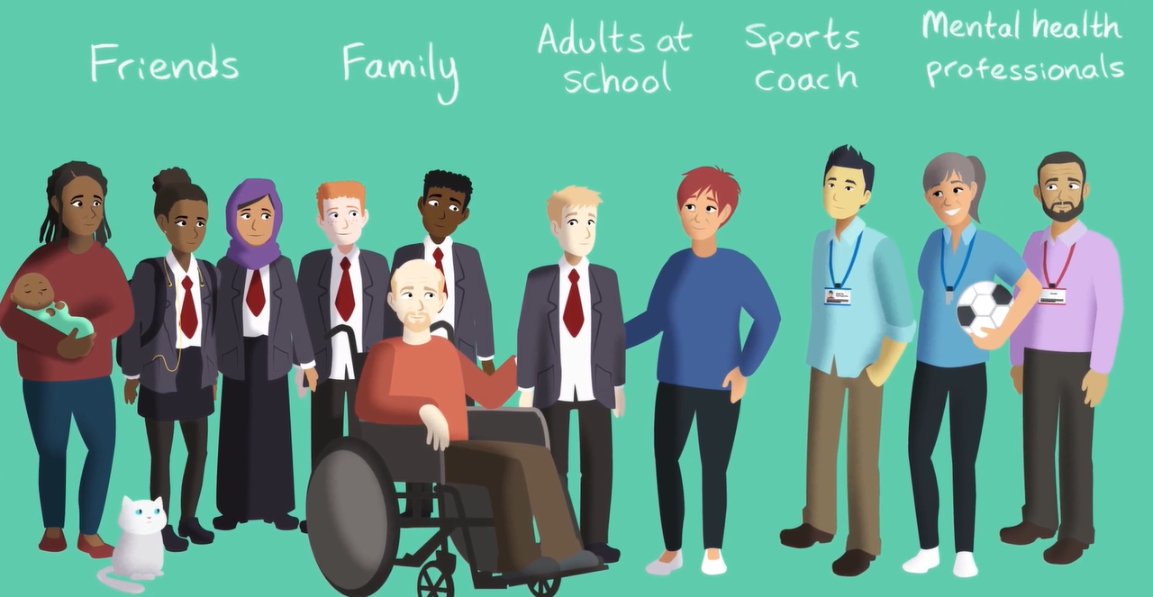
Where can I learn more?
What other valid and reliable people, resources or information can you access to learn more about mental health?

Slide 13
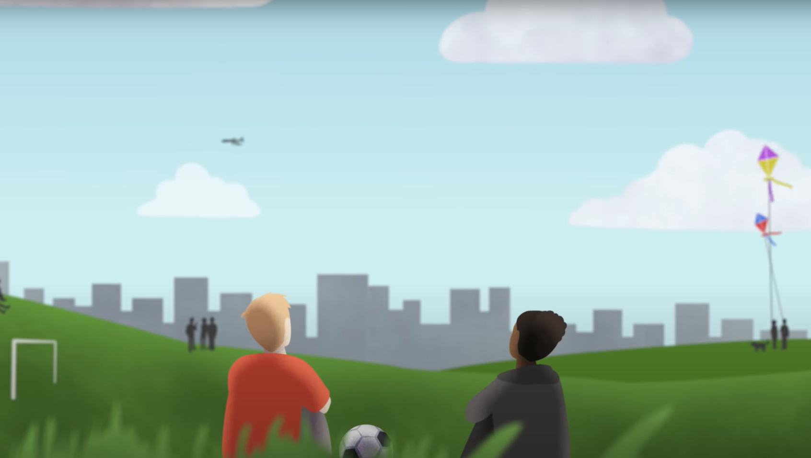
If you or a friend need immediate support, talk to an adult or dial 911.
Who can you talk to in your school? Where can you find them?

Slide 14
If you or a friend need immediate support, talk to an adult or dial 911.
988 Suicide and Crisis Lifeline
988
Text or Call

Slide 15
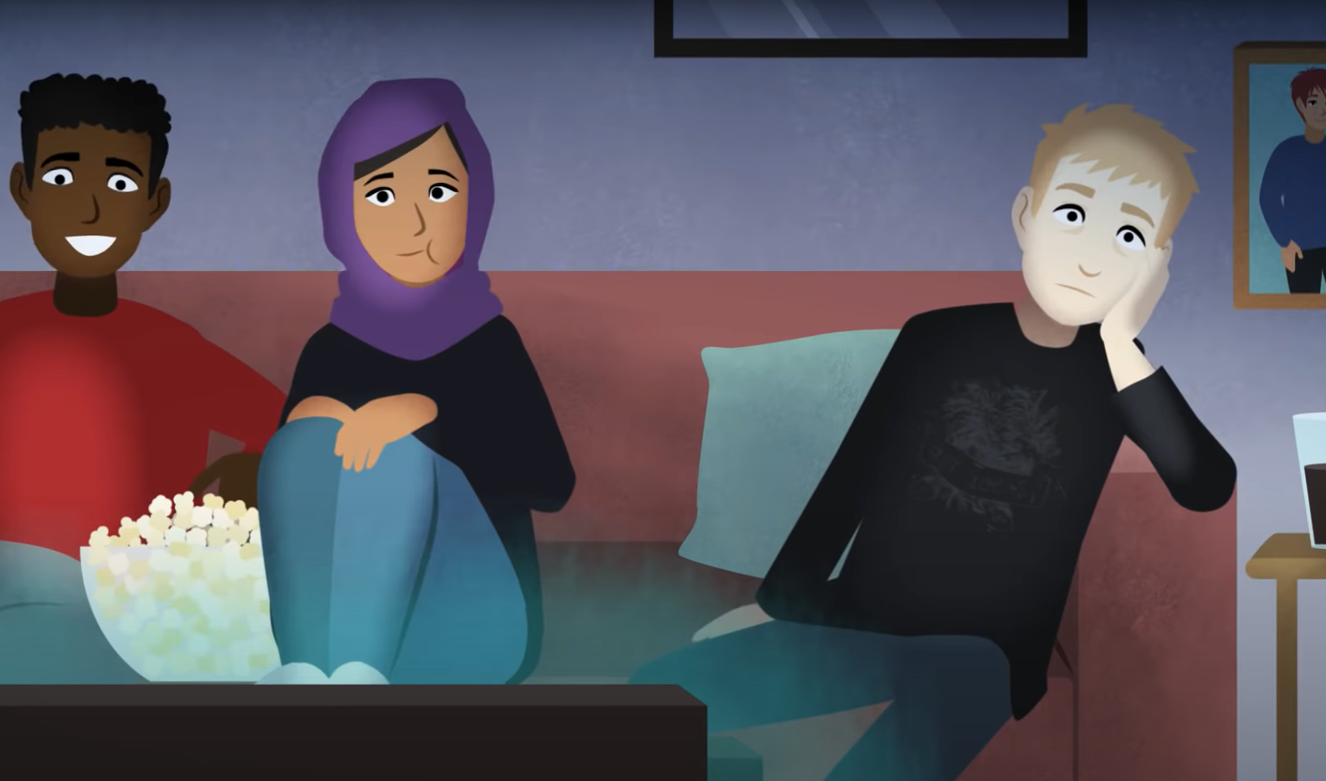
Stigma
A mark of shame associated with a particular circumstance, quality, or person.

Slide 16
We can help to get rid of STIGMA
Notes:
Image source: NAMI

Slide 17
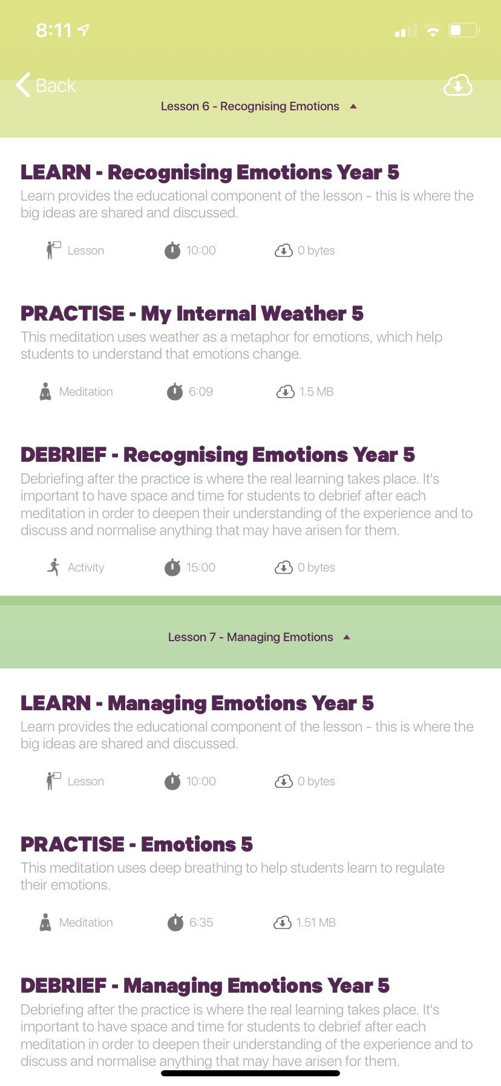
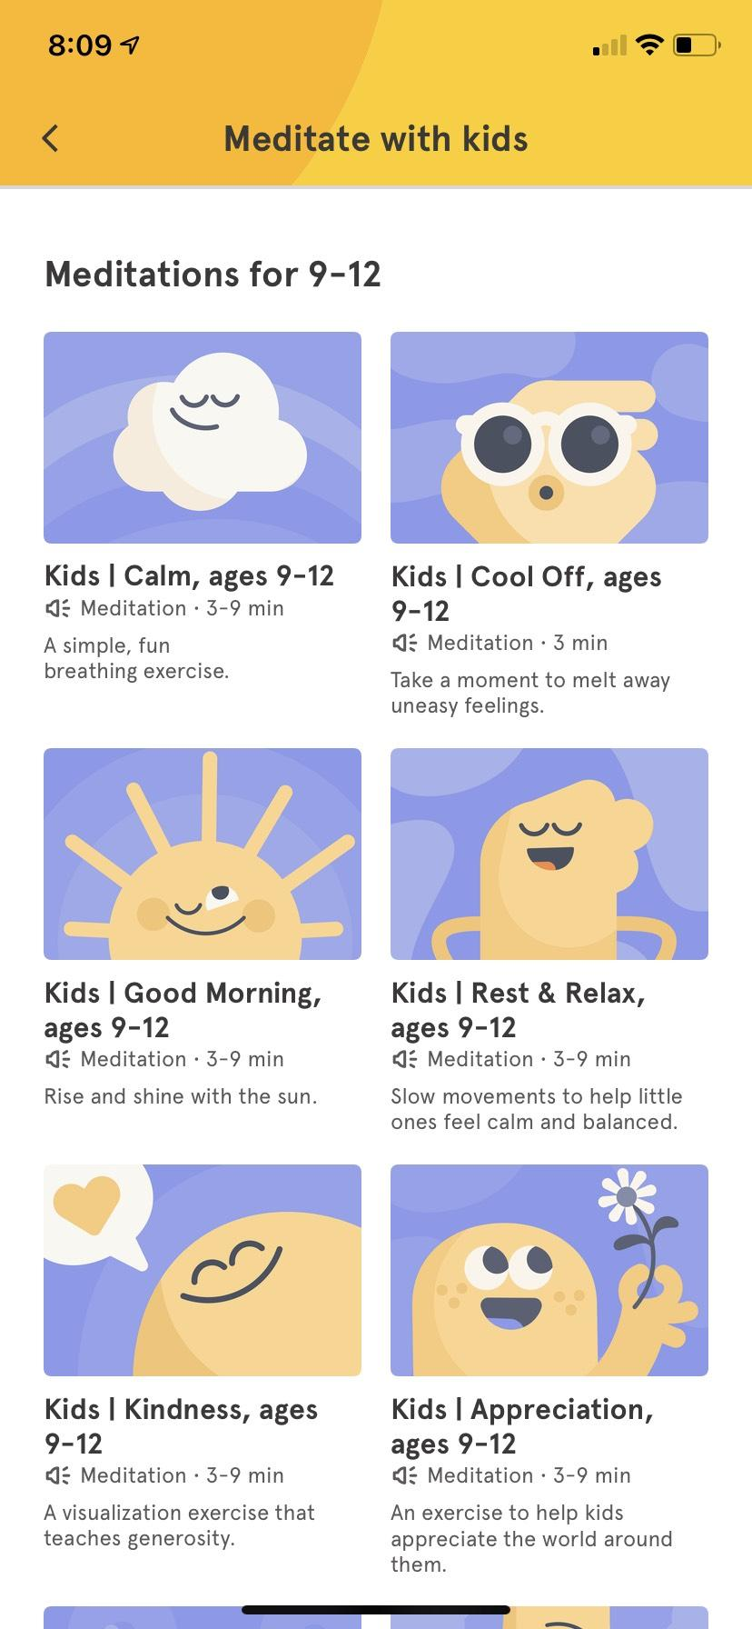
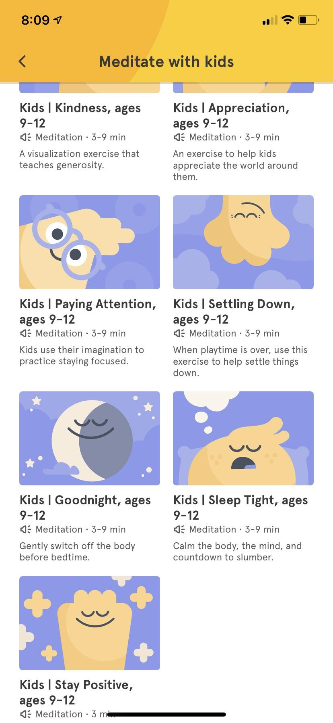
Community / Classwide Meditation
Headspace Options
Smiling Mind Options

Slide 18
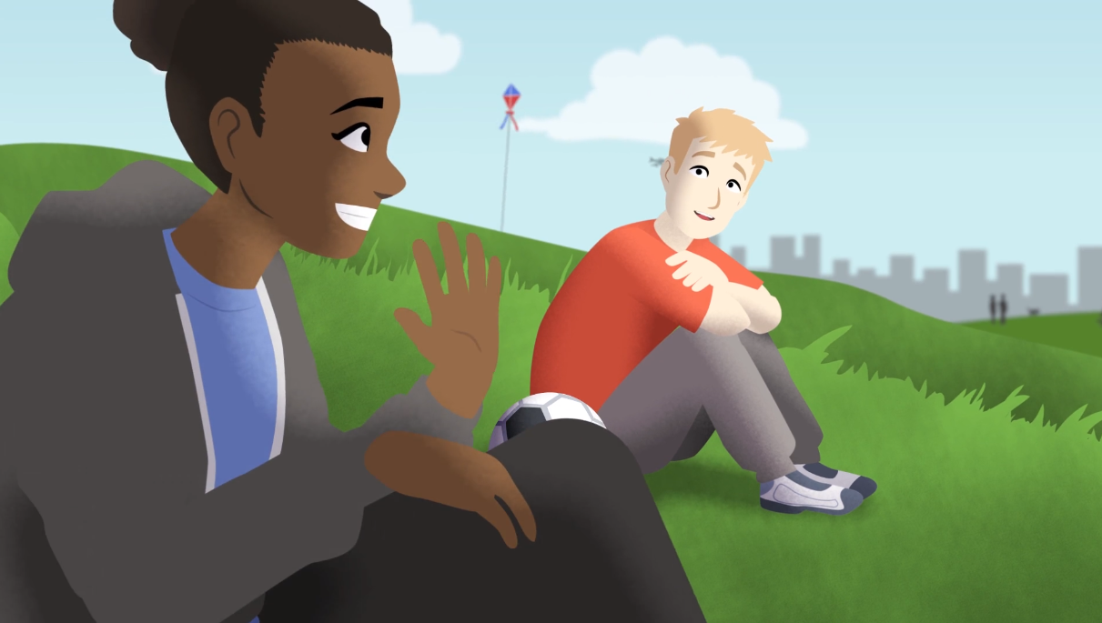
Help is available!

Slide 19
Create a 3-word summary!
Think about what we’ve learned today about getting help for overwhelming feelings.
Using EXACTLY three words, give some advice related to what you’ve learned.

Slide 20
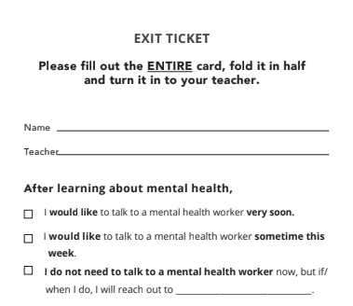
EXIT TICKET time!
Next time...you’ll SHOW WHAT YOU KNOW about mental health!

Slide 21
Please complete a short survey:
http://elhuepost.info
For more information
visit us online at
ErikasLighthouse.org

Slide 22
Level I:
We All Have Mental Health
Based on material created by and copyright of the Anna Freud Centre

