Slide 1
Lesson 1:
We All Have Mental Health
Based on material created by and copyright of the Anna Freud Centre
Pre-test: http://elhue.info
To edit/customize this slideshow, please make a copy.

Slide 2
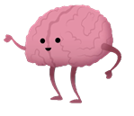
What is Mental Health?
Mental health is about our feelings, thinking, emotions and moods.​​
Mental health is important for a happy, healthy and productive life.
Just like we brush our teeth every day, we need to make sure our brains have the tools we need to be mentally healthy.
​​Looking after our mental health is just as important as looking after our physical health.

Slide 3
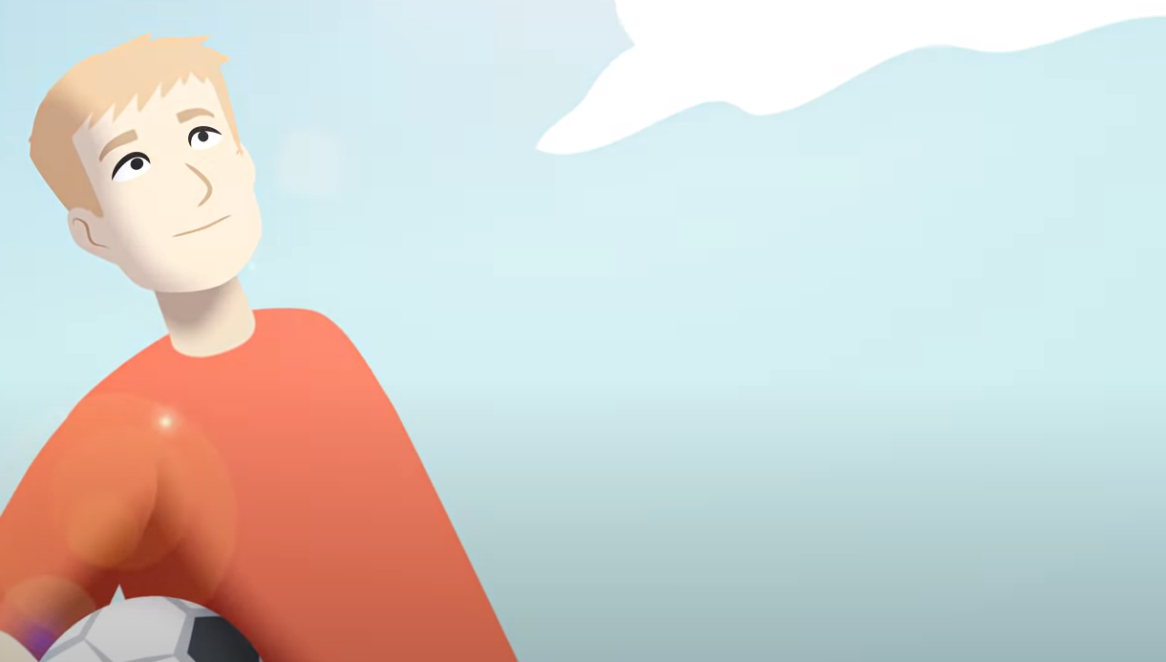
In today’s lesson you will learn:
More about mental health
Ways to keep your mind healthy
The difference between everyday feelings and overwhelming feelings.
And how to ACT if a friend or your self needs help with their mental health.

Slide 4
How do we care for our mental health?

Slide 5
Mental Health and Feelings
Everyday feelings come and go and are a normal reaction to what is happening in our lives. They are always changing and don't usually hang around for too long.​​
Overwhelming feelings hang around for a long time, change the way we feel and behave and may stop us from doing what we want to in life. You have heard people call them a mental health problem, mental illness or mental disorder. ​

Slide 6
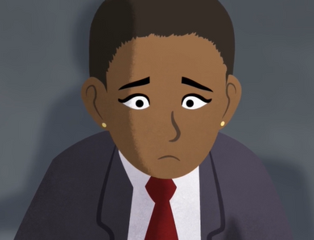
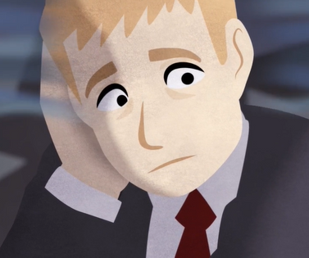
Everyday
Feelings
Overwhelming Feelings
Examples of everyday feelings might include: happiness, joy, disappointment.
Examples of overwhelming feelings might include: loss, grief, despair.

Slide 7
Where you are on the feeling thermometer?
How are you feeling today?

Slide 8
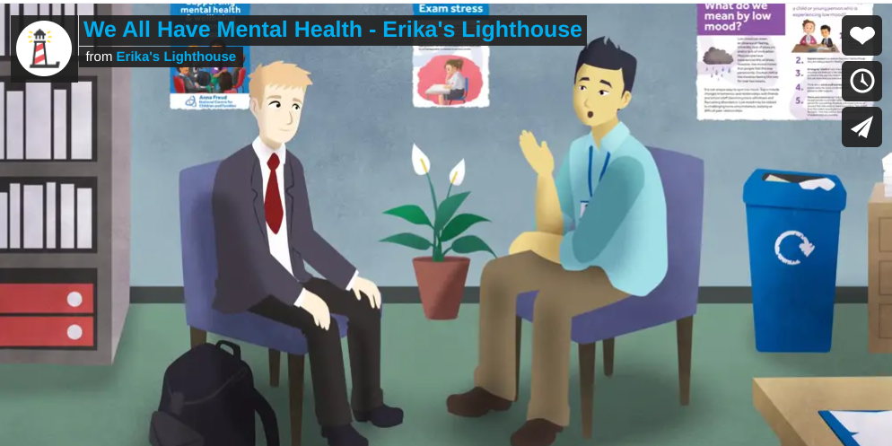
Let's watch Sasha and Andre to learn more about
feelings

Slide 9
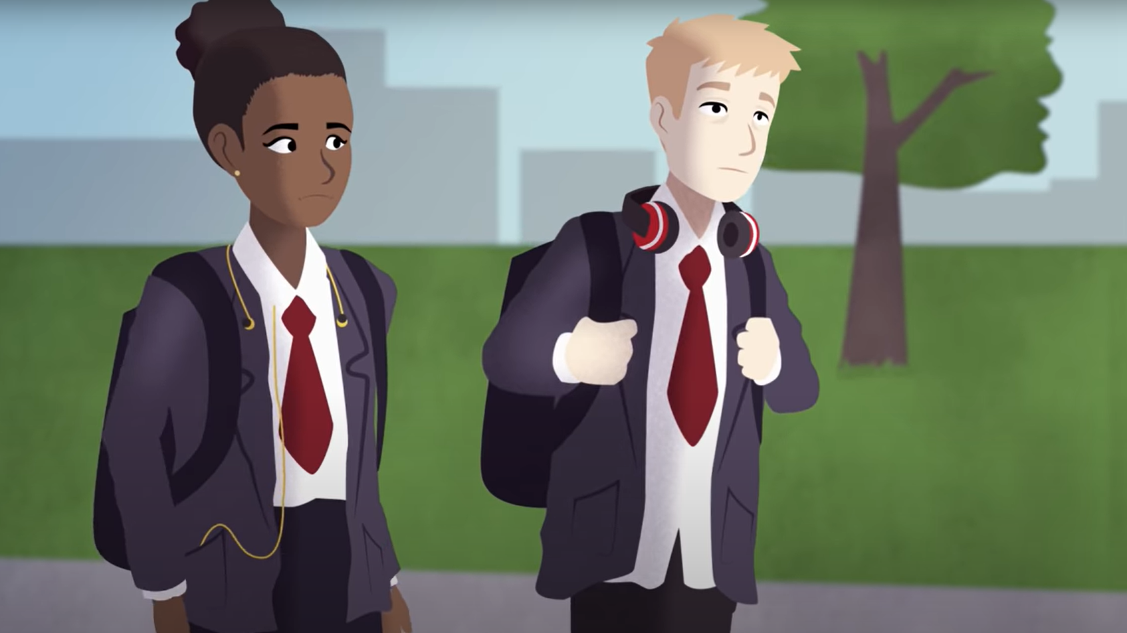
How are the feelings that Sasha & André experiencing different?

Slide 10
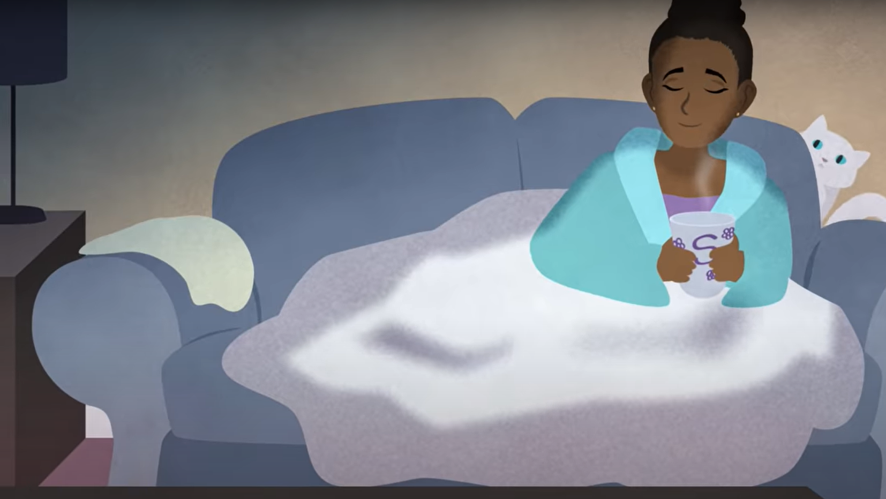
What does Sasha do to manage her everyday feelings?

Slide 11
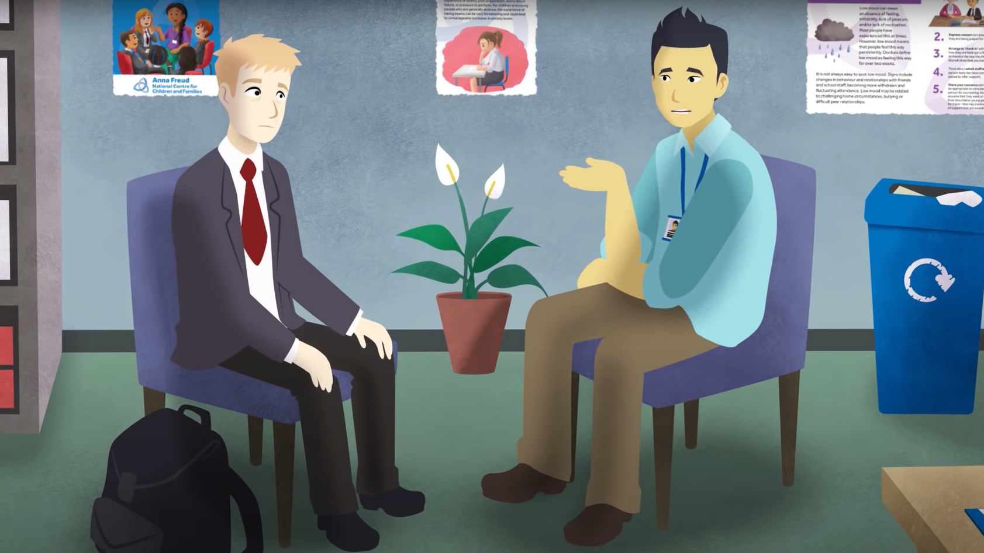
What does André do to manage his overwhelming feelings?

Slide 12
Overwhelming feelings can be difficult to admit or talk about.
What made it difficult for André to talk about his mental health or to ask for help?

Slide 13
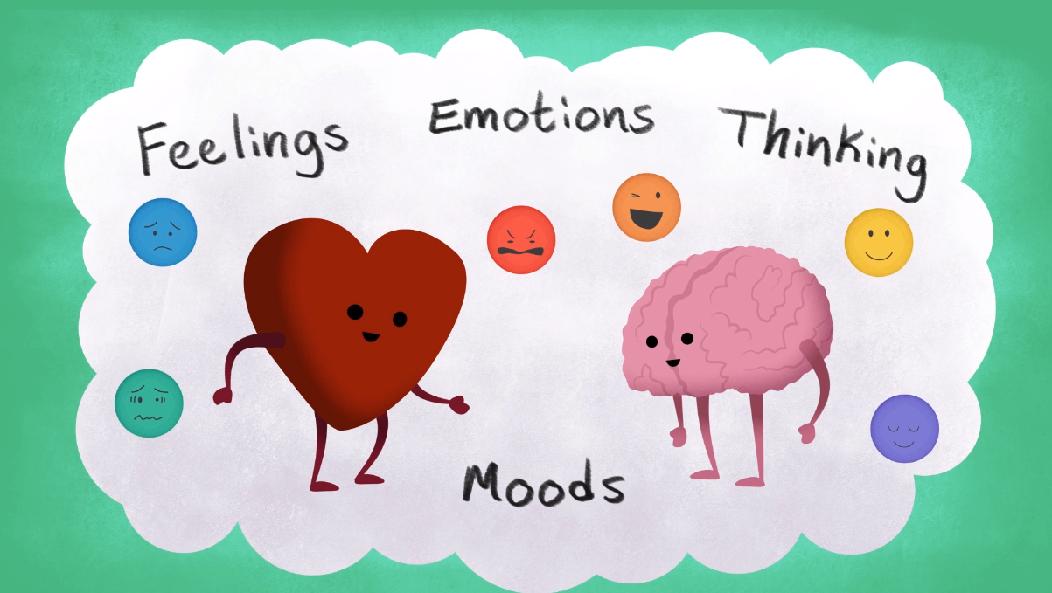
TRUE or FALSE​​?
​​We all have mental health.
TRUE

Slide 14
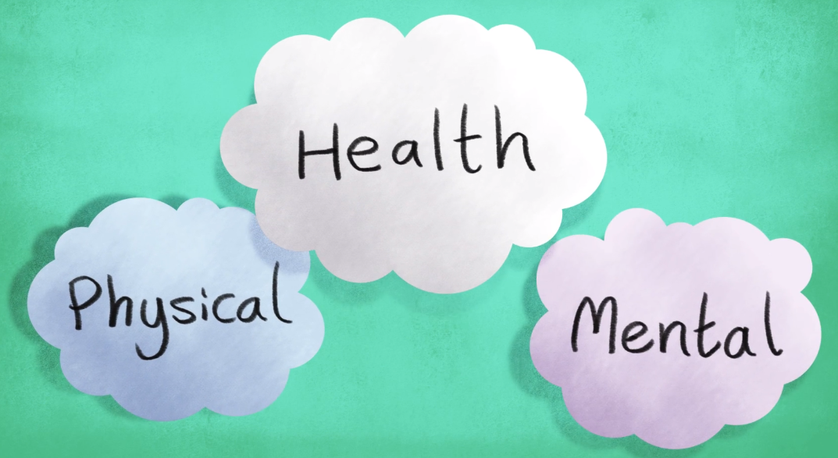
TRUE or FALSE​​?
Our physical health is more important than our mental health.
FALSE

Slide 15
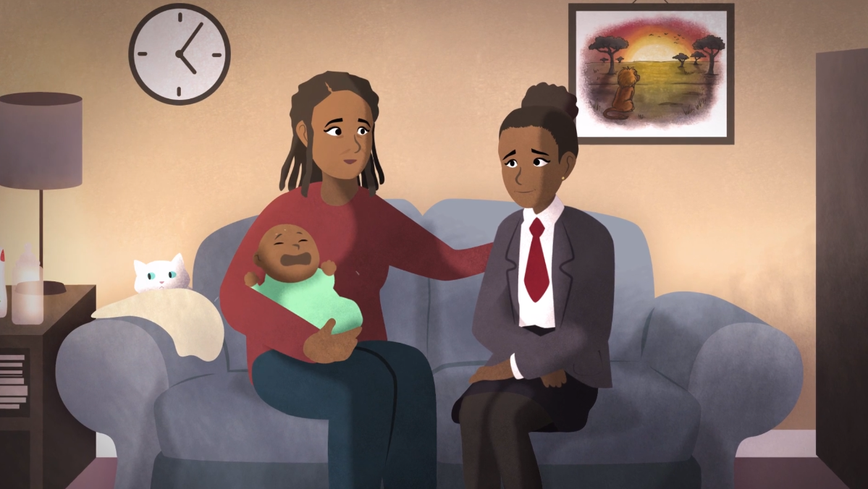
TRUE or FALSE​​?
​​If I want to talk about my mental health, I always have to ask a doctor.
FALSE

Slide 16
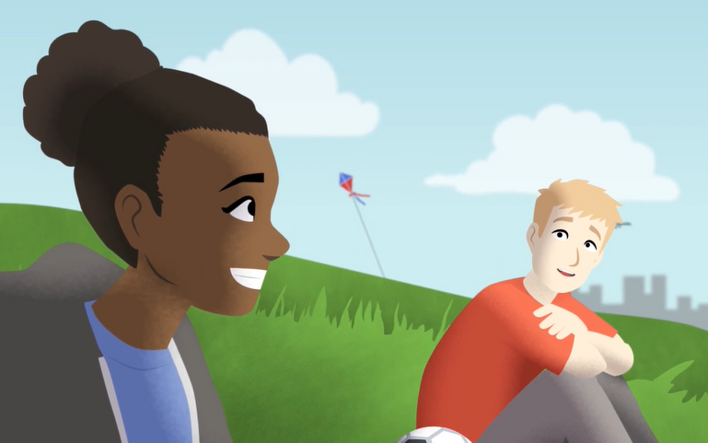
TRUE or FALSE​​?
One way to manage our mental health is to talk about it with someone we trust.
TRUE

Slide 17
What do you notice?
What do you wonder?

Slide 18
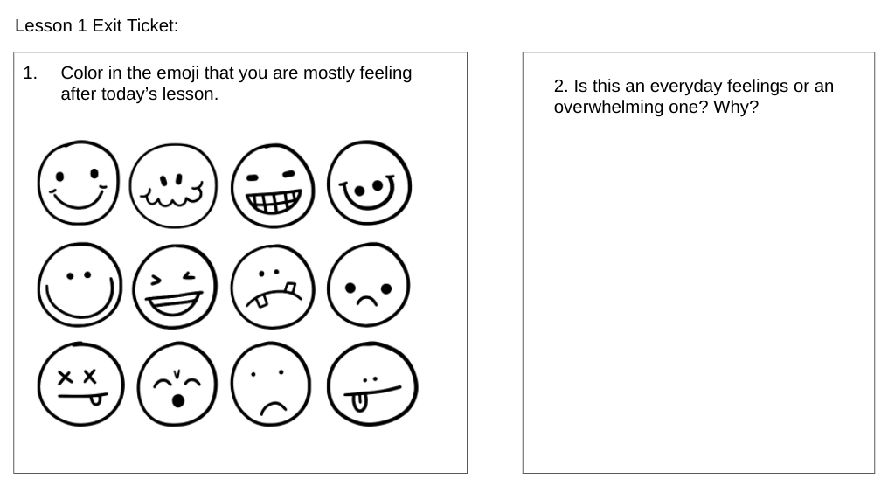
During this lesson/workshop, I hope you learned:
Exit Ticket: Emotions
More about mental health
Ways to keep your mind health
The difference between everyday feelings and overwhelming feelings.

Slide 19
REMEMBER
Everyone deserves good mental health.
Mental health is balance: the ability to manage stress and achieve one’s potential.
Stress is normal, but too much increases the risk for health problems, like depression.
Small improvements in nutrition, sleep, exercise and coping skills can help us to better manage stress and achieve good mental health.

Slide 20
Good mental health is something that everyone deserves, but sometimes too much stress can get in the way of good mental health.
We’ll explore stress next time!

Slide 21
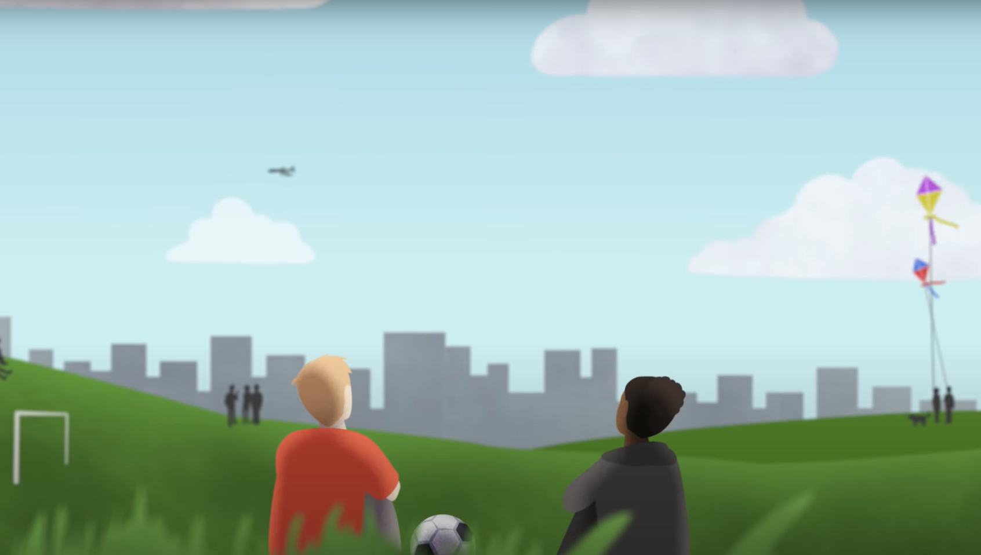
If you or a friend need immediate support, talk to an adult or dial 911.
988 Suicide and Crisis Lifeline
988
Text or Call

