Slide 1
Lesson 2:
We All Have Mental Health
To edit/customize this slideshow, please make a copy.

Slide 2
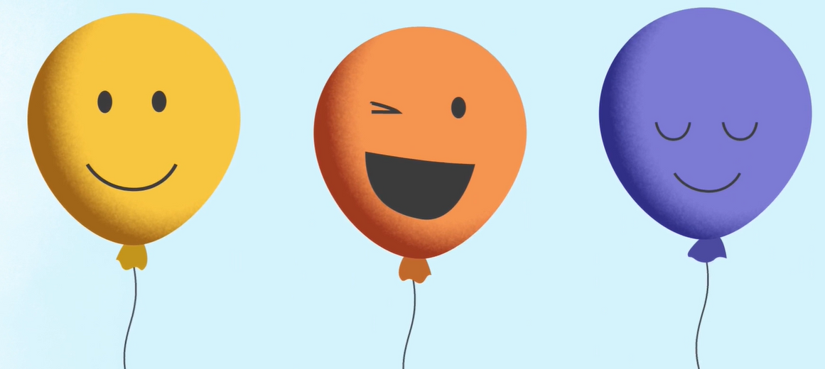
Good mental health is something everyone deserves

Slide 3
What gets in the way
of mental health?

Slide 4
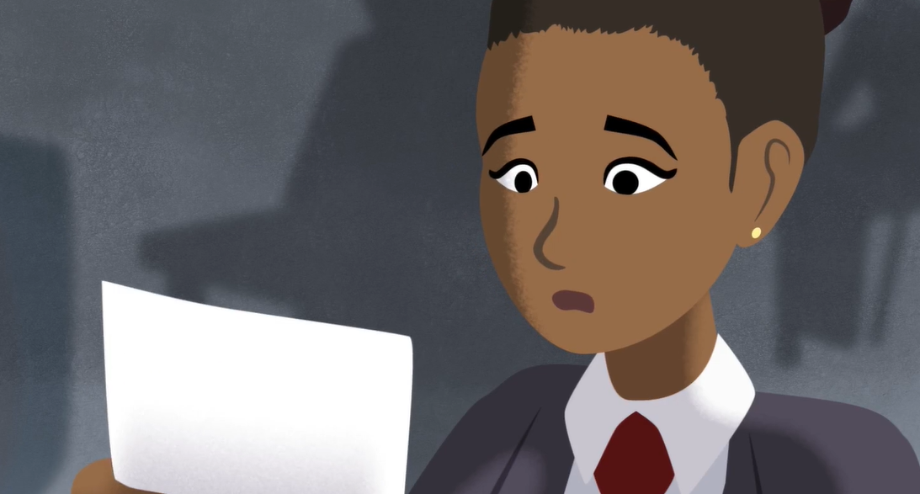
What gets in the way
of good mental health?
Stress

Slide 5
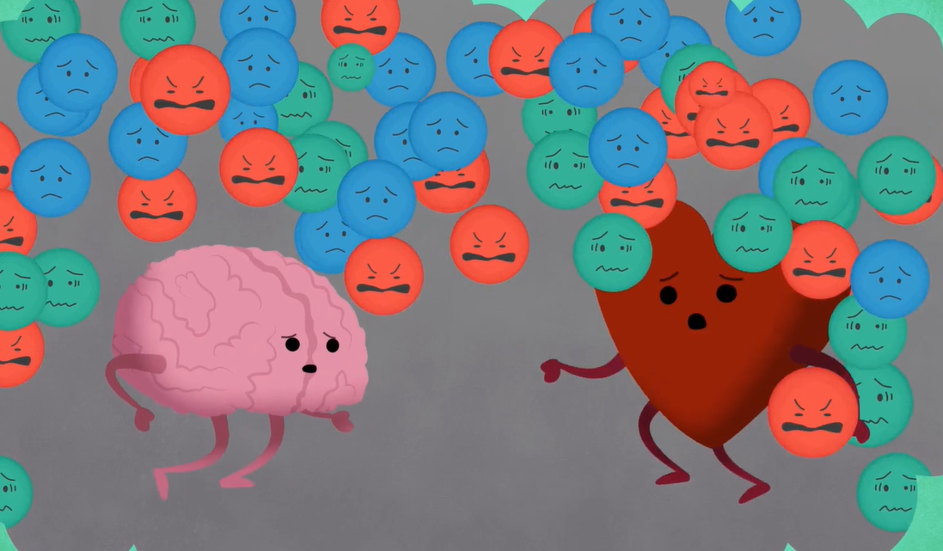
Too much stress can lead to overwhelming feelings.

Slide 6
Low Battery

Slide 7
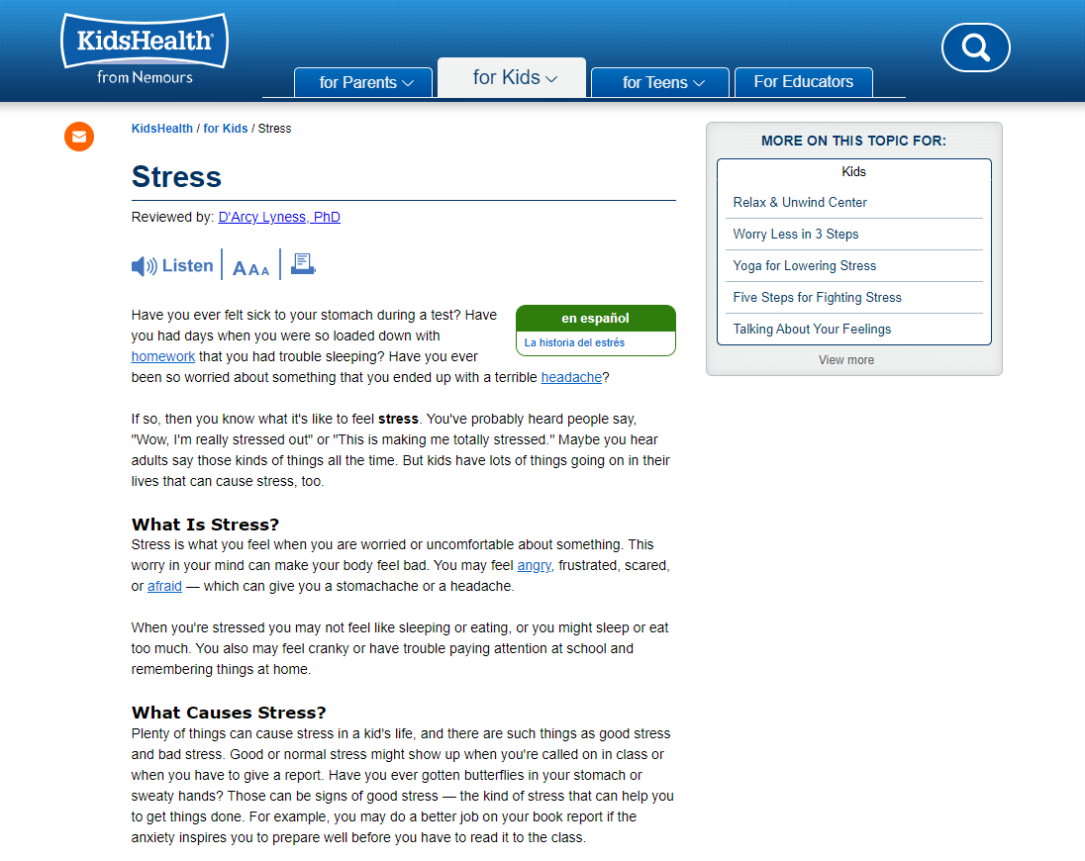

Slide 8
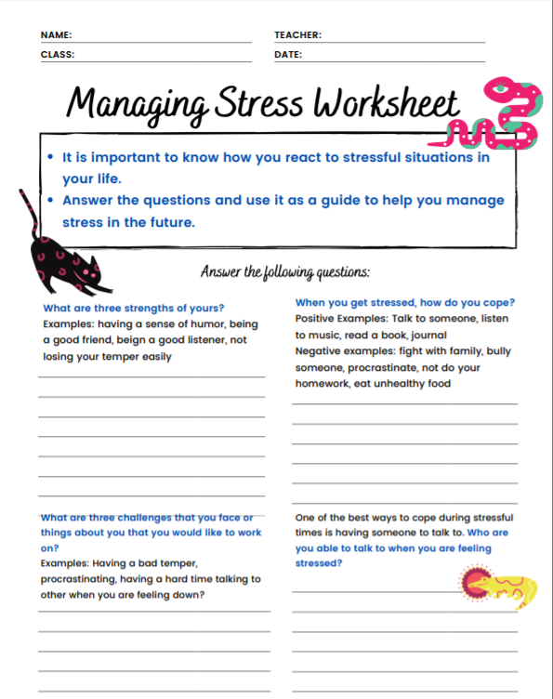
How can you better manage stress and promote good mental health?
Nutrition
Sleep
Exercise
Coping Skills

Slide 9
Coping skills can help us manage life’s challenges.
Doing something you love
Mindfulness activities
Journaling

Slide 10
Coping Stations
Activity

Slide 11
How do you feel after doing this activity?
How many of these activities can you actually do in real life?
Who is responsible for your mental health?
What healthy behaviors can you do to keep mentally healthy?

Slide 12
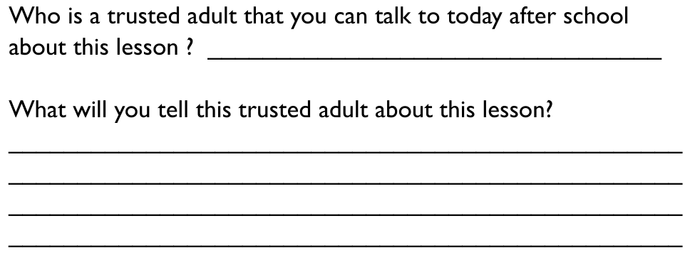
Exit Ticket: Trusted Adult

Slide 13
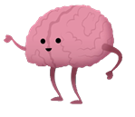
REMEMBER...
Everyone deserves good mental health
​
Stress is normal, but too much increases the risk for health problems
Small improvements in nutrition, sleep, exercise and other coping skills can help us to better manage stress and achieve mental health

Slide 14
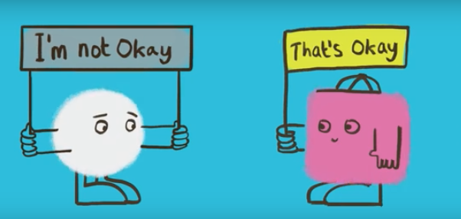
It’s ok not to feel ok.

Slide 15
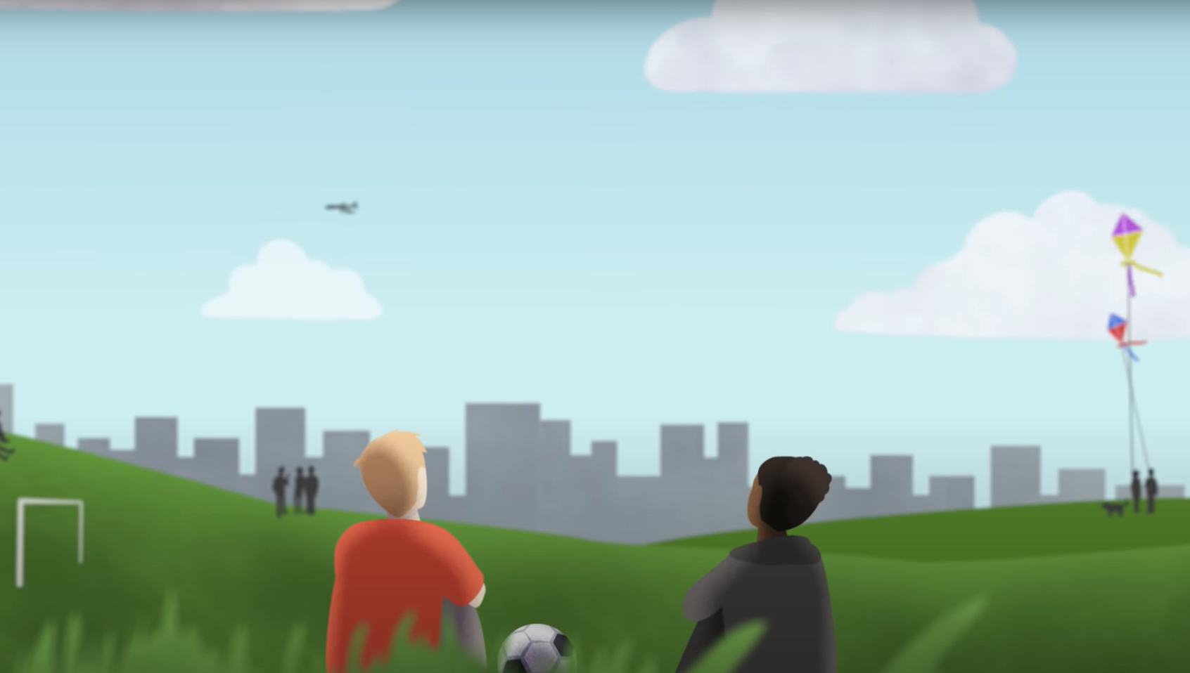
If you or a friend need immediate support, talk to an adult or dial 911.
988 Suicide and Crisis Lifeline
988
Text or Call

Slide 16
Level I:
We All Have Mental Health
Based on material created by and copyright of the Anna Freud Centre

