Slide 1
Level I:
We All Have Mental Health
One-Day Lesson
Based on material created by and copyright of the Anna Freud Centre
Pre-test: http://www.elhue.info
To edit/customize this slideshow, please make a copy.

Slide 2
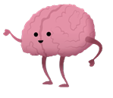
What is Mental Health?
Mental health is about our feelings, thinking, emotions and moods.​​
Mental health is important for a happy, healthy and productive life.
Just like we brush our teeth every day, we need to make sure our brains have the tools we need to be mentally healthy.
​​Looking after our mental health is just as important as looking after our physical health.

Slide 3
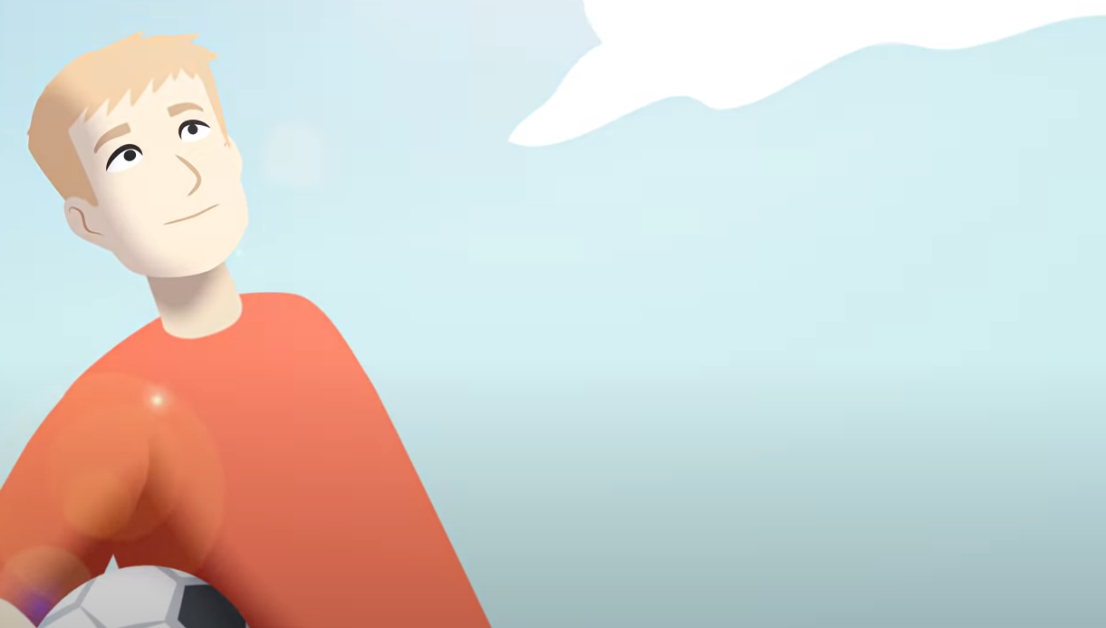
In today’s lesson you will learn:
More about mental health
Ways to keep your mind healthy
The difference between everyday feelings and overwhelming feelings.

Slide 4
How do we care for our mental health?
Let’s play charades!

Slide 5
Mental Health and Feelings
Everyday feelings come and go and are a normal reaction to what is happening in our lives. They are always changing and don't usually hang around for too long.​​
Overwhelming feelings hang around for a long time, change the way we feel and behave and may stop us from doing what we want to in life. You have heard people call them a mental health problem, mental illness or mental disorder. ​

Slide 6
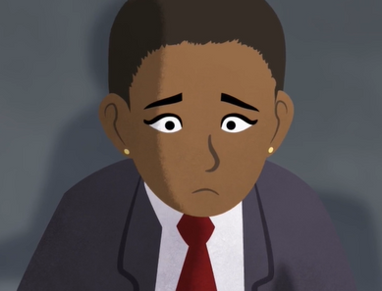
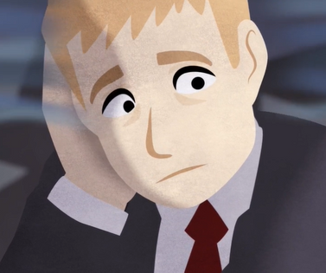
Everyday
Feelings
Overwhelming Feelings
Examples of everyday feelings might include: happiness, joy, disappointment.
Examples of overwhelming feelings might include: loss, grief, despair.

Slide 7
Where you are on the feeling thermometer?
How are you feeling today?

Slide 8
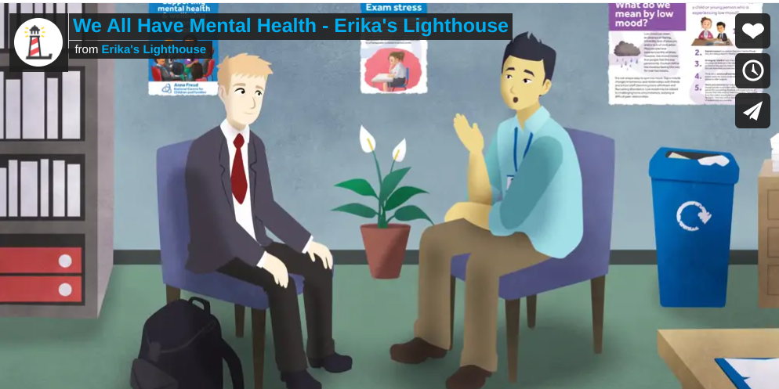
Let's watch Sasha and Andre to learn more about
feelings

Slide 9
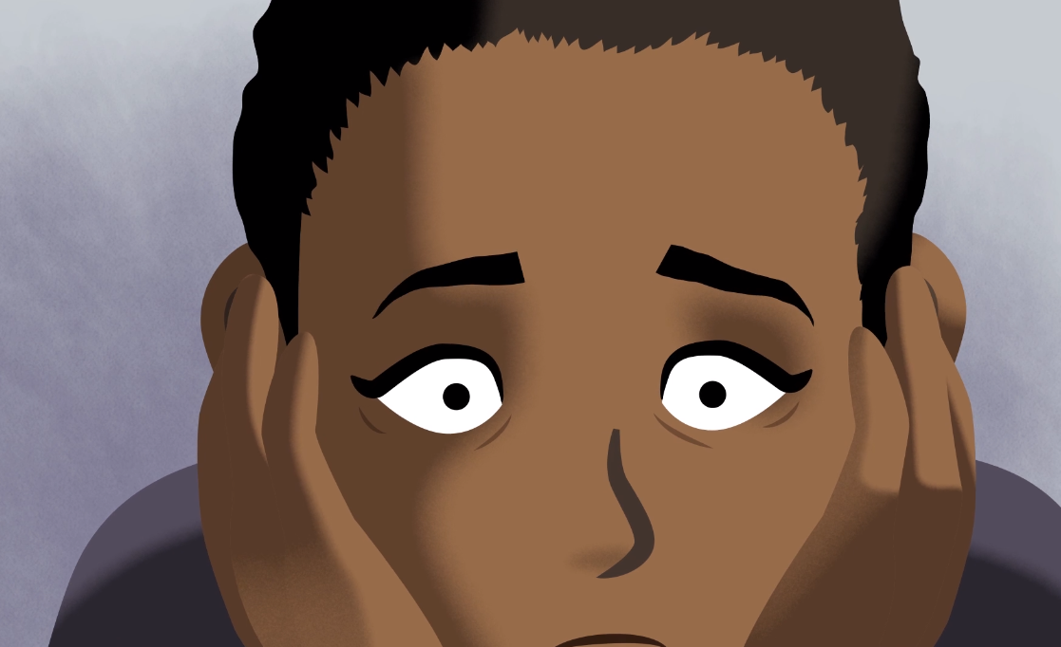
How are the feelings that Sasha and Andre are feeling different?

Slide 10
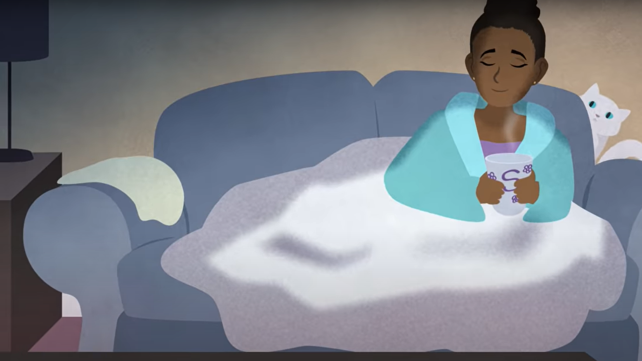
What does Sasha do to manage her everyday feelings?

Slide 11
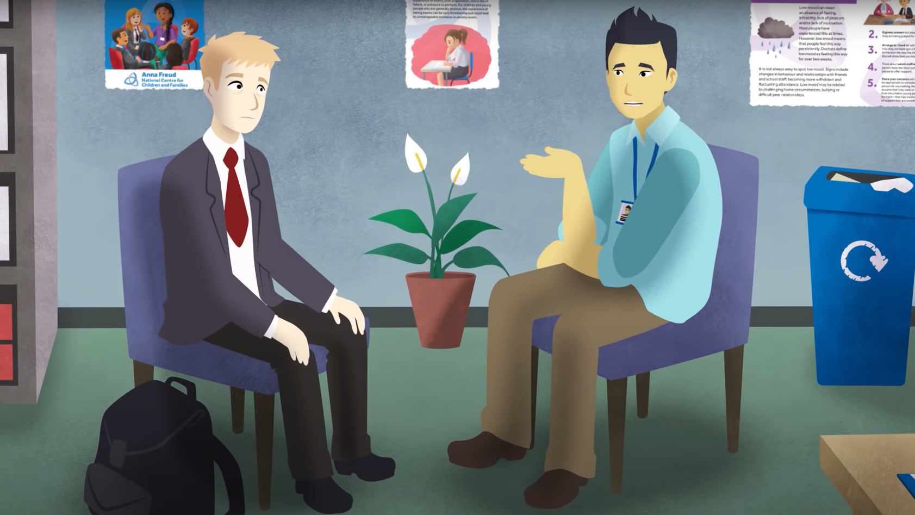
What does Andre do to manage his overwhelming feelings?

Slide 12
Overwhelming feelings can be difficult to admit or talk about.
What made it difficult for Andre to talk about his mental health or to ask for help?

Slide 13
What gets in the way
of good mental health?

Slide 14
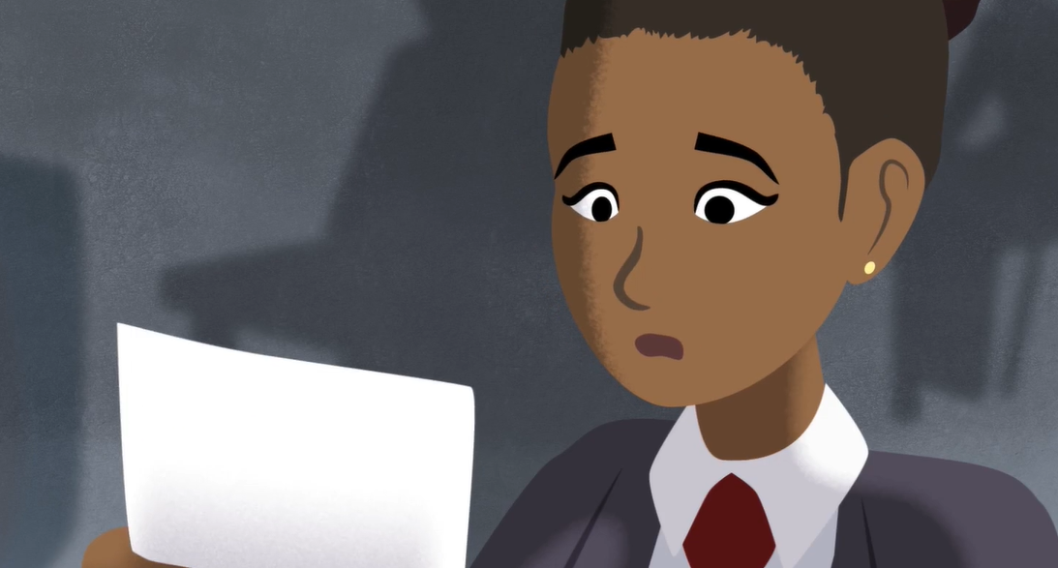
Stress

Slide 15
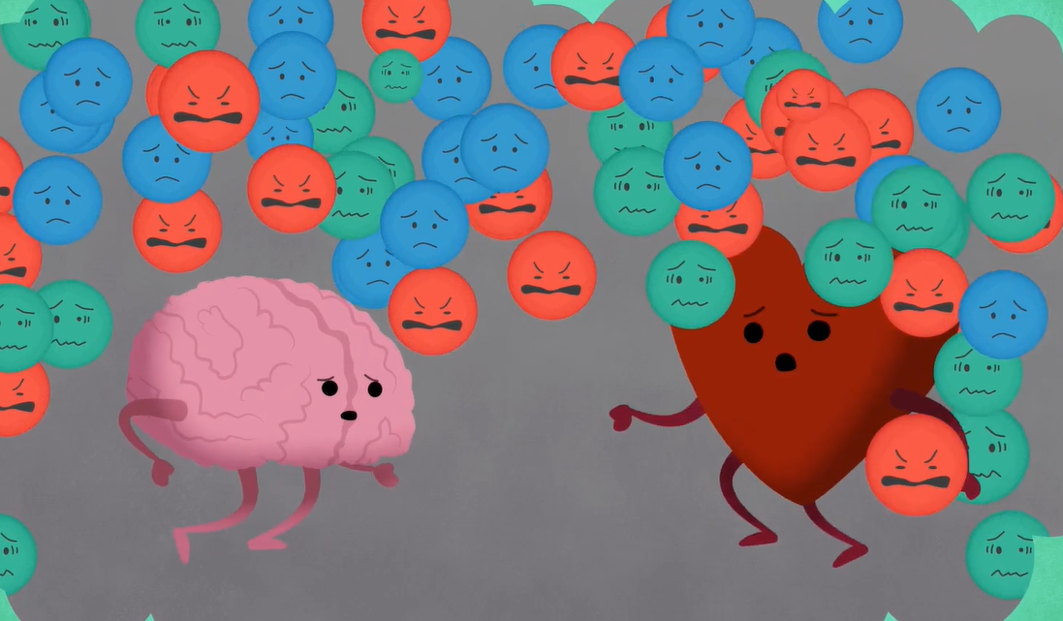
Too much stress can lead to overwhelming feelings.

Slide 16
Low Battery

Slide 17
Coping skills can help us manage life’s challenges.
Doing something you love
Mindfulness activities
Journaling

Slide 18
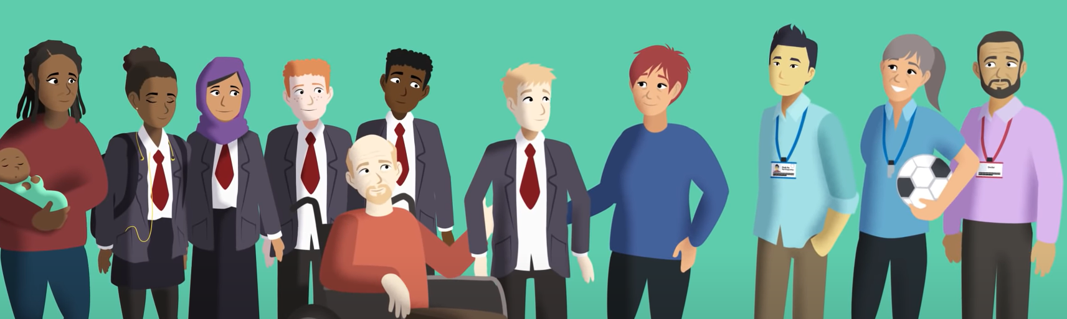
If you are concerned about yourself or a friend, talk to a Trusted Adult - someone who is reliable and dependable.

Slide 19
How do you know a person is reliable?
How do you know a person is dependable?

Slide 20
Who are trusted adults in your life?
AT HOME
IN THE COMMUNITY
AT SCHOOL

Slide 21
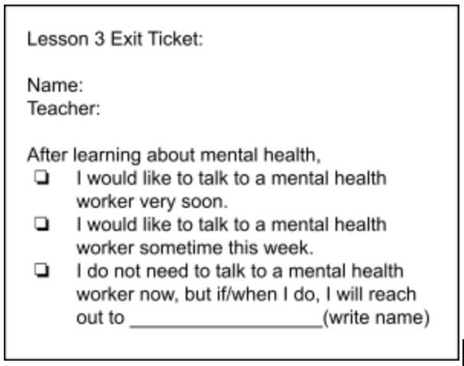
Exit Ticket

Slide 22
REMEMBER...
Everyone deserves good mental health
​
Stress is normal, but too much increases the risk for health problems
Small improvements in nutrition, sleep, exercise and other coping skills can help us to better manage stress and achieve mental health

Slide 23
Please complete a short survey:
http://elhuepost.info
For more information
visit us online at
ErikasLighthouse.org

Slide 24
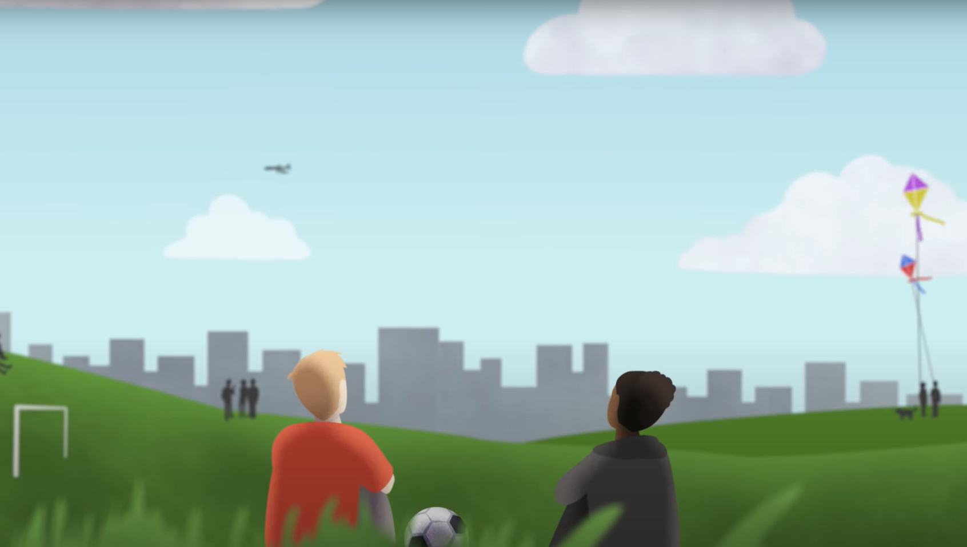
If you or a friend need immediate support, talk to an adult or dial 911.
988 Suicide and Crisis Lifeline
988
Text or Call

