Slide 1
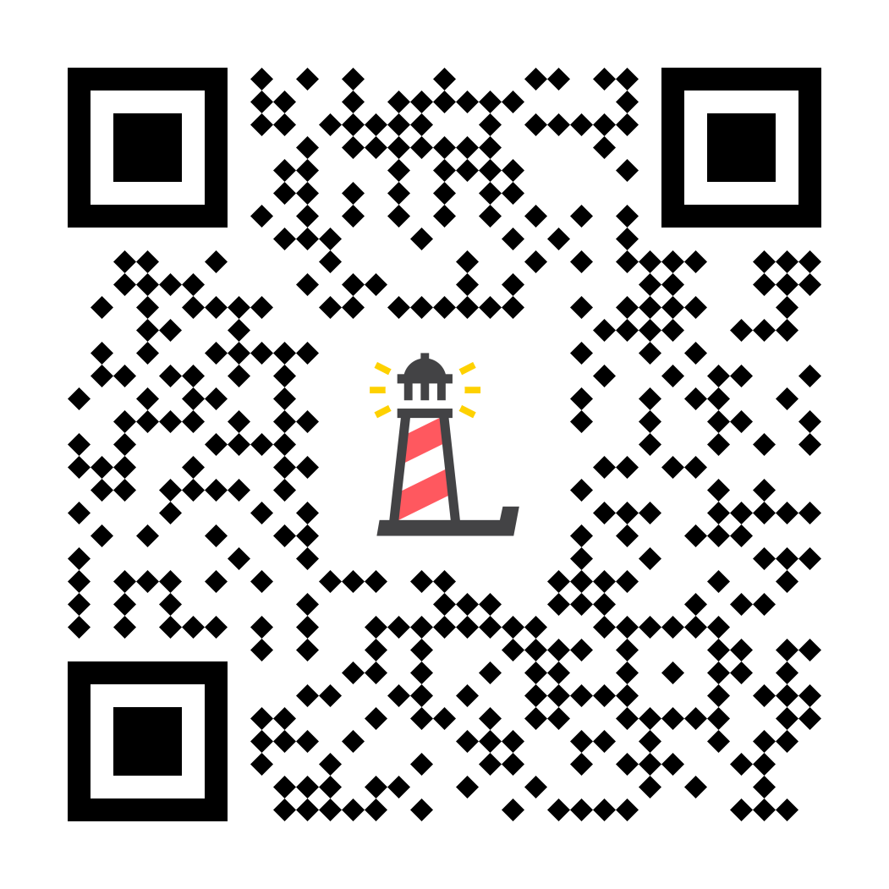
Level III:
Depression Education & Suicide Awareness
ONE-DAY LESSON
Pre-test: http://elhhs.info

Slide 2
Erika's Lighthouse Overview
This program was inspired by a young person named Erika. Erika was a bright light who, sadly, lost her battle with depression in 2004, at age 14.
Erika's Lighthouse was founded in her honor and is dedicated to helping other young people learn about depression and overcome the stigma surrounding mental health disorders.

Slide 3
You will...
Define that depression is a common mood disorder with specific changes in moods, thoughts, and behaviors
Explain that there is not one reason someone has depression
Recognize that depression can get better and you can find support
Explain that good self-care is a key piece to managing depression
Describe that self-harm and suicidal thoughts are symptoms of depression that we must take very seriously

Slide 4
The Video
Notes:
https://vimeo.com/282907828/d5e633e16c

Slide 5
Discussion
What are some of the signs and symptoms of depression?

Slide 6
Symptoms
Depressed mood, sadness or irritability
Loss of interest or pleasure in activities
Change in weight or appetite
5 symptoms present
most of every day
for at least 2 weeks
Change in sleep
Feeling sped up or slowed down
Fatigue or loss of energy
Feelings of worthlessness or guilt
Trouble concentrating or making decisions
Thoughts of death or acts of self-harm

Slide 7
Discussion
What is Stigma?
What are examples of stigma that some of the teens in the video experienced?

Slide 8
Stigma
Stigma is the belief that if you share that you need help, you will be disrespected or disgraced

Slide 9
Stories
Using your Student Workbook select a story or
multiple stories to read about individually or in small groups.
The goal is to learn more about each teen’s experience
with depression

Slide 10
Follow Up Questions
What was going on in their life when the teen experienced depression?
Why was it so hard for the teen to talk about their depression?
What self-care strategies did the teen use?
Who did the teen seek support from?

Slide 11
If a friend at your school felt depressed, list two people (or resources) that would be trustworthy and reliable?

Slide 12
Definitions
suicide
Suicide: death caused by self-directed injurious behavior with intent to die as a result of the behavior. (NIMH)
[ /'su:isaid/ ]
noun
self-harm
Self-Harm: when people intentionally hurt themselves or put themselves in dangerous situations because they are feeling a lot of pain and don't know what else to do. It is often a sign of emotional distress. (NAMI)
[ /'self-harm/ ]
noun

Slide 13
What would you do if a friend was feeling suicidal and turned to you for help?

Slide 14
Self-Referral Cards

Slide 15
Scan the QR code to fill out a short survey.
Or follow this link: http://elhhspost.info/
Por favor cuéntanos lo que has aprendido.

Slide 16
Whatever time: Day. Night. Weekend.
Whatever the reason: Mental health distress. Thoughts of suicide.
Worried about a friend or loved one. Would like emotional support.
The 988 Suicide & Crisis Lifeline is here for you.
Text or Call 988 | Chat 988lifeline.org |
For emergencies, call 911

