Slide 1


Level III:
Depression Education & Suicide Awareness
LESSON TWO

Slide 2
Definitions
stigma
Stigma: a mark of shame associated with a particular circumstance, quality or person
[ /'stigma/ ]
noun
self-care
Self-Care: the practice of taking action to improve one's health. This includes physical, social and emotional health
[ /'self kair/ ]
noun

Slide 3


Review Prompts
  Who can define self-care and share what they do for self-care?
  What is a warning sign of depression?
  What is a cause of depression?
  Name a trusted adult in the school. How do you know they are a trusted adult?
  What does it mean when a resource is valid?
  What does it mean when a resource is reliable?

Slide 4
Video Part #2 (10:43-12:22)
Level III:
Depression Education & Suicide Awareness

Slide 5
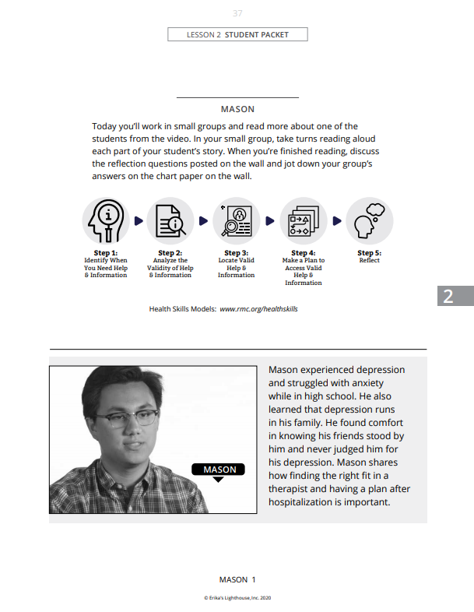

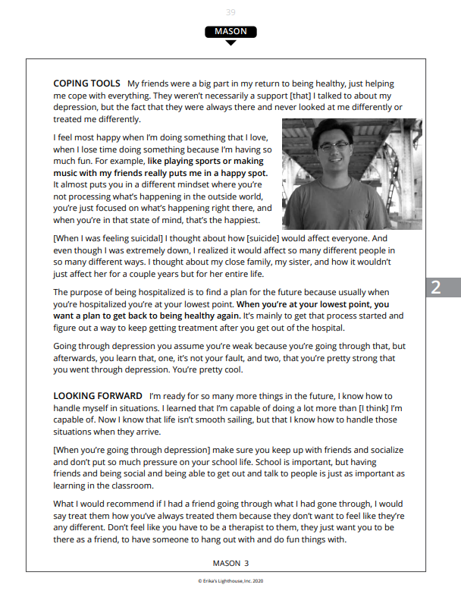
Student Stories
In your groups:
  Read the story of your assigned person.
  Go to the station associated with that person.
  Read the questions and answer them on the chart paper.
  Be prepared to share out your answers in the next lesson.

Slide 6


Closure
There are optional extension questions in your packet.
Today we:
Learned about self-care and stigma
Read stories about different peoples' experience with depression and worked in groups to process those stories
The valid and reliable trusted adults in our school are:

Slide 7

Whatever time: Day. Night. Weekend.
Whatever the reason: Mental health distress. Thoughts of suicide.
Worried about a friend or loved one. Would like emotional support.
The 988 Suicide & Crisis Lifeline is here for you.
Text or Call 988 | Chat 988lifeline.org |
For emergencies, call 911

