Slide 1


Level III:
Depression Education & Suicide Awareness
LESSON THREE

Slide 2
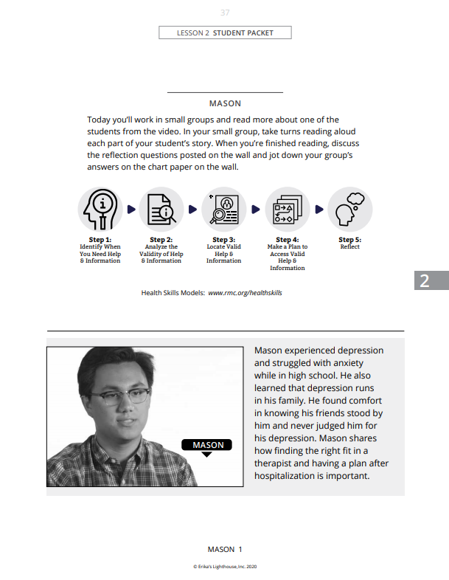

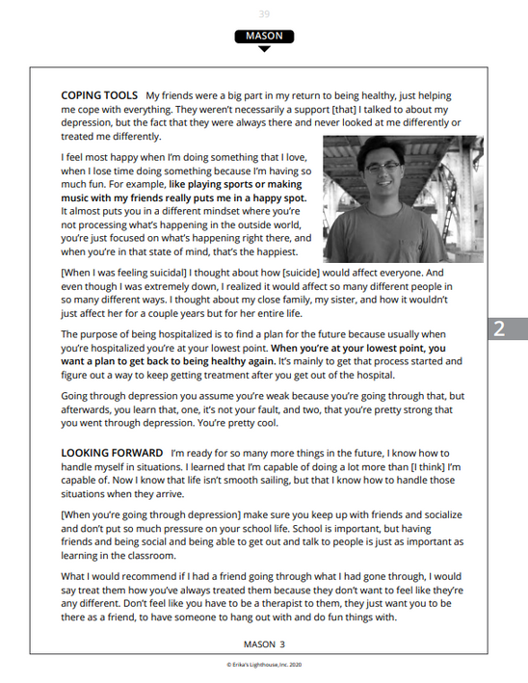
Student Stories
In your groups:
  Read the story of your assigned person.
  Go to the station associated with that person.
  Read the questions and answer them on the chart paper.
  Be prepared to share out your answers in the next lesson.

Slide 3
Definitions
suicide
Suicide: death caused by self-directed injurious behavior with intent to die as a result of the behavior. (NIMH)
[ /'su:isaid/ ]
noun
Self-Harm: when people intentionally hurt themselves or put themselves in dangerous situations because they are feeling a lot of pain and don't know what else to do. It is often a sign of emotional distress. (NAMI)
self-harm
[ /'self harm/ ]
noun

Slide 4
Video Part #3 (12:23 - 18:00)
Level III:
Depression Education & Suicide Awareness

Slide 5


What are two signs to look for in yourself or friends regarding depression or self-harm?

Slide 6
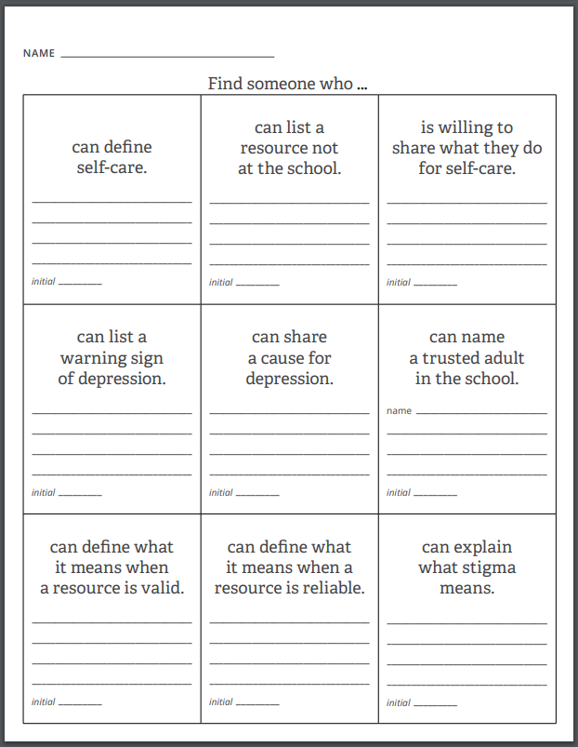

Find Someone Who

Slide 7

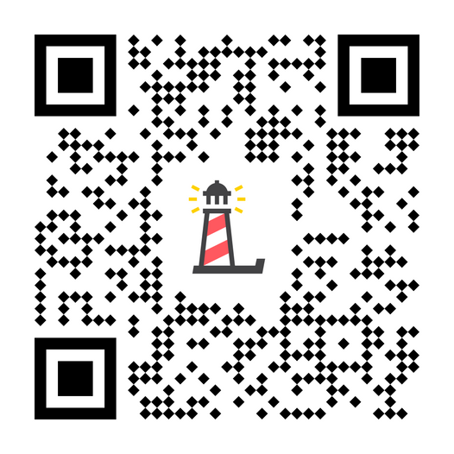
Scan the QR code to fill out a short survey.
Or follow this link: http://elhhs.info/
Please tell us what you've learned.

Slide 8
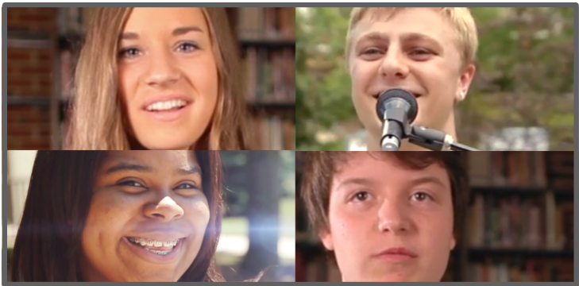

Closure
Today we:
Shared our group debriefs around stories of depression
Learned about suicide and self-harm in the video
Reviewed the content from the prior lessons
The valid and reliable trusted adults in our school are:

Slide 9
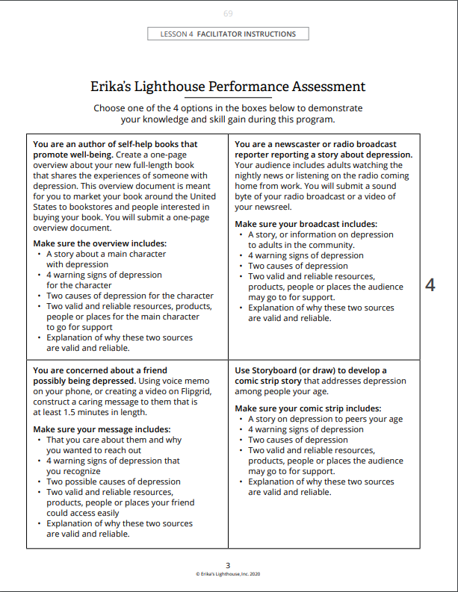
Lesson 4
During the next lesson, you will have time to complete a performance assessment which will enhance your knowledge and skills around accessing valid and reliable health information

