Slide 1
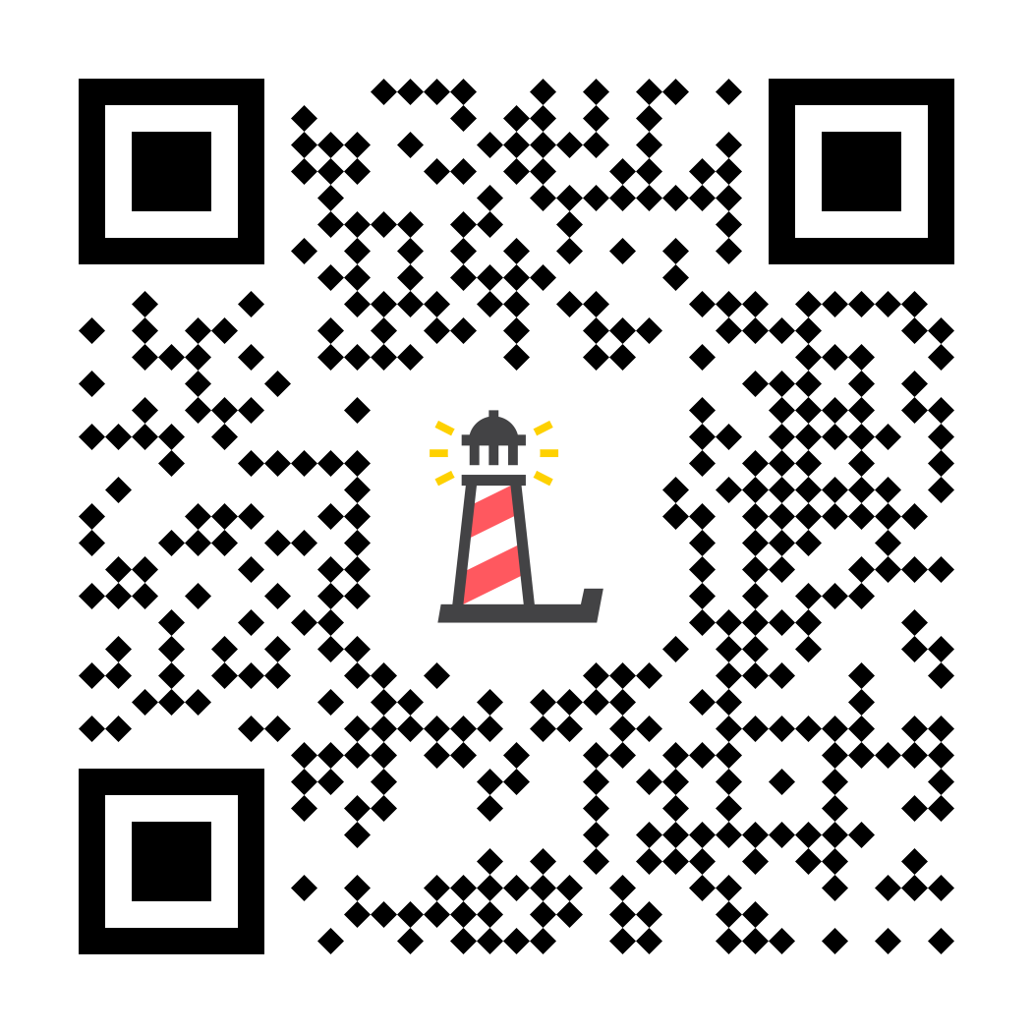
Erika’s Lighthouse
Staff Training: Part 1: Signs & Symptoms
Notes:
“Welcome to the Erika’s Lighthouse Staff Training. This is part 1 of a 3-part series. This section of the training will cover the signs & symptoms of depression and suicide.”

Slide 2
Content Notice
This training contains discussion of depression, self-harm and suicide.
If you or someone you know is experiencing suicidal thoughts or is in crisis, please reach out to the 988 Lifeline, which provides 24/7, free, confidential support for people in distress.
Notes:
“This training contains discussions of depression, self-harm and suicide. We recognize this is a heavy topic. Many people are affected in various ways by the topic of suicide and mental illness and we want you to take what you need during this time”

Slide 3
PART 1
Signs and Symptoms of Depression & Suicide
Agenda
Current Statistics on Youth Mental Health
Signs & Symptoms of Depression
Signs & Symptoms of Suicide
Shared Risk Factors & Warning Signs
Notes:
“In Part 1, we are going to review the current statistics on youth mental health. We are going to examine what depression looks like, how you might be able to identify that a student is struggling and what are some of the differences and similarities between signs/symptoms of depression and suicide. We are also going to talk about why this is important and particularly why depression education specifically is a good way to address both of these troubling issues.
It is always important to note that it is NOT a teacher’s job to diagnose a student; rather, in your role as an educator or a trusted adult, by knowing some of the signs and risk factors, you can help identify a student in need and help connect that student to the appropriate mental health professionals or school staff members.”

Slide 4
Youth Are In A Mental Health Crisis
Notes:
“You may have heard that there is a youth mental health crisis. Let’s take a look at the current statistics about youth mental health, suicide rates, and the rates of depression in our young people.”

Slide 5
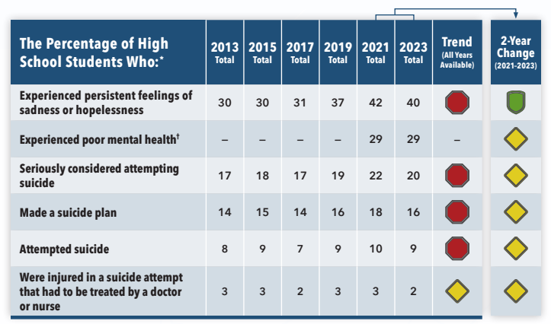
The Need is Significant: We know young people are experiencing poor mental health, and we must act. The reality is troubling:
Based on 2023 CDC YRBS Data
Notes:
“In August of 2024, the CDC released the newest Youth Risk Behavior Survey Data. Nearly all indicators of poor mental health and suicidal thoughts and behaviors worsened from 2013 to 2023 . Specifically, there were increases in the percentage of students who experienced persistent feelings of sadness or hopelessness, seriously considered attempting suicide, made a suicide plan, and attempted suicide . Two-year changes show a recent decrease in the percentage of high school students who experienced persistent feelings of sadness or hopelessness from 2021 to 2023 . All other experiences and behaviors did not change
This chart summarizes the findings for poor mental health. We’ll discuss the findings for suicide on the next slide. In 2023,
4 out of 10 students felt persistently sad or hopeless
Nearly 1 in 3 experienced poor mental health
Female and LGBTQ+ students were more likely than their peers to experience persistent feelings of sadness or hopelessness, poor mental health, and suicidal thoughts and behaviors.

Slide 6
Suicide by the Numbers
Specifically relating to suicide, the statistics are alarming and widespread:
Youth and young adults ages 10-24 years account for 15% of all suicides. (CDC)
20% of high school students have seriously considered attempting suicide. (CDC YRBS, 2023)
9% of high school students reported having attempted suicide. (CDC YRBS, 2023)
Rates are rising among young people, suicidal behaviors among high school students increased more than 40%. These trends were exacerbated during the COVID-19 pandemic. (National Institute for Health)
Suicide is the
SECOND
leading cause of death
among 10-24 year olds. (CDC)
Notes:
“Specifically relating to suicide, statistics are alarming and widespread. Youth and young adults, ages 10-24, account for 15% of all suicides. For high school students, in 2023, 20% of high school students report they seriously considered attempting suicide and 9% report attempting suicide. According to the National Institute for Health, suicidal behaviors have increased 40% for high school students. Suicide has gone from being the #3 cause of death to the second cause of death for young people. As these troubling numbers continue to be a concern, we know that effective mental health education is more important than ever.”

Slide 7
Depression by the Numbers
Depression is the number one risk factor for suicide.
An estimated 5 million of adolescents, ages 12-17, have had at least one major depressive episode.
At risk populations - females & LGBTQ+
Depression is the most common mental health disorder that is accompanied by co-occurring disorders. 3 out of 4 teens with depression have also been diagnosed with anxiety and half have been diagnosed with behavior problems.
50% of mental health disorders begin before the age of 14 and 75% occur before 24.
Childhood depression is more likely to persist into adulthood if gone untreated.
Up to 20% of young people will experience a major depressive episode before age 20. (NIMH)
Notes:
“Here are some alarming statistics about youth depression. Depression is the number one risk factor for suicide. Between 15-20% of young people will experience a depressive episode before the age of 20 -- another way of looking at that is that it’s 5 kids out of a class of 25. 50% of mental health disorders begin before the age of 14 and 75% occur before 24. This is why it is so important for us to understand the signs & symptoms so that we can intervene sooner rather than later.”

Slide 8
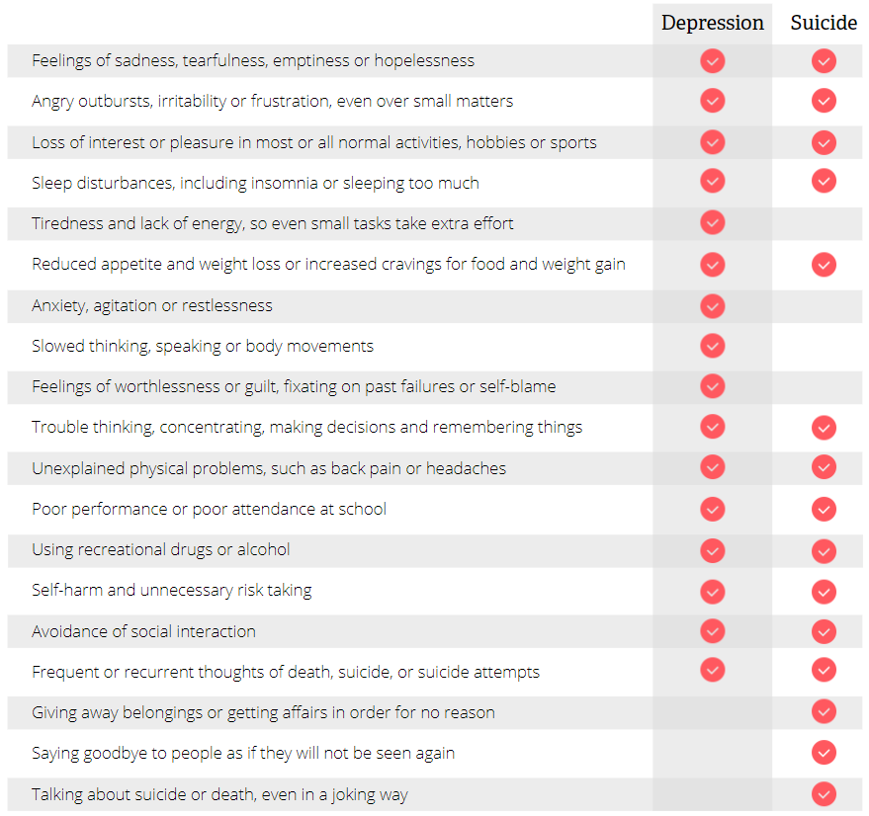
Importance of Prevention
Many warning signs & symptoms of depression and suicide are shared
Notes:
The numbers are startling, and many of the warning signs and symptoms of depression overlap with those of suicide, as we can see from looking at this image. So, by educating all students about depression and its signs and symptoms, we are taking an upstream approach in order to impact more young people. On the next slide, we’ll see why that is important.

Slide 9
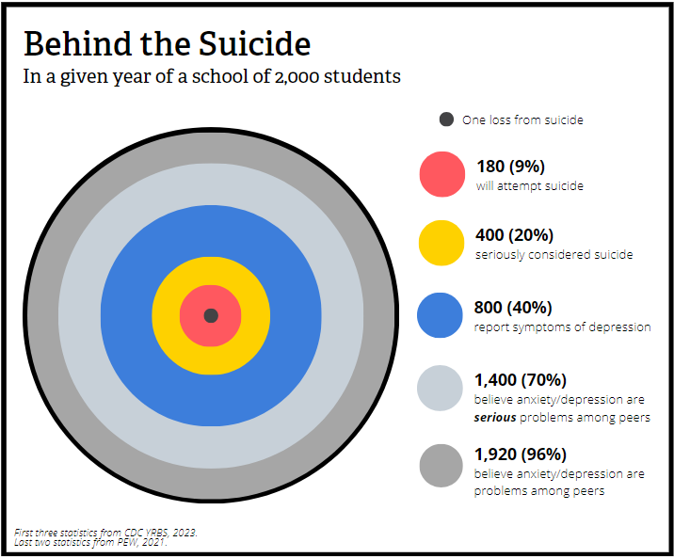
Upstream Approach:
Depression Education is Suicide Prevention
Notes:
“Upstream, more kids are affected by depression, so we can reach all students earlier with this education. Think about this quote “There comes a point in time where we need to stop just pulling people out of the river. We need to go upstream and find out why they’re falling in”-Desmond Tutu
This is why Erika’s Lighthouse takes an upstream approach to suicide prevention: Depression education is suicide prevention and here’s why:
Depression accounts for many of the issues that impact a student’s ability to learn and perform on any given day - it impacts attendance, underachievement, behavioral concerns, etc.
It touches a much larger population of students
Teaching depression literacy reduces stigma & builds a climate of mental health – where everyone is educated about depression and knows how to help a young person find help in the building.
It promotes early identification of depression by giving all of us an understanding and vocabulary to talk about it
It encourages early intervention and help-seeking – unlike traditional suicide prevention this program empowers both the teen struggling and the peers and adults around them
There are so many young people who struggle with depression, and while suicide is actually rare, when it happens, it is tragic and affects more than the family. If you lose a child to suicide in your school community, it’s a tragedy.
Let’s take a look at this chart, representing a school of 2,000 students. The black dot is a suicide. Surrounding that suicide are 200 other kids who will attempt suicide, 442 or 22% will seriously consider suicide, 840 (42%) report symptoms of depression 70% of students believe that anxiety and depression are serious problems amongst their peers, and finally almost 2000 students who believe anxiety and depression are problems among their peers. By being aware and talking about depression, we’re really focusing on identifying struggling adolescents before they get to the point of taking their life.

Slide 10
Early Identification is Critical
1 out of 5 young people will experience depression before adulthood
50% of those will be symptomatic by the age of 14
Notes:
“1 out of 5 young people will experience depression before adulthood and 50% will be symptomatic before 14. So, the need for early intervention is critical. We don’t know who will attempt suicide and who won’t, but depression education captures all of those people.It’s important to remember that people make attempts because they lose hope. Depression education provides hope that things can get better.”

Slide 11
Signs & Symptoms of Depression
Depression symptoms can vary from mild to severe and can include:
Feeling sad or having a depressed mood
Loss of interest or pleasure in activities once enjoyed
Changes in appetite — weight loss or gain unrelated to dieting
Trouble sleeping or sleeping too much
Loss of energy or increased fatigue
Increase in purposeless physical activity (e.g., hand-wringing or pacing) or slowed movements and speech (actions observable by others)
Feelings of worthlessness or guilt
Difficulty thinking, concentrating or making decisions
Thoughts of death or suicide
*The individual must be experiencing five or more symptoms during the same 2-week period and at least one of the symptoms should be either (1) depressed mood or (2) loss of interest or pleasure.
Notes:
“Depression looks different for everyone, but in order for there to be a diagnosis of depression, there are particular symptoms. The symptoms must include at least either feeling sad or having a depressed mood OR loss of interest or pleasure in activities that someone used to enjoy, along with at least 4 of the others on the list. The signs/symptoms are going to be a change from what’s “normal” for that particular individual and will have lasted for at least 2 weeks.”

Slide 12
More than Just Sadness
Sadness:
Often connected to a specific cause like a disappointment or setback.
Temporary; if it lasts more than two weeks and is accompanied by other warning signs, it can cause impairment and turn into depression over time.
Symptoms typically pass after using coping strategies.
Depression:
Doesn’t always have a direct cause; can be triggered by a situation, early experience, and trauma and often affects overall well-being and quality of life, not just emotional state.
Is a diagnosable mood disorder that has specific signs & symptoms that last everyday for two weeks or longer.
Symptoms may intensify without treatment.
Notes:
“It’s important to make sure we are using the right words to describe the various parts of mental health and mental illness; doing this helps to improve mental health literacy. Interchanging terms can lead to misunderstandings and misrepresentations of individuals’ experiences and emotions.
Although they can overlap and share some symptoms, sadness and depression are experiences with different causes and significance. Understanding the differences is crucial to getting the right kind of help, if needed, and to be clear about the language used to tell others how we are feeling. For example, mislabeling depression as sadness can minimize its seriousness and discourage seeking help.”

Slide 13
Depression in Teens
Irritability
Self defeating attitude
Bizarre sleep patterns
Substance use
Risk taking
Aggression
Acting out
Problems in school
Notes:
“More specifically, depression in teens might have a different look, as teens might become more irritable or develop a more self-defeating attitude. For some, it might look like a more aggressive reaction to things or acting out. Again, these are going to be different for each student but if it’s a noticeable change in that kid, you’ll want to make note and consider that something might be going on.
Irritability – Teens are good at making people not want to be around them.
Self-defeating attitude – Hearing them say things like “I’m not good enough, smart enough, good looking enough” etc.
Bizarre sleep patterns - More time in bed, less time sleeping (isolating).
Substance use – Widely available at this age.
Aggression – This looks like getting into fights.
Acting out – This takes the form of running away, disrespect, etc.
Risk taking – Doing anything that could knowingly cause harm, i.e. trying to beat a train and racing over train tracks.
Problems in school – Cognition problems are the first signs, even if grades are fine, work takes longer.
Depression looks different at different ages. The key is to understand what is normal at different developmental stages and what is normal for a particular kid and their personality and temperament.

Slide 14
Depression in Teens
Notes:
“You are now going to meet Lindsey. Listen as she describes the signs & symptoms she experienced when facing depression”.

Slide 15
Notes:
“We are going to meet Lindsey. In this video segment, you will meet a real teen who will describe the signs & symptoms she experienced when facing depression”.
Play video

Slide 16
Risk Factors of Depression
Personal or family history of depression
Major life changes, trauma, or stress
Certain physical illnesses and medications
Notes:
“There are some known risk factors for depression. A personal or family history of depression, major life changes, stress, trauma, and certain medical illnesses or medication can all be risk factors.”

Slide 17
It’s easy to tell when an adolescent is depressed because they just cry all the time.
That’s a MYTH
The FACT is that adolescents with depression may have various symptoms. They may cry, they may seem irritable or anxious. They may have no energy and feel tired, have trouble sleeping; or they sleep too much.
Notes:
“Let’s play myth or fact. Myth or fact: it’s easy to tell when an adolescent is depressed because they cry all the time.” (pause and let audience answer and then click slide for explanation) “That’s a myth. The Fact is that adolescents with depression may have various symptoms. They may cry, may seem irritable or anxious, they may not cry at all. They may have no energy and feel tired, have trouble sleeping, or they sleep too much. It’s important to remember that it’s a marked change for the individual.”

Slide 18
Teens are just moody. Depression and self-destructive behavior is rare.
That’s a MYTH
THE FACT is that both forms of behavior are common in adolescents.
Notes:
“Let’s try another one. Myth or fact: Teens are just moody. Depression and self-destructive behavior is rare.” (pause for audience participation) “That’s a myth. The fact is that both forms of behavior are common in adolescents.”

Slide 19
Treatment
Treatment is effective, yet hard to get.
In 2021, an estimated 41% of US adolescents with depression received treatment in the past year.
Stigma and other barriers play a role in youth not receiving the treatment they need.
Approximately ⅔ of teens receiving mental health treatment are receiving services at school.
Schools & parents can create protective relationships with students & help them grow into healthy adulthood.
Notes:
“I want to bring up treatment because these statistics show the need for treatment. Most young people do not get the treatment they need (and deserve), but by equipping schools with the resources and education, young people can know help is available. School mental health services are very important -- approximately 2/3 of teens receiving mental health treatment are doing so in school. The more we can educate adults in our school buildings about depression and suicide, the more students will learn that they can ask for help at school.
Undiagnosed, untreated or inadequately treated mental illnesses can significantly interfere with a student’s ability to learn, grow and develop. Since children spend much of their productive time in educational settings, schools offer a unique opportunity for early identification, prevention, and interventions that serve students where they already are.”

Slide 20
Warning Signs of Suicide
Talking about:
Wanting to die
Great guilt or shame
Being a burden to others
Feeling:
Empty, hopeless, trapped, or having no reason to live
Extremely sad, more anxious, agitated, or full of rage
Unbearable emotional or physical pain
Change in behavior, such as:
Making a plan or researching ways to die
Withdrawing from friends, saying goodbye, or giving away prized possessions
Taking dangerous risks such as driving extremely fast
Displaying extreme mood swings
Eating or sleeping more or less
Using drugs or alcohol more often
If these warning signs apply to you or someone you know, get help as soon as possible, particularly if the behavior is new or has increased recently.
Notes:
Suicide is now the #2 cause of death for young people ages 10-24. Even though the actual incidents of suicide are relatively rare, it is important to ask if concerned about what you are hearing or observing. Asking if someone is thinking of suicide will not “plant an idea in their head.” Suicide is tied to intense psychological pain, hopelessness and feeling as if there is no other way to relieve the psychological pain. However, most people give verbal or behavioral clues within the week or so leading up to their death. Things to look out for include:
Observable signs of depression - loss of interest in activities, depressed mood, irritability, intense frustration
Talking or writing about not being around anymore or having no reason to live – “ I want it to be over, I won’t be here next year, you won’t see me again, This is the last time I’ll…”
In general, if they say something puzzling or cryptic in regards to life and death ask what that means.
Looking for a way to kill themselves, such as searching online for materials or means or having a definitive plan
Giving away prized possessions or saying goodbye to everyone – no longer have a need for the possessions or putting affairs in order
Feeling unbearable pain, hopelessness or feeling like you are trapped – “I feel so desperate, I can’t bear it anymore, There is no way to pull myself out of this..
Feeling like you don’t belong or are a burden to others – acting as if one is already gone and that everyone would be better off if you were gone. Intense shame.
We are trying to create a web of safety around students – one person can make a big difference, but no one should feel that they alone are responsible for an individual’s safety. This is why it’s important for schools to have a plan in place for helping a student in crisis.

Slide 21
Risk Factors of Suicide
Depression, other mental disorders, or substance abuse disorder
Certain medical conditions
Chronic pain
A prior suicide attempt
Family history of suicide, a mental disorder or substance abuse
Family violence, including physical or sexual abuse
Having guns or other firearms in the home
Having recently been released from prison or jail
Being exposed to others' suicidal behavior, such as that of family members, peers, or celebrities
Many people have some of these risk factors but do not attempt suicide. It is important to note that suicide is not a normal response to stress. Suicidal thoughts or actions are a sign of extreme distress and should not be ignored.
Notes:
“There are some known risk factors for suicide. Depression, other mental illnesses, substance abuse, certain medical conditions, chronic pain, a prior suicide attempt, family history of suicide, family violence, having guns or firearms in the home, recent incarceration, and recent exposure to other’s suicidal behavior. Many people may have risk factors but do not attempt suicide. It is important to remember that suicide is not a normal response to stress. Suicidal thoughts or actions are a sign of extreme distress and should not be ignored”

Slide 22
Most young people thinking about suicide never seek or ask for help.
That’s a MYTH
THE FACT is that often, young people will tell their peers of their thoughts and plans. 66% of young people first report suicidal thoughts to a friend.
Notes:
“Myth or fact number 3: Most young people thinking about suicide never seek or ask for help” (pause to wait for audience participation) “That’s a myth: the fact is that often, young people will tell their peers of their thoughts and plans. 66% of young people first report suicidal thoughts to a friend”

Slide 23
Most suicide attempts or deaths happen without warning.
That’s a MYTH
THE FACT is that warning signs, verbally and behaviorally, precede most suicides. In most cases where someone attempts or dies by suicide, there were warning signs in their behaviors and/or conversations.
Notes:
“Myth or fact: most suicide attempts or death happen without warning” (pause to wait for audience participation). “That’s a myth: the fact is that warning signs, verbally and behaviorally, precede most suicides. In most cases where someone attempts suicide or dies by suicide, there were warning signs in their behaviors and/or conversations”

Slide 24
People who die by suicide are selfish and take the easy way out.
That’s a MYTH
THE FACT is that typically people do not die by suicide because they do not want to live. People die by suicide because they want to end their pain and suffering.
Notes:
“Myth or fact: people who die by suicide are selfish and take the easy way out” (pause to wait for audience participation). “That’s a myth. The fact is that typically, people do not die by suicide because they do not want to live. People die by suicide because they want to end their pain and suffering.”

Slide 25
Suicide is not preventable.
That’s a MYTH
THE FACT is that early identification and intervention make it possible to help someone before they attempt suicide. You can be someone’s lifeline.
Notes:
“Last one…myth or fact: Suicide is not preventable” (pause for audience participation) “That’s a myth. The fact is that early identification and intervention make it possible to help someone before they attempt suicide. You can be someone’s lifeline”

Slide 26
Thank You!
Program Support
Katie Conklin - Vice President of Programs
Katie@erikaslighthouse.org
Ilana Sherman - Director of Education
Ilana@erikaslighthouse.org
Notes:
“If you have additional questions for the Erika’s Lighthouse staff, please feel free to reach out to them. Their contact information is on the screen. We will now move on to small group work.”

