Slide 1
Erika’s Lighthouse
Staff Training: Part 2: Helping a Student
Notes:
Welcome to the Erika’s Lighthouse Staff Training. This is part 2 of a 3-part series. This section of the training will cover helping a student.

Slide 2
Content Notice
This training contains discussion of depression, self-harm and suicide.
If you or someone you know is experiencing suicidal thoughts or a crisis, please reach out to the 988 Lifeline, which provides 24/7, free, confidential support for people in distress.
Notes:
“This training contains discussions of depression, self-harm and suicide. We recognize this is a heavy topic. Many people are affected in various ways by the topic of suicide and mental illness and we want you to take what you need during this time”

Slide 3
PART 2
Helping a Student
Agenda
Being Sensitive & Trauma-Informed
Being a Trusted Adult
Intervention Language
Following School Policy
Protective Factors
Notes:
“We will learn about being trauma-informed, what it means to be a trusted adult, how to have a conversation with a student if you are concerned, following school protocol and what proactive factors can support student well-being.
It is always important to note that it is NOT a teacher’s job to diagnose a student; rather, in your role as an educator or a trusted adult, by knowing some of the signs and risk factors, you can help identify a student in need and help connect that student to the appropriate mental health professionals or school staff members.”

Slide 4
Being Sensitive & Trauma-Informed
Trauma-informed practice is a paradigm shift – shifting away from the deficit/blaming model to one with understanding & compassion.
If we don’t look for or acknowledge trauma in the lives of children and adolescents, we end up chasing behaviors and limiting the possibilities for change.
Suarez, Flores & Zamarelli, 2007
“
Notes:
“I want to talk a bit about the Prevalence of Trauma in our young people. We know that more than 60% of children have been exposed to some form of abuse or violence (Finkelhor, Turner, Ormrod, & Hamby, 2009).
In short, it's reasonable to assume that a majority of students in school have been exposed to at least one traumatic event at some point in their lives. No matter how big or small that event is, people experience trauma when they witness or are exposed to an event that presents a real or perceived threat to well-being or safety, and the event causes the person to feel fear or helplessness.
Traumatic events bring on strong feelings that may strain a person's coping capacity. Children who've experienced trauma may have challenges that affect their social and academic performance at school, including, for example, difficulty sustaining attention, concentration, and completing tasks;
Remember, a child’s misbehavior may not be intentional at all, but rather an involuntary discharge of traumatic stress that’s been stored up.

Slide 5
Being Sensitive & Trauma-Informed

Slide 6
Being Sensitive & Trauma-Informed
What does it mean?
Students:
Come to the classroom with many different values, cultural and religious beliefs, and ideas about these topics.
May have experienced trauma of some sort in their life, it may have an impact on their ability to thrive and be healthy.
May have difficulty sharing ideas and discussing these issues with their peers.
Educators should:
Infuse language and guidelines to support sensitive and personal discussions in classrooms.
Seek opportunities to instill hope, resilience, safety.
Notes:
“So what does that mean?
Students:
Come to the classroom with many different values, cultural and religious beliefs, and ideas about these topics.
May have experienced trauma of some sort in their life, it may have an impact on their ability to thrive and be healthy.
May have difficulty sharing ideas and discussing these issues with their peers.
Educators should:
Infuse language and guidelines to support sensitive and personal discussions in classrooms.
Seek opportunities to instill hope, resilience, and safety.
Find ways to foster students' resilience; be empathetic as students connect with you”

Slide 7
Young People’s Barriers to Reaching out for Help
Students may find it challenging to ask for help.
I feel like a burden.
I don’t want to disappoint anyone.
I’m having a tough time recognizing if there is a problem.
I feel ashamed & embarrassed.
There’s no hope so what’s the point of asking for help.
My problems are not as bad as other people’s problems.
I should be able to handle this on my own.
I don’t deserve help or support.
People have already told me, “You’re fine. Just look at the positives.”
Maybe I’m just being dramatic.
Notes:
“Young people have a difficult time asking for help with something as benign as math homework, so expressing that they are concerned about their mental health is a rather daunting task. Over the years, Erika’s Lighthouse has spoken with many young people. Below are some of the barriers they feel about asking for help. They say things like “I feel like a burden, I don’t want to disappoint anyone, I feel ashamed or embarrassed, my problems aren’t as bad as other people’s, I should be able to handle it on my own. This is why it’s so important to let young people know that we are available to listen and here to help.”

Slide 8
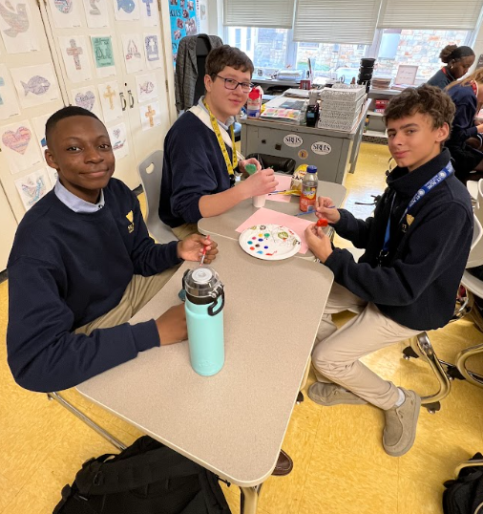
Peer to Peer
66% of young people first report suicidal thoughts to a friend (UCLA).
Friends are on the front lines of treatment every day.
It’s important to have conversations with students about what they can and cannot do for their friends’ mental health.
Notes:
“Friends are on the front lines supporting other friends every day. 66% of young people first report their suicidal thoughts to a friend. This is one reason why it’s so important for young people to understand signs & symptoms and know how to identify trusted adults. We also want to teach young people that there are limitations to the type of support they can offer a friend. So, it’s critical that we let young people know that we are here to support them.”

Slide 9
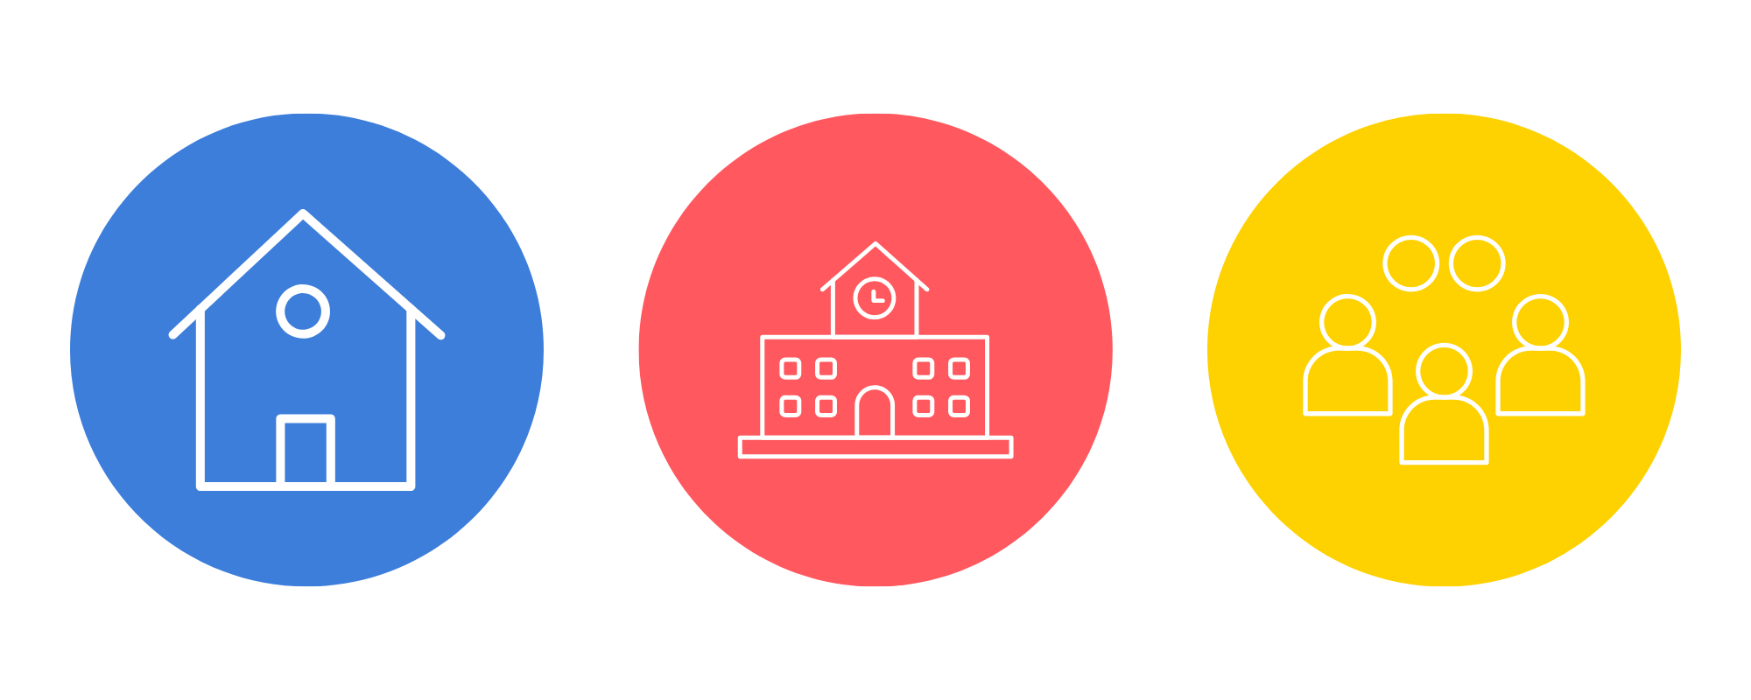
What is a Trusted Adult?
What comes to mind when you think of a trusted adult?
Students say it is someone who is a good listener, offers advice, shows empathy, or won’t make you feel silly for coming to them - someone they feel a connection with. A trusted adult is reliable and dependable.
Who may be a trusted adult?
The role of a trusted adult is to:
Listen and validate how hard it must be to confide in someone or to ask for help.
And then, help the student get to the appropriate person to provide the help or support they need.
Parent
Guardian
Grandparent
Family Member
School Counselor
Social Worker
Teacher
Coach
Religious Leader
Coach/Instructor
Mental Health Professional
Notes:
“Erika’s Lighthouse classroom programs emphasize and encourage students to identify who is their trusted adult and how to engage a trusted adult if they are worried about themself or a friend.
When students are asked to think about a trusted adult and what comes to mind - some of their responses include being a good listener, offering advice, showing empathy, or not making you feel silly for coming to them - someone they feel a connection with. A trusted adult is reliable and dependable. It’s important for students to know that a trusted adult may be found at home, in school or in the community. Your role as a trusted adult is to listen and help the student get to the appropriate person in the building to help them.”

Slide 10
What if a student wants to talk?
A student may reveal information which makes you and them feel uncomfortable.
Stay calm and listen
Thank them for trusting you
Be sure to take care of yourself
Remember
We can go a long way toward helping a child simply by acknowledging what they say and treating them with respect and sensitivity.
There are limits to the kind of support you can provide.
Teachers are not responsible for either diagnosing or treating a student.
Notes:
“During the course of a school year, particularly after a classroom program which discusses depression, suicide and good mental health, a student might reach out to you to express a concern or to ask a question about their own mental health. To ask for help about anything - even something as benign as not understanding an assignment - can be difficult for a teenager. This is a big step and perhaps the first time a student has verbalized that they are struggling.
It is important to stay calm and listen carefully. Acknowledging what they have said and really validating their experience.
Remember:
We can go a long way toward helping a child simply by acknowledging what they say and treating them with respect and sensitivity.
There are limits to the kind of support you can provide.
Teachers are not responsible for either diagnosing or treating a student.
Please know that it is ok if this interaction is emotional for you, too; it can be difficult to have this kind of intense conversation. However, it is equally important to remember to take care of yourself.”

Slide 11
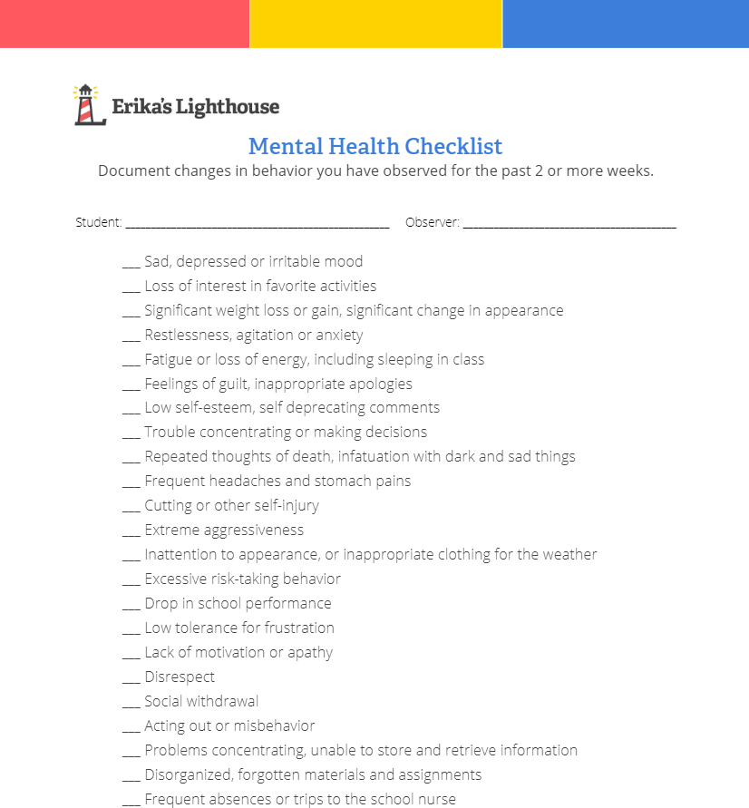
What if you’re concerned about a student?
There will be times when you may notice a change in behavior or performance of a student that has lasted two weeks or longer.
Document these changes using the Mental Health Checklist.
These changes may warrant a conversation.
Confer with your building’s mental health expert.
Schedule a private time for this conversation because a student might disclose some personal information to you.
Notes:
“You see students daily over the course of a semester. You may notice changes in a student long before a parent does. When your gut tells you that something doesn’t seem typical for a student, begin to document what you are seeing.
This mental health checklist will be helpful here. The first 9 symptoms are the DSM V (Diagnostic and Statistical Manual of Mental Disorders 5th edition) diagnostic list for depression. Below that are signs you may notice in the classroom like a drop in school performance, frustration, and inability to focus. Document changes in behavior for 2 weeks and then have a conversation with the student, referring back to what you see and using the language we will introduce to you on the next slide. Set aside a private time to meet because you are opening the door for disclosure.”

Slide 12
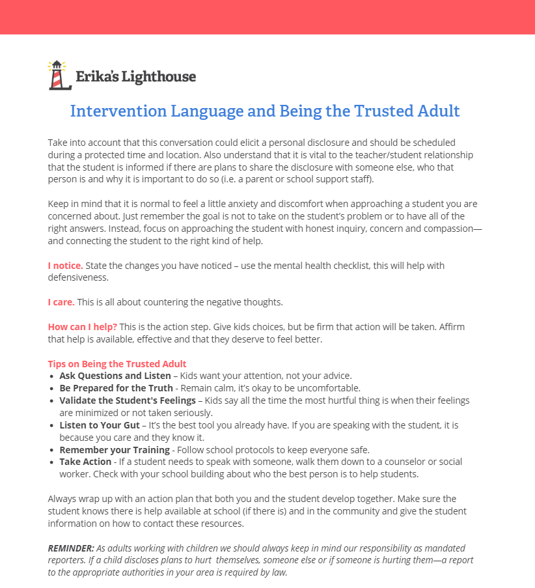
Intervention Language
“We need to talk…”
I notice.
“Is everything okay? I’ve noticed you have been….”
I care.
“I’m concerned because I know this isn’t normal for you.”
How can I help?
“What can I do to help? Let’s come up with a plan together.”
QUICK TIPS
Ask questions and listen
Be prepared for the truth
Validate the student’s feelings
Listen to your gut
Take action and follow up
Notes:
“This simple format will be helpful for tough conversations. Nobody likes to have uncomfortable conversations, but this may be the first step towards helping a young person get the help they deserve.
I notice.
“Is everything okay? I’ve noticed you have been….”
I care.
“I’m concerned because I know this isn’t normal for you.
How can I help?
“What can I do to help? Let’s come up with a plan together.”
Quick Tips
Ask questions and listen
Be prepared for the truth
Validate the student’s feelings
Listen to your gut
Take action and follow up
It must always end in action - even if a student says everything is fine, you are leaving the door open for future conversations.”

Slide 13
Responding to a Student
Unhelpful Response
Things could be worse.
You’ll catch up if you just put in a little effort.
Just relax. Stop worrying so much.
Helpful Response
I care about you. What do you think is causing you to feel this way?
Let’s come up with a plan together to help you catch up with some of your assignments. What can I do to help?
Being your age can be hard. I remember being a teenager and all the stress that came along with it. How can I help?
Notes:
“This slide gives some examples of unhelpful and helpful responses. Remember, we want to validate and encourage the conversation, not shut down the conversation.”

Slide 14
Talking about suicide or asking someone if they feel suicidal will give someone the idea and will encourage a suicide attempt.
That’s a MYTH
The FACT is that talking about suicide provides the opportunity for communication and help-seeking and reduces stigma.
Notes:
“Time for a myth or fact: So, myth or fact: talking about suicide or asking someone if they feel suicidal will give someone the idea and will encourage a suicide attempt.” (pause to let audience answer and click to show explanation) “That’s a myth. The fact is that talking about suicide provides the opportunity for communication and help-seeking and reduces stigma.”

Slide 15
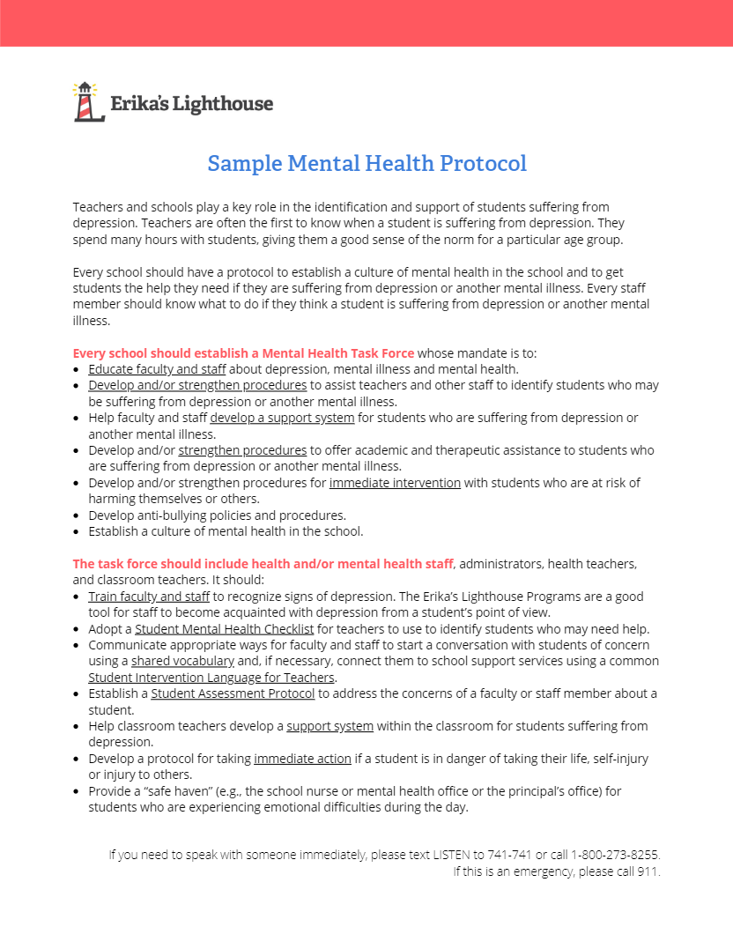
Following School Protocol
Every school should have a protocol and all staff should be aware of it. A protocol should be used to:
Establish a culture of mental health in the school.
Get students the help they need if they are suffering from depression or another mental illness.
Inform every staff member to know what to do if they think a student is suffering from depression or another mental illness.
Notes:
“This professional development training has been to raise your awareness of the issues of adolescent depression and suicide.”
Ensure that you provide the policy and guidance set by your school during this slide
Erika’s Lighthouse recommends that every school have a protocol and that all staff be aware of it. A protocol should be used to:
Establish a culture of mental health in the school
Get students the help they need if they are suffering from depression or another mental illness.
Inform every staff member to know what to do if they think a student is suffering from depression or another mental illness.

Slide 16
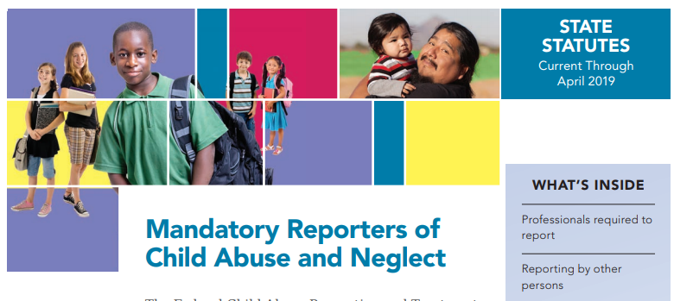
!
Being A Mandated Reporter
As adults working with children we should always keep in mind our responsibility as mandated reporters.
If a child discloses plans to hurt themselves, someone else or if someone is hurting them—a report to the appropriate authorities in your area is required by law.
Notes:
“It is important to keep in mind that we are mandated reporters.”
Please review your district’s policy(s) for mandated reporting

Slide 17
Everyone has someone they feel close to at school.
That’s a MYTH
The FACT is that only 55% of high school students report feeling close to people at school.
Notes:
“Let’s play myth or fact. Myth or fact: everyone has someone they feel close to at school” (pause and let the audience answer) “That’s a myth. The Fact is that only 55% of high school students report feeling close to people at school”

Slide 18
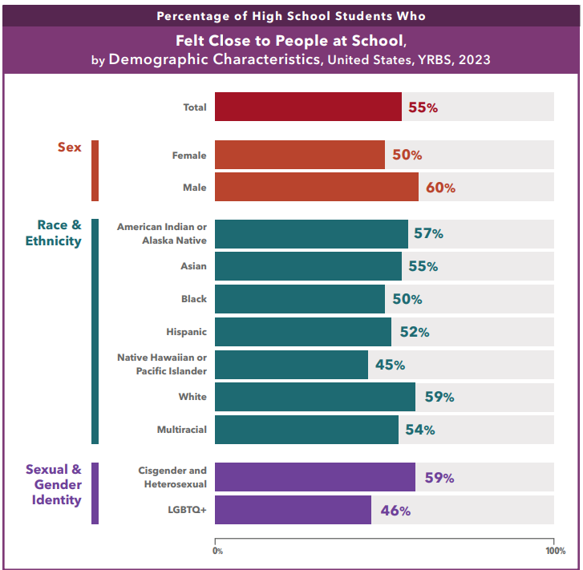
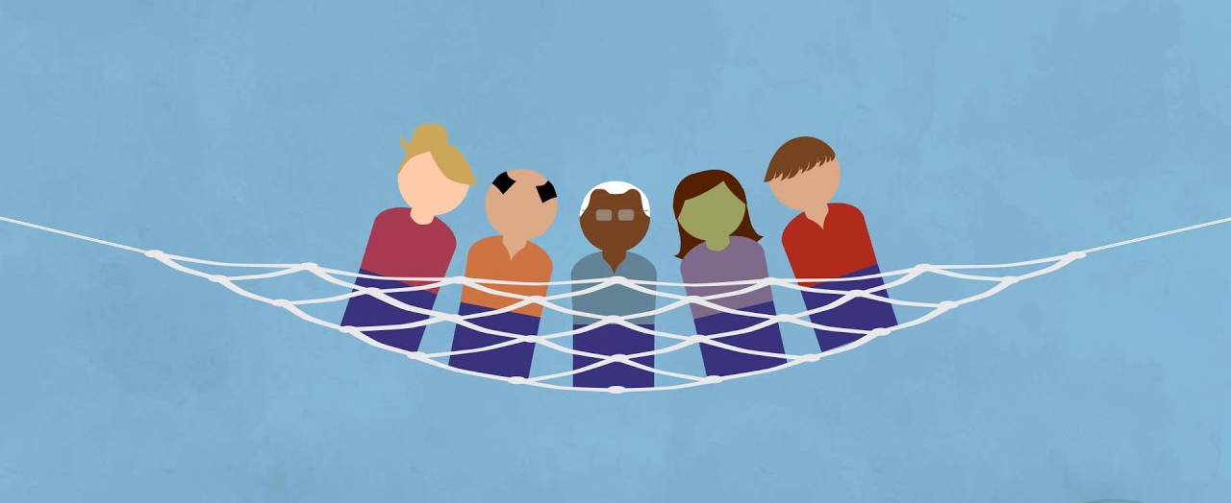
School Connectedness is a Protective Factor
Youth need to know someone cares about them.
Building a safety net around a student.
Based on 2023 CDC YRBS Data
Notes:
“In 2023, 55% of high school students agreed or strongly agreed that they felt close to people at their school, also referred to as school connectedness. We need to remember how important it is for young people to know someone cares about them. By being intentional about creating a school environment where young people feel supported and cared about, we are working to build a safety net for all students. The good news is that young people are resilient, and we know what works to support their mental health: feeling connected to school and family.”

Slide 19
Notes:
“We know that you go above and beyond to support students. But it’s equally important to take care of yourself. Carve out time for what you need to be mentally well. We care about your well-being, so please remember to do the things you need to take care of yourself.”

Slide 20
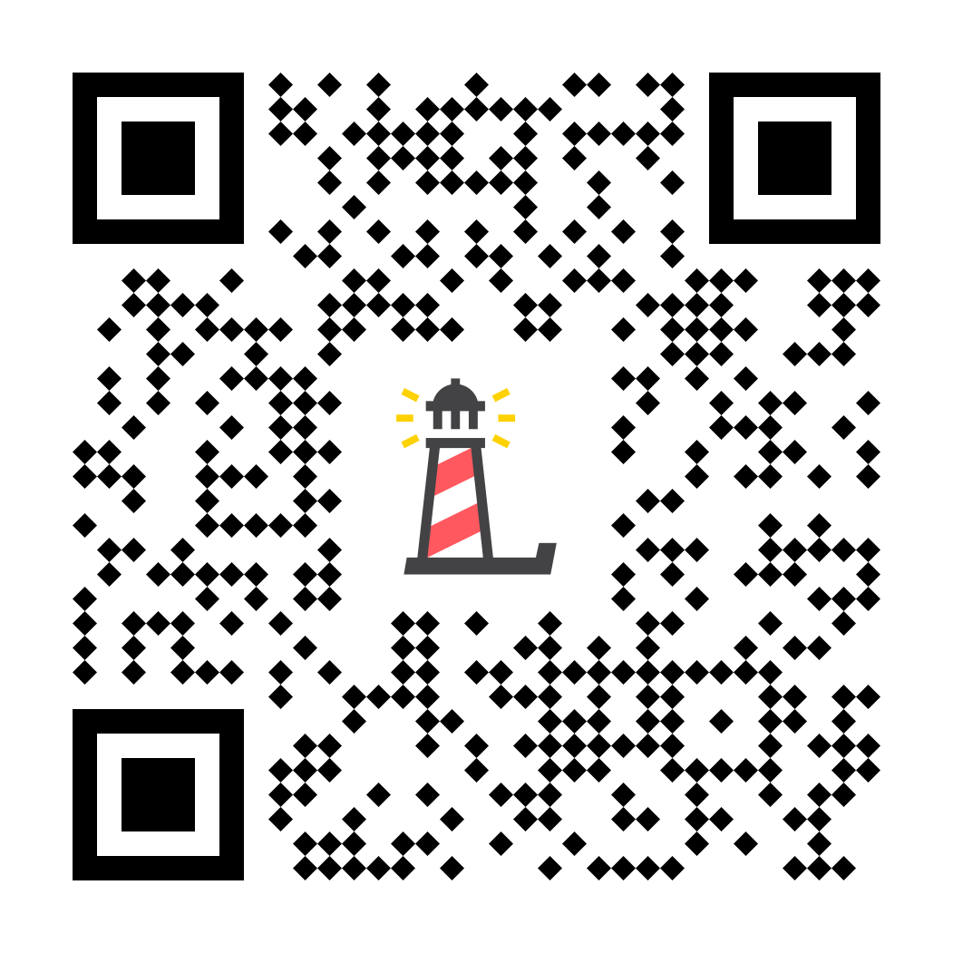
Thank you
Program Support
Katie Conklin - Vice President of Programs
Katie@erikaslighthouse.org
Ilana Sherman - Director of Education
Ilana@erikaslighthouse.org

