Slide 1
Welcome to Erika’s Lighthouse Staff Training
Notes:
Welcome to the Erika’s Lighthouse Staff Training. We’re glad you could join us.

Slide 2
Founded in 2004
Founded in 2004 after the loss of a 14-year-old who died from her depression; it was the second suicide in the community in the same school year
Mission-driven
Dedicated to educating and raising awareness about adolescent depression, encouraging good mental health and breaking down the stigma surrounding mental health issues
Free programs, always
All programs are no cost and focus on bringing our hopeful and empowering message to schools
Evidence-informed
Published in Advances in Social Work in January 2019 based on an independent evaluation conducted by Michael S. Kelly, PhD, LCSW, of the Loyola University Chicago School of Social Work
OUR STORY
Notes:
“Let me give you a bit of information about Erika’s Lighthouse - Erika’s Lighthouse is a National non-profit organization that started in 2004 after the loss of Erika, a 14-year old 8th grader who died from her depression.
Erika’s Lighthouse is mission-based, focused on mental health literacy, depression awareness, stigma reduction and empowering young people to take charge of their mental health. By using a teen voice, Erika’s Lighthouse is normalizing discussions around mental health and creating a common vocabulary for a topic that wasn’t discussed back when Erika died. Erika’s Lighthouse provides all of its evidence-informed programs at no cost and focuses on bringing these messages to elementary, middle and high schools.”

Slide 3
OUR CORE MESSAGE
Every student deserves good mental health.
Copyright © 2022. All rights reserved.
Notes:
“Erika’s Lighthouse wants all young people to know that they deserve good mental health.”

Slide 4
STAFF TRAINING
Part 1: Signs and Symptoms of Depression & Suicide
Part 2: Helping A Student
Part 3: Crisis Intervention
Notes:
“Part 1 of today’s staff training will cover the current statistics around youth mental health, signs and symptoms of depression and suicide and the importance of depression education. Part 2 will cover helping a student and how to have a conversation with a student if you are concerned about their well-being. Part 3 of the training will cover how and what to do in the event of a crisis.”

Slide 5
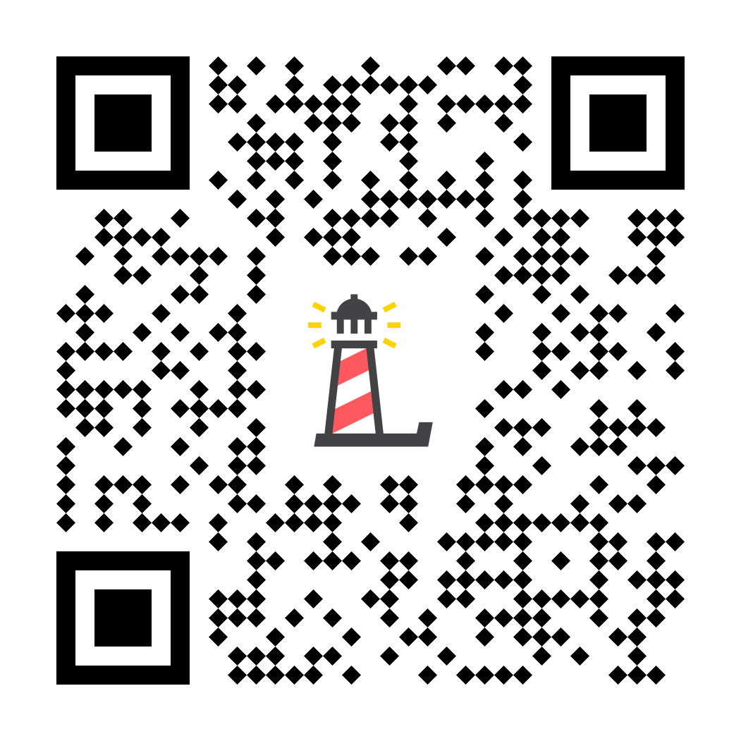
ERIKA’S LIGHTHOUSE PROGRAMS:
Tier-1
Prevention Focused & Early Identification
An Upstream Approach: Depression Education is Suicide Prevention
Building an Inclusive School Culture
Scan this QR code to gain access to all of Erika’s Lighthouse programs
Notes:
“If you are interested in learning more about the no-cost, tier-1 programs at Erika’s Lighthouse, please scan the QR code to create a Resource Portal account. When reviewing the multi-tiered systems of support (MTSS) framework, Erika’s Lighthouse falls in the tier-1 category. Erika’s Lighthouse wants all students to be educated on the signs & symptoms, help-seeking, and coping strategies. The programs are prevention-focused, promote early identification and take an upstream approach to suicide prevention: Depression Education is suicide prevention. Erika’s Lighthouse takes this approach because depression continues to be the most common mental health disorder among teens and the rates are rising. Lastly, when schools provide classroom education, family engagement, student-led empowerment clubs and staff training, they are working to build an inclusive school culture around mental health.

Slide 6
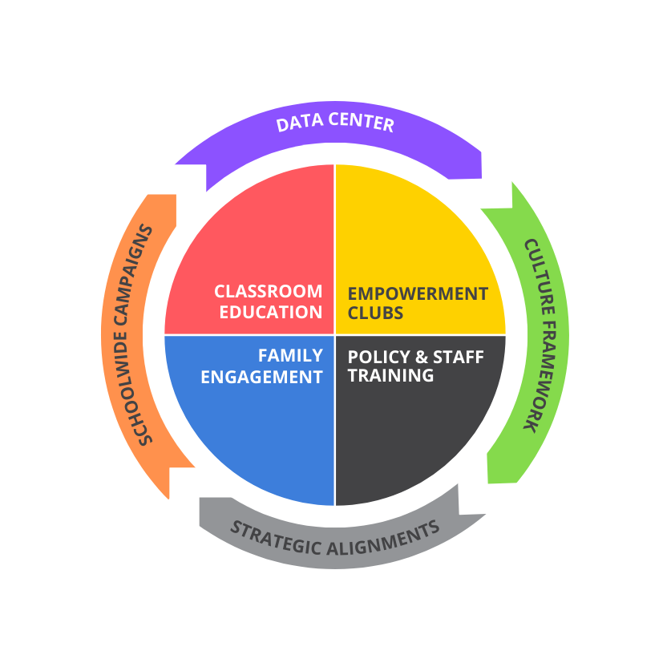
FREE PROGRAM MODEL
FOUR PILLARS
Classroom Education
Empowerment Clubs
Family Engagement
Policy & Staff Training
WRAPAROUND SUPPORTS
Schoolwide Campaigns
Culture Framework
Data Center
Strategic Alignments
Copyright © 2022. All rights reserved.
Notes:
“As an organization, Erika’s Lighthouse promotes inclusive school cultures around mental health by using a four-pillar approach to impact every stakeholder in a young person’s life. These four pillars include classroom education, student-led empowerment clubs, family engagement and school policy & staff training. In addition to these four pillars, Erika’s Lighthouse offers wraparound supports for schools. This includes, schoolwide campaigns, such as Give Voice for Suicide Prevention week in September, Positive Pledge for mental health awareness month in May, and more. There is a culture framework that can help schools establish their values and beliefs around supporting youth mental health. The data center offers assessment tools, program evaluations and school culture surveys. All of this and the data that schools can retrieve is free of charge. Lastly, we have strategic alignments where we partner with like minded organizations.”

Slide 7
Thank You & Enjoy the Staff Training
Program Support
Katie Conklin - Vice President of Programs
Katie@erikaslighthouse.org
Ilana Sherman - Director of Education
Ilana@erikaslighthouse.org
Notes:
“I hope you find this training informative and helpful. You have an opportunity to support young people and this is the first step. If you have any questions about Erika’s Lighthouse resources, you are welcome to reach out to one of their team members.”

