Slide 1
Implementation Training
for
Level II: Depression Awareness Classroom Program
Notes:
Welcome to the implementation training for the Erika’s Lighthouse Level II: Depression Awareness program. We’re glad you could join us.

Slide 2
LEVEL II IMPLEMENTATION TRAINING AGENDA
Erika’s Lighthouse Core Messages
Level II Objectives & Components
Addressing Sensitive Topics
Level II Content
Tips for a Successful Teaching
Notes:
The Level II implementation training will review the Core Messages from Erika’s Lighthouse, the objectives & components of the Level II program, how to address sensitive topics within the classroom, the content of the program and tips for successful teaching and implementation.

Slide 3
Classroom Education Programs
Use Together or Standalone. All are fully bilingual in English & Spanish
Level I: We All Have Mental Health (Ideal for gr. 4-6)
Introduction to mental health by understanding everyday feelings vs. overwhelming feelings with a strong focus on help-seeking and good mental health.
Level II: Depression Awareness (Ideal for gr. 5-9)
Introduction to depression by recognizing signs and symptoms with a strong focus on help-seeking and good mental health.
Level III: Depression Education & Suicide Awareness (Ideal for gr. 8-12)
Introduction to depression and suicide with a strong focus on help-seeking and good mental health.
Notes:
Erika’s Lighthouse offers 3 classroom programs that are designed to educate students about mental health, depression, suicide, good mental health and help-seeking behaviors. This implementation training is focused on Depression Awareness, our Level II program. The Level II program provides an introduction to the topic of depression and is ideal for middle school and early high school students, in grades 5-9. The program is fully bilingual in English and Spanish. The lessons and activities are designed to increase young people's knowledge of depression, decrease negative attitudes of depression and its treatment, increase self-advocacy and peer to peer intervention and increase engagement in good mental health behaviors.

Slide 4
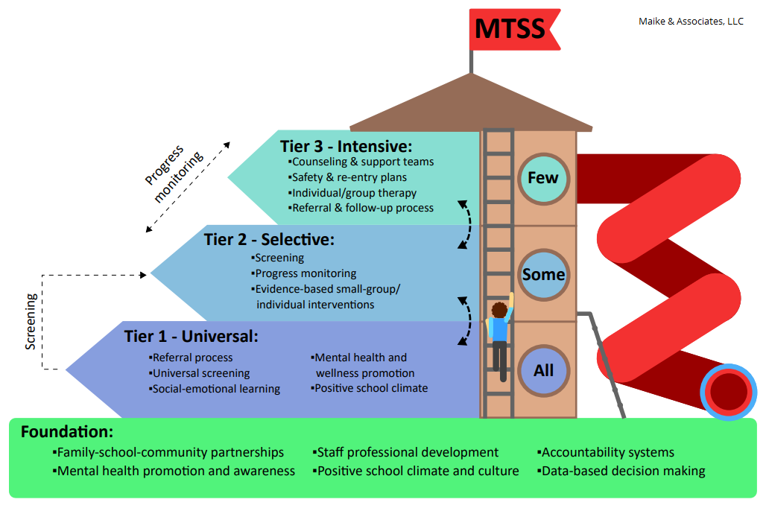
MTSS AREA OF FOCUS
What more can we do here?
What can we do better?
Notes:
When we look at the multi-tiered system of supports (MTSS), there are foundational, tier-one, tier-two, and tier-three levels. Erika’s Lighthouse fits into the tier-one, foundational level of MTSS. We want all students to be educated on mental health, signs and symptoms of depression, positive coping mechanisms, help-seeking skills and good mental health behaviors. That being said, these are sensitive topics.

Slide 5
Representation Matters
Addressing Sensitive Topics
In order for students to feel safe and be fully engaged in the lessons, there are some important things to do when this program is introduced to students.
Establish Group Norms
Answer Difficult Questions
Be Sensitive & Trauma Informed
Notes:
In order for students to feel safe and be fully engaged in the lessons, there are some important things to do when introducing the program to students. On the coming slides, we will review how to establish group norms, answer difficult questions that may arise and provide reminders about the importance of being sensitive and trauma informed.

Slide 6
Representation Matters
Establishing Group Norms
Here are some guidelines you may find useful in helping students come up with them:
Everyone should be involved in creating the group norms.
Use guiding questions to help students identify the norms that will achieve a safe and caring classroom:
Some examples of group norms that are brainstormed may include:
Listen to others’ perspectives
Maintain confidentiality
Participate
Right to pass
Respect differences
Notes:
it is important to establish group norms. Group norms are ways that groups of people can work together in a thoughtful, respectful, safe and productive way. Here are some guidelines you may find useful in helping students come up with group norms:
Everyone should be involved in creating the group norms.
Use guiding questions to help students identify the norms that will achieve a safe and caring classroom: Some examples of guiding questions are:
How can we be sure that people will be able to safely share private information and feelings?
How can we be sure that everyone has a chance to freely share and that they are heard?
How can we be sure that people are not forced to say or do something that makes them feel uncomfortable or unsafe?
Some examples of group norms that are brainstormed may include:
Listen to others’ perspectives
Maintain confidentiality
Participate
Right to pass
Respect differences

Slide 7
Representation Matters
Answering Difficult Questions
It may be helpful to follow this protocol when responding to difficult questions:
Affirm that the student’s question is legitimate. Restate it for clarification and acknowledge that others might also wonder about this. “Thanks for asking that. I am sure other people would like to know about...”
Identify if there is a belief/value that is inherent in the question. Point out anything about the question that might be opinion-related. It is important to express the range of opinions without identifying that any single opinion is the right one. “Some people might believe…while others believe…”
Answer the factual part of the question. “Here is what is known to be true…”
Refer to a trusted adult. “This would be a great question to ask your (aunt, dad, caregiver, etc.)”
Check back. “Did I answer your question?”
Leave the door open. “If you have any other related questions, I hope you will feel free to ask.”
Notes:
Sometimes when covering sensitive content such as emotions, social influences, and personal topics, questions may arise that are difficult to answer. Sometimes, the question may relate to personal values that are not universally shared. Or the question might have more than one answer depending on a person’s values, beliefs, and personal history.
It may be helpful to follow this protocol when responding to difficult questions:
Affirm that the student’s question is legitimate. Restate it for clarification and acknowledge that others might also wonder about this. “Thanks for asking that. I am sure other people would like to know about...”
Identify if there is a belief/value that is inherent in the question. Point out anything about the question that might be opinion-related. It is important to express the range of opinions without identifying that any single opinion is the right one. “Some people might believe…while others believe…”
Answer the factual part of the question. “Here is what is known to be true…”
Refer to a trusted adult. “This would be a great question to ask your (aunt, dad, caregiver, etc.)”
Check back. “Did I answer your question?”
Leave the door open. “If you have any other related questions, I hope you will feel free to ask.”

Slide 8
Representation Matters
Being Sensitive & Trauma-Informed
Students:
Come to the classroom with many different values, cultural and religious beliefs, and ideas about these topics.
May have experienced trauma of some sort in their life, it may have an impact on their ability to thrive and be healthy.
May have difficulty sharing ideas and discussing these issues with their peers.
Educators should:
Infuse language and guidelines to support sensitive and personal discussions in classrooms.
Seek opportunities to instill hope, resilience, safety.
Switch your mindset-”remember the student who has experienced trauma is not trying to push your buttons.
Notes:
Any time a sensitive topic is addressed in the classroom, it is important to ensure that all students are protected from potential trauma. We need to approach the topic with sensitivity and from the lens of being trauma informed. So what does that mean to be trauma-informed?
Students:
Come to the classroom with many different values, cultural and religious beliefs, and ideas about these topics.
May have experienced trauma of some sort in their life, it may have an impact on their ability to thrive and be healthy.
May have difficulty sharing ideas and discussing these issues with their peers.
Educators should:
Infuse language and guidelines to support sensitive and personal discussions in classrooms.
Create routines to promote a feeling of stability and comfort. Kids who have been through trauma, worry about what’s going to happen next.
Create a classroom community that builds connections with students and let them know you are here to help them succeed.
Seek opportunities to instill hope, resilience, and safety.
Greeting your students in the hall, offering praise, listening non-judgmentally all help to foster resiliency in your students.
Talk to the student 1 on 1. Ask gently what going on in their life and what you can do to support them-maybe listening to music, taking a walk, or having a snack will help them get through the day.
Switch your mindset-”remember the student who has experienced trauma is not trying to push your buttons. Positive interactions might seem small but they can build resilience.”

Slide 9
Level II Core Messages
Notes:
We want you and the young people you are with everyday to know that depression is real, it’s common (in fact, 15-20% of young people will experience depression before adulthood), it’s serious (90-98% of suicides are a result of a diagnosable mental illness – the vast majority being depression) and it’s treatable. Just as important as the signs and symptoms of depression, we teach our young people that everyone deserves good mental health and we carry the message that you are not alone and that there is always hope. That is a key component for our students and our educators to understand.

Slide 10
Level II: Depression Awareness
teaches young people the skills to seek help through depression education that is teen centered, factual and hopeful.
AUTHENTIC
Real stories from real teens
EMPOWERING
Teens can find their voice
ACCESSIBLE
Flexible and ready to use
HOPEFUL
Not fear-based; comes from the heart
Notes:
Fighting adolescent depression requires compassion, empathy, and education. Our depression programs provide educators with youth-oriented materials that raise awareness, teach skills, encourage conversation, promote early identification and prevention, and help show teens that they are never alone. So many young people do not seek help they need. By raising awareness of depression and reducing the stigma that surrounds it through education that is teen-centered, factual and hopeful, we can change that.
All programs are easy to download and implement and are available at no cost. The messages that come from Erika’s Lighthouse are hopeful, never dark, sensational or fear based. We focus on good mental health. Absolutely everyone, even those not going through depression, can learn to take care of themselves. Our classroom programs are tier one, early intervention, and early identification programs.
This program can serve as your school’s primary depression and suicide awareness teaching tool or can be used to supplement the education you’re already providing your students through your own lesson plans, textbooks, other curricula and/or guest speakers. Student education can be delivered in whatever class makes the most sense - health class or advisory, and can be taught by a health teacher, social worker, and/or counselor in conjunction with another classroom teacher. Know that when you use our classroom programs as part of your depression and suicide prevention education -we are here for you. We are committed to partnering with you as you teach this program. Please let us know how we can best support you.

Slide 11
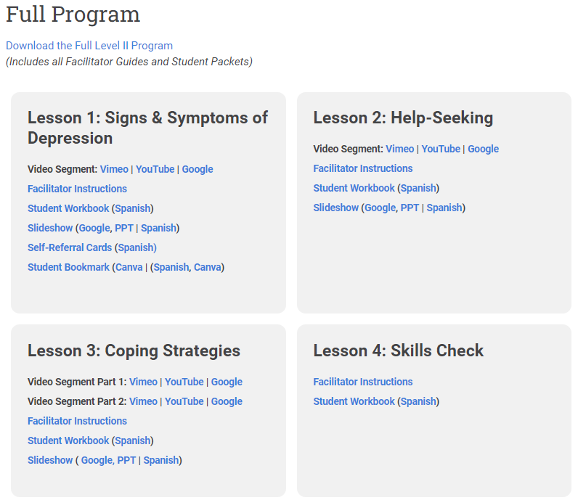
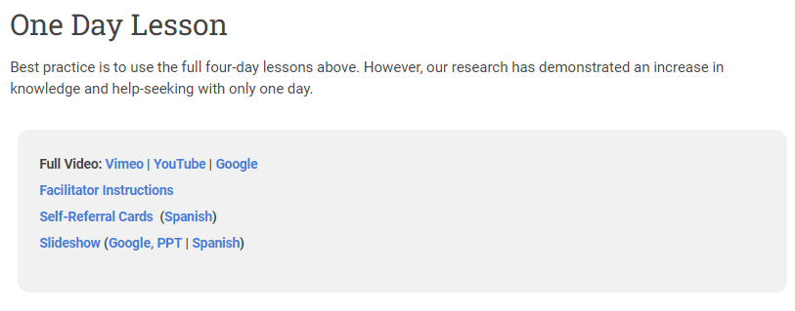
Choose Your Path for Level II
Determine which version you will be teaching:
Full Program:
Made up of 4 lessons
Each lesson is 40-45 minutes
Meets National Health Education Standards
1-Day Lesson:
One lesson that is a condensed version of the Full Program.
The lesson is 40-45 minutes
Notes:
One of the first steps to take as you prepare to teach the Level II program is to choose your path. Two versions of the Level II program are available to teach - the Full version or the 1-Day version. The full version is made up of 4 lessons, each running about 40-45 minutes in length. Teaching the full version of Level II meets National Health Education Standards. The 1-day lesson is made up of one lesson, running about 40-45 minutes in length and this is a condensed version of the full program.

Slide 12
Objectives of Level II: Full Program (4 lessons)
Lesson 1: Signs & Symptoms of Depression
Define depression as a mood disorder
Describe the signs & symptoms, risk factors and resources for depression
Learn how to access a reliable, trusted adult at school
Lesson 2: Help-Seeking
Stigma
Treatment
Demonstrate how to reach out for help for themselves or a friend
Lesson 3: Coping Strategies
Demonstrate how to help themselves or others
Discuss what we can all do to support mental health
Demonstrate the ability to use interpersonal communication skills to support health and well-being of self & others
Lesson 4: Student Skills Check
Establish a plan for maintaining or improving their mental health
Notes:
Each lesson in the full version has objectives. In lesson 1 students will define that depression is a mood disorder, be able to describe the signs & symptoms, risk factors and resources for depression. They will also learn how to access a reliable, trusted adult at school. In lesson 2, students will understand stigma, the treatment available for depression, and demonstrate how to reach out for help for themself or a friend. In lesson 3, students will demonstrate how to help themself or others, discuss how to support their mental health, and demonstrate the ability to use interpersonal communication skills to support health and well-being of themself and others. Lesson 4 is a student skills check where students can establish a plan for maintaining and improving their mental health.

Slide 13
Objectives of Level II: One-Day Lesson
This one-day version of the program consists of an engaging and interactive lesson designed to be taught to provide students with increased:
knowledge of key concepts related to identifying depression
self-advocacy and peer-to-peer intervention to promote help-seeking
awareness of how they can support their own mental health and well-being
Notes:
The 1-day version of the Level II classroom program consists of an engaging and interactive lesson designed to be taught to provide students with increased
-knowledge of key concepts related to identifying depression
-self-advocacy and peer-to-peer intervention to promote help-seeking
-awareness of how students can support this own mental health and well-being

Slide 14
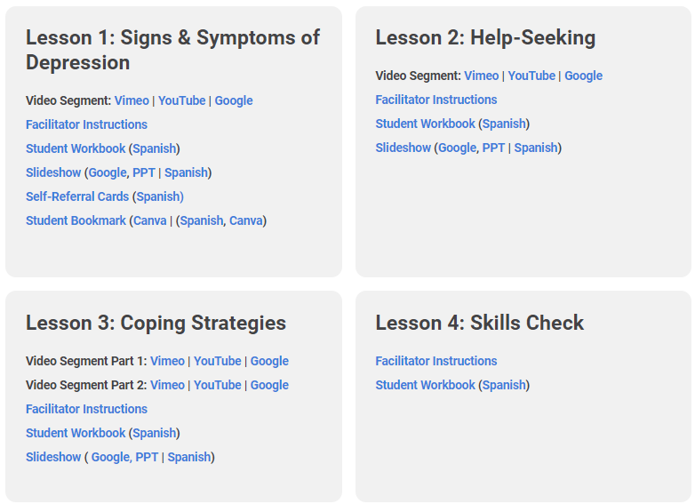
Components of Level II Program
Videos
Content video
Student Story Vignettes
Facilitator Instructions
Student-facing Slides
Student Workbooks
Self-Referral Cards
Student Bookmarks
Pre- and Post-Tests
Notes:
Everything you need to teach the Level II program is on the Resource Portal. The Full and 1-day program are video-based programs that include a facilitator guide, student-facing slides, student workbooks, self-referral cards, student bookmarks and pre and post tests. On the right side of the slide, you can see what the Full program looks like on the resource portal.

Slide 15
Plan & Implementation for Teaching Level II
Step 1: Prior to teaching every lesson
Read through the Facilitator’s Guide
Watch the video(s)
Determine if your students will select their own vignettes to watch or if you will choose the vignettes for them.
Review the slides
Prep classroom materials & pre/post tests
Step 2: Remind the school mental health team that you are teaching this programming (if using self referral cards).
Step 3: Teach program
Step 4: Complete the required Erika’s Lighthouse Report on Impact form
Step 5: Complete the Educator Evaluation Survey
Notes:
Here are some steps to take before you teach each lesson: review the Facilitator Guide, watch the video, review the student-facing slides and prep any classroom materials and/or pre and post test for your students. We recommend informing the school mental health team that you are teaching this program, especially if you will be using the self-referral cards. Once you have completed the first two steps, you are ready to teach the program. After you teach, please complete the required Report on Impact form letting Erika’s Lighthouse know you have taught the program and then complete the Educator Evaluation Survey.

Slide 16
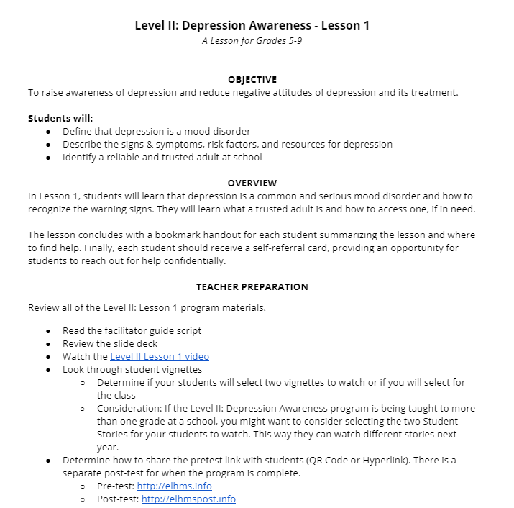
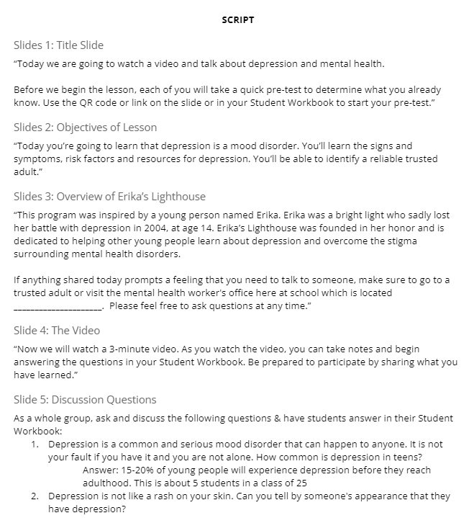
Representation Matters
Level II Facilitator Guide
Notes:
We’re now going to go through some of the resources you will use to teach the Level II program. Both versions of the Level II program have a complete facilitator's guide for you to use. The facilitator’s guide lists all of the materials that you will need to teach the program. It also includes a full teaching script that pairs with the student facing slide deck.

Slide 17
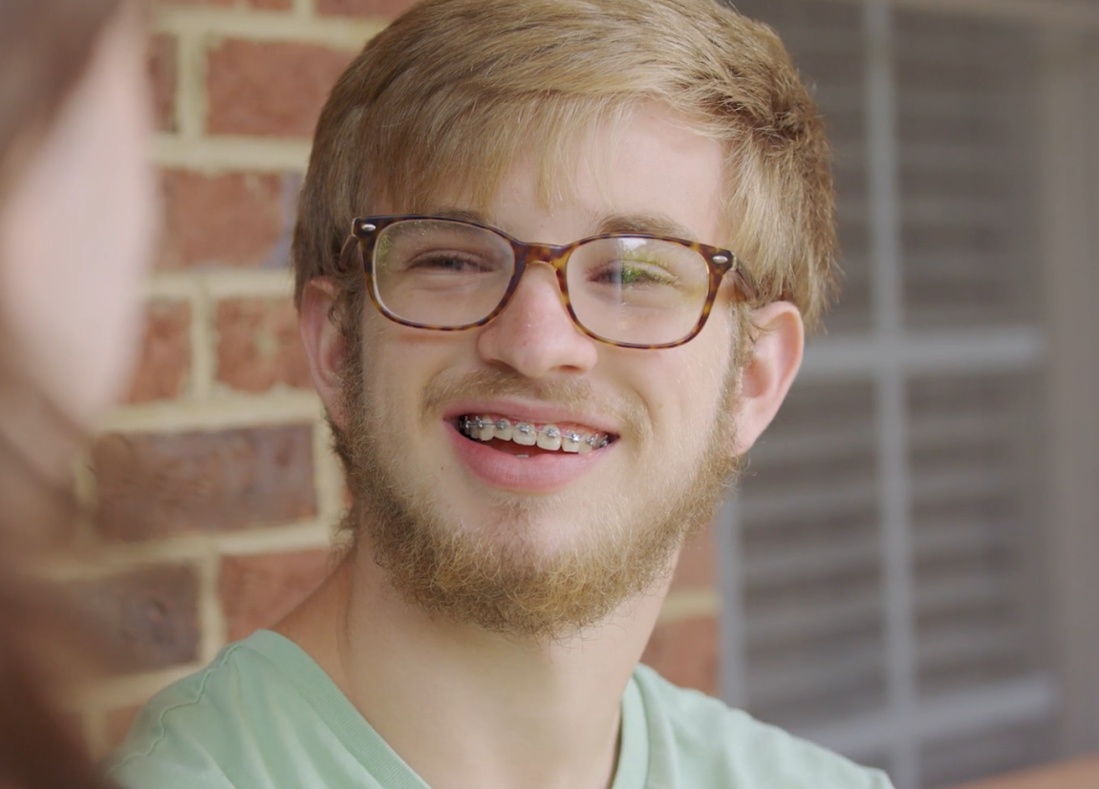
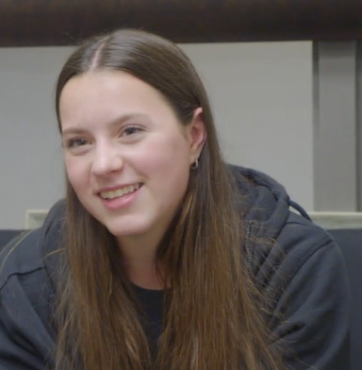
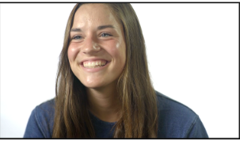
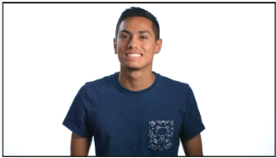
Representation Matters
Notes:
One strength of our classroom programs is our videos. And a strength of our videos is their authenticity. The teens in the videos are real teens, not actors, talking about their life, their depression, how it started, what has helped them, who has helped them, and how they practice good mental health. In our Level II program, the messages delivered come from young people who look and sound like most students, making it easier for a young person to recognize themselves in our videos.

Slide 18
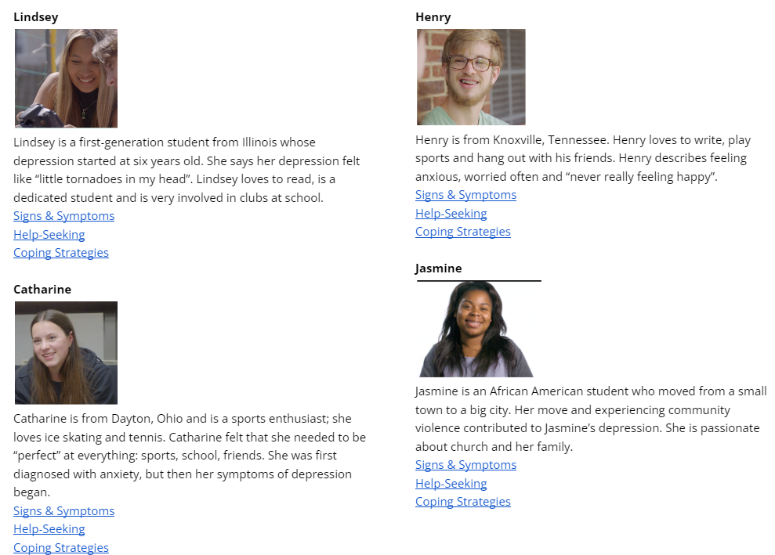
Navigating the Student Story Vignettes
Notes:
Each lesson in the Level II program has an opportunity for students to select which student story they would like to learn more about. The links to the student stories are divided into 3 categories - Signs & Symptoms, help-seeking and coping strategies, which aligns with each lesson topic. You may choose to listen ahead of time to the student stories and pre-determine which student story you would like your students to learn about. The format of this program allows for a lot of small group work and opportunity for students to dive deeper if you’d like.

Slide 19
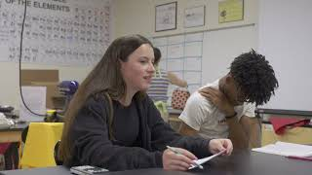
Notes:
We are going to meet Catharine and hear how she describes her signs and symptoms of depression. We hope this gives you a nice overview of the messages in the Level II program.

Slide 20
Level II Slides
Representation Matters
Notes:
Each lesson has its own student facing slide deck. Here is a sample of one of the slide shows. We encourage you to take a look at each deck prior to showing them to students.

Slide 21
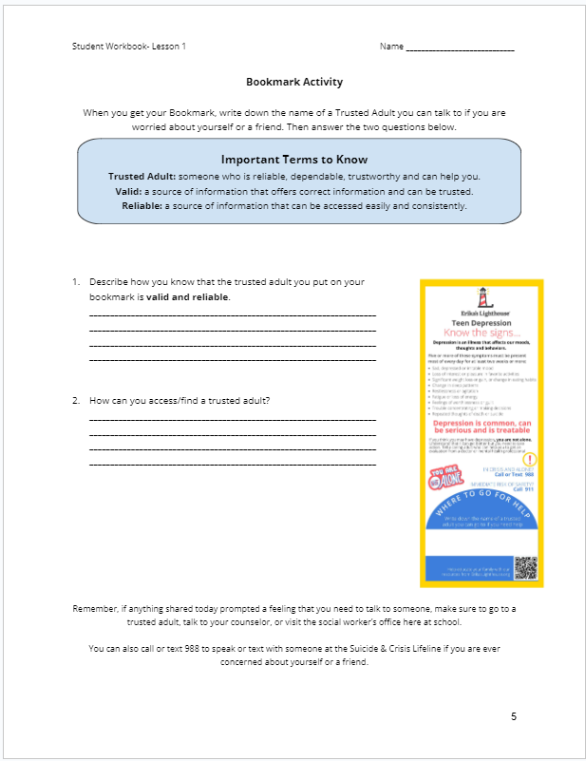
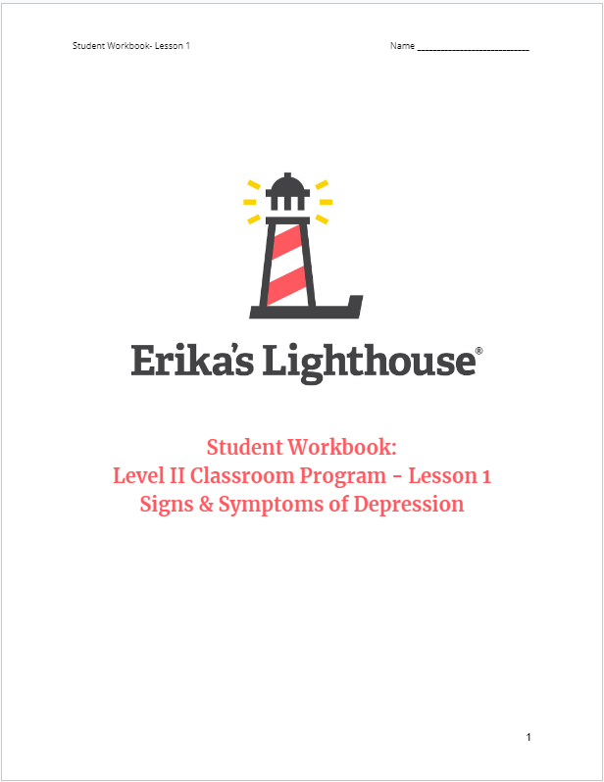
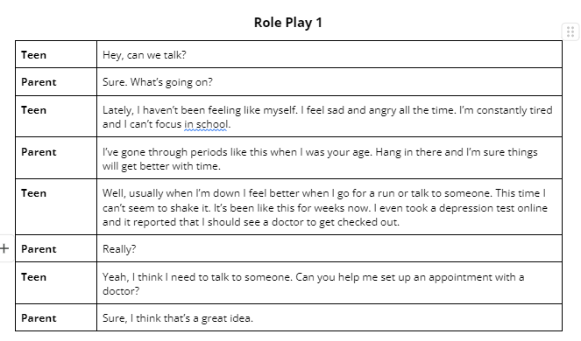
Level II Student Workbook
Notes:
The student workbooks are used in a variety of ways. First, students will record their answers to the video prompts in the workbook. Second, they can keep the workbooks so that they have access to important information, such as the role play, who they identify as their trusted adults, and a prompt for how to ask for help, if needed. We recommend either printing a copy for each student or using the fillable form.

Slide 22
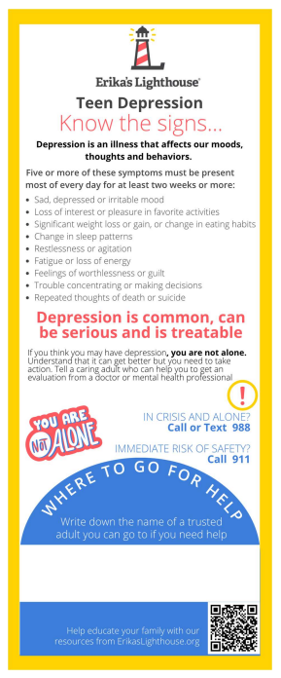
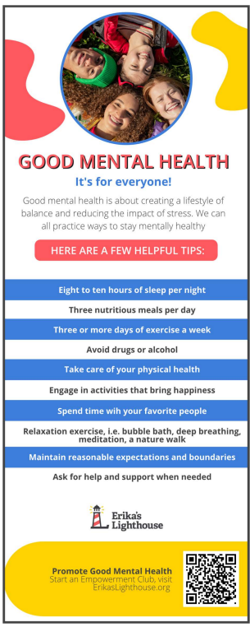
Student Bookmarks
Ideas of trusted adults:
Parent/Guardian
Aunt/Uncle/Grandparent
School Counselor
Coach
Teacher
Religious Leader
Therapist
Notes:
We want to ensure that students know where they can access a trusted adult at school. So, the student bookmarks have a blank space for you or the students to write down the name of the school counselor or school social worker. We encourage you to also include their office number so that students know where they can locate them in the building. If your school does not have an onsite counselor or social worker, you can encourage the students to write down who they identify as a trusted adult. That could be a family member, coach, someone in their community, or YOU!
You will notice, that on one side the student bookmark lists the signs and symptoms of depression and on the other side, there are tips for taking care of their mental health.

Slide 23
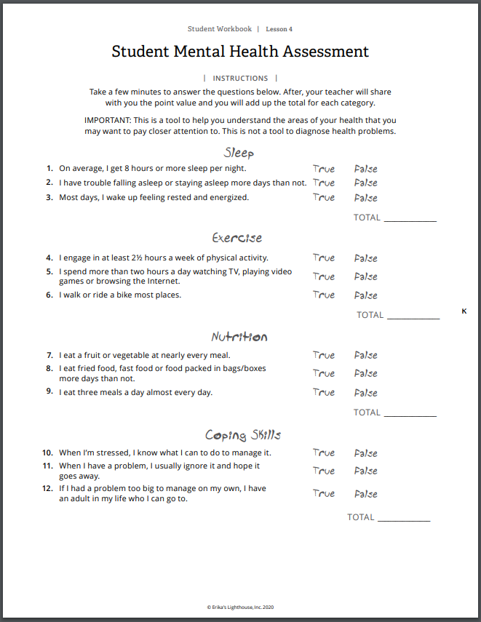
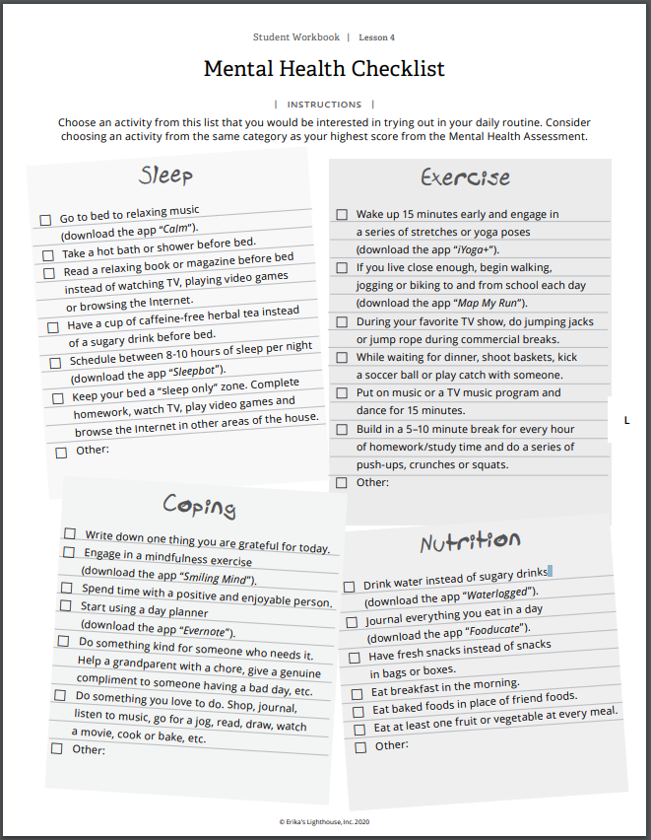
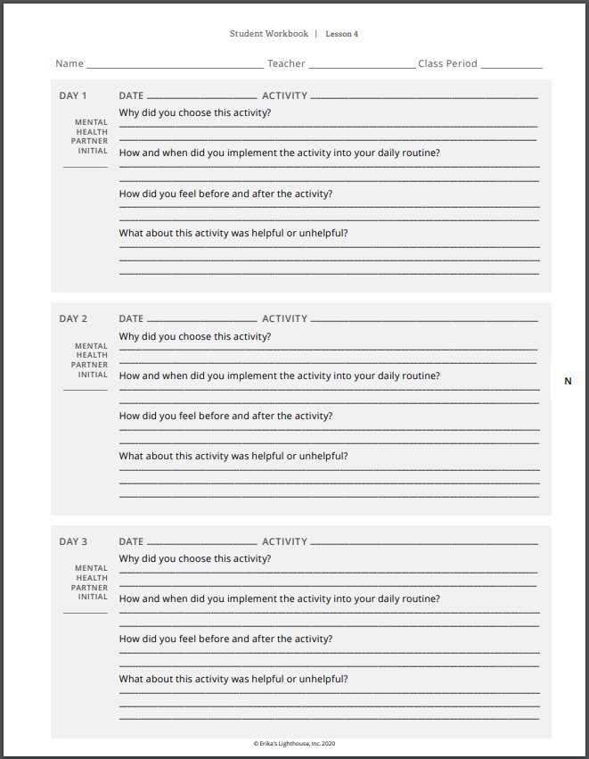
Student Skills Check - Lesson 4
Notes:
Lesson 4 is a skills check. There are three portions for the skills check: a true/false quiz, a mental health checklist, and a mental health journal. These assignments are optional and just ideas, if you have an idea that feels more appropriate for your students you are welcome to use something different.

Slide 24
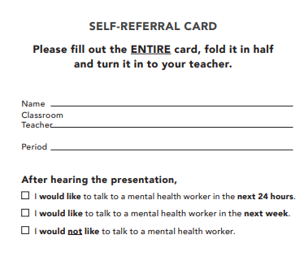
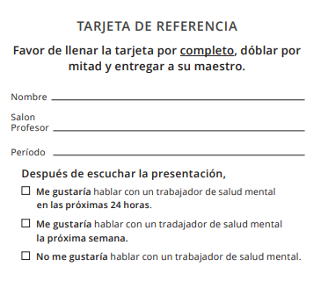
Self-Referral Card
Work with the school counselor(s) or other mental health professionals in the school for this process.
Notes:
Erika’s Lighthouse does not use screeners, we use a self-referral card. Here you can see an example of the it. On this card, it gives students the option of choosing the following: I would like to speak to a mental health worker in 24 hours, in 7 days, I do not need to speak to someone. If you will be using the self-referral cards, please ensure that every student turns one in at the end of the lesson.
Like everything else in our program, you have flexibility and choice about using the self- referral cards. However, if you are planning to use them please make sure to collaborate with the mental health professionals in your building as they may see an uptick in the number of students who need support.

Slide 25
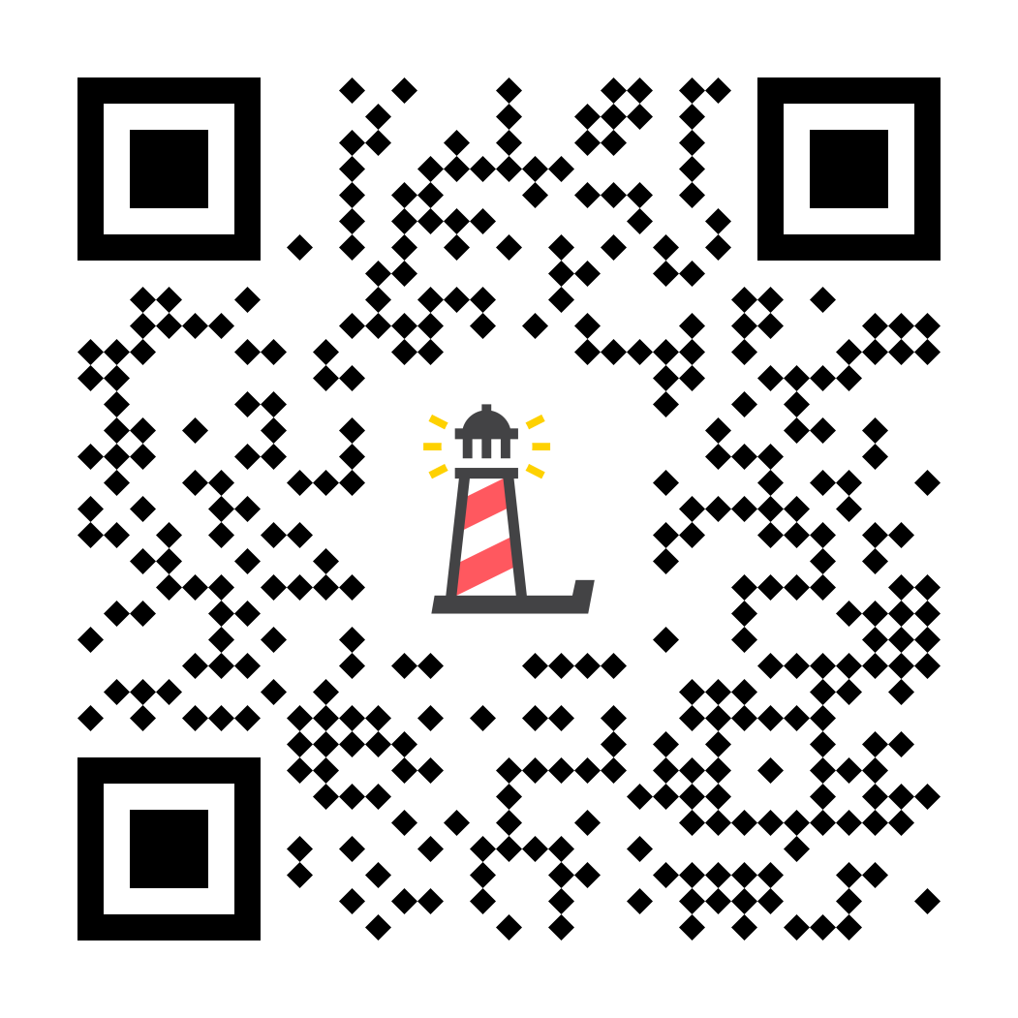
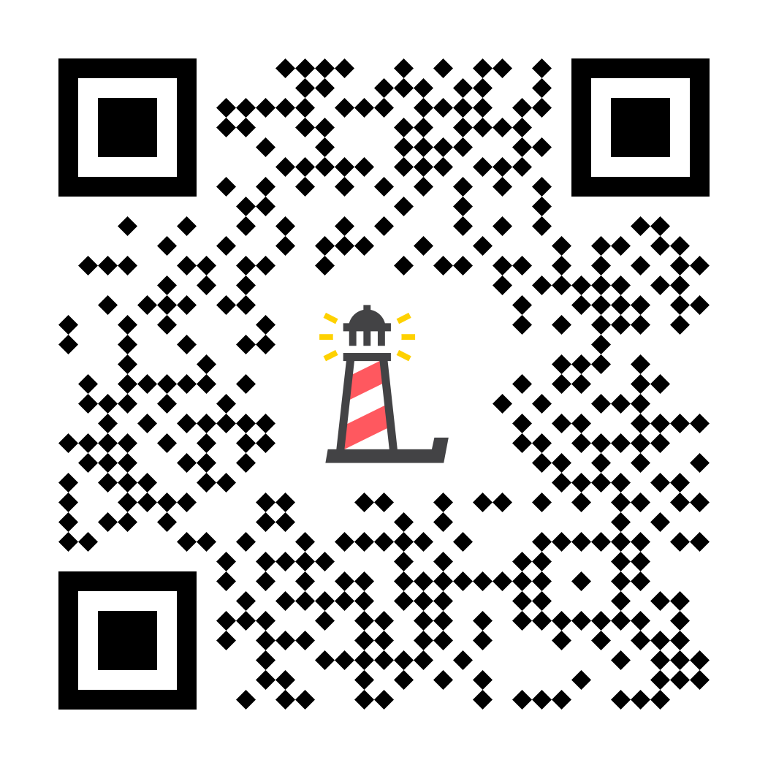
Level II Pre/Post Test
Pre- and Post-Tests
Notes:
We ask you to have students complete the pre and post tests as part of teaching the Level II program. If teaching the full program, students will complete the pre-test before Lesson 1 and will complete the post-test after Lesson 3. If teaching the 1-day lesson, students will complete the pre test before the lesson and the post-test after the lesson. The results of the pre and post tests can be found on the Erika’s Lighthouse Data Center on the Resource Portal, which is updated daily.

Slide 26
TIPS FOR A SUCCESSFUL PROGRAM
Our programs are extremely FLEXIBLE- if you need more time or to cut something from a lesson, you are welcome to do so.
Best practice is to teach this program at the classroom-level, not auditorium-style due to the sensitive & personal nature of the topic.
You know your students best. You know what content they are ready for and how to continue the conversation in meaningful ways.
Best practice is to NOT deliver program on a Friday or before an extended break - especially with the self-referral cards.
Pick a day with extra support
Have a plan for self-referrals and who is going to support that process (admin, mental health staff, nurses etc.)
Notes:
After our many years working with schools, we have developed some helpful tips for a successful program. First, our programs are extremely flexible. You can edit slide decks, cut something or add something from a lesson. Please feel free to make the script and the program materials work for you. Second, you know your students best.You know what content they are ready for and how to continue the conversation in meaningful ways. It is best practice not to deliver this program at the end of a day or on a Friday and to make sure there is extra mental health support on the days the programs are taught. And lastly, a plan should be in plan for how to handle self-referrals and who will be supporting that process. Please know that Erika’s Lighthouse education team is here to support you. Should you have any questions or concerns you are welcome to contact them
‹#›

Slide 27
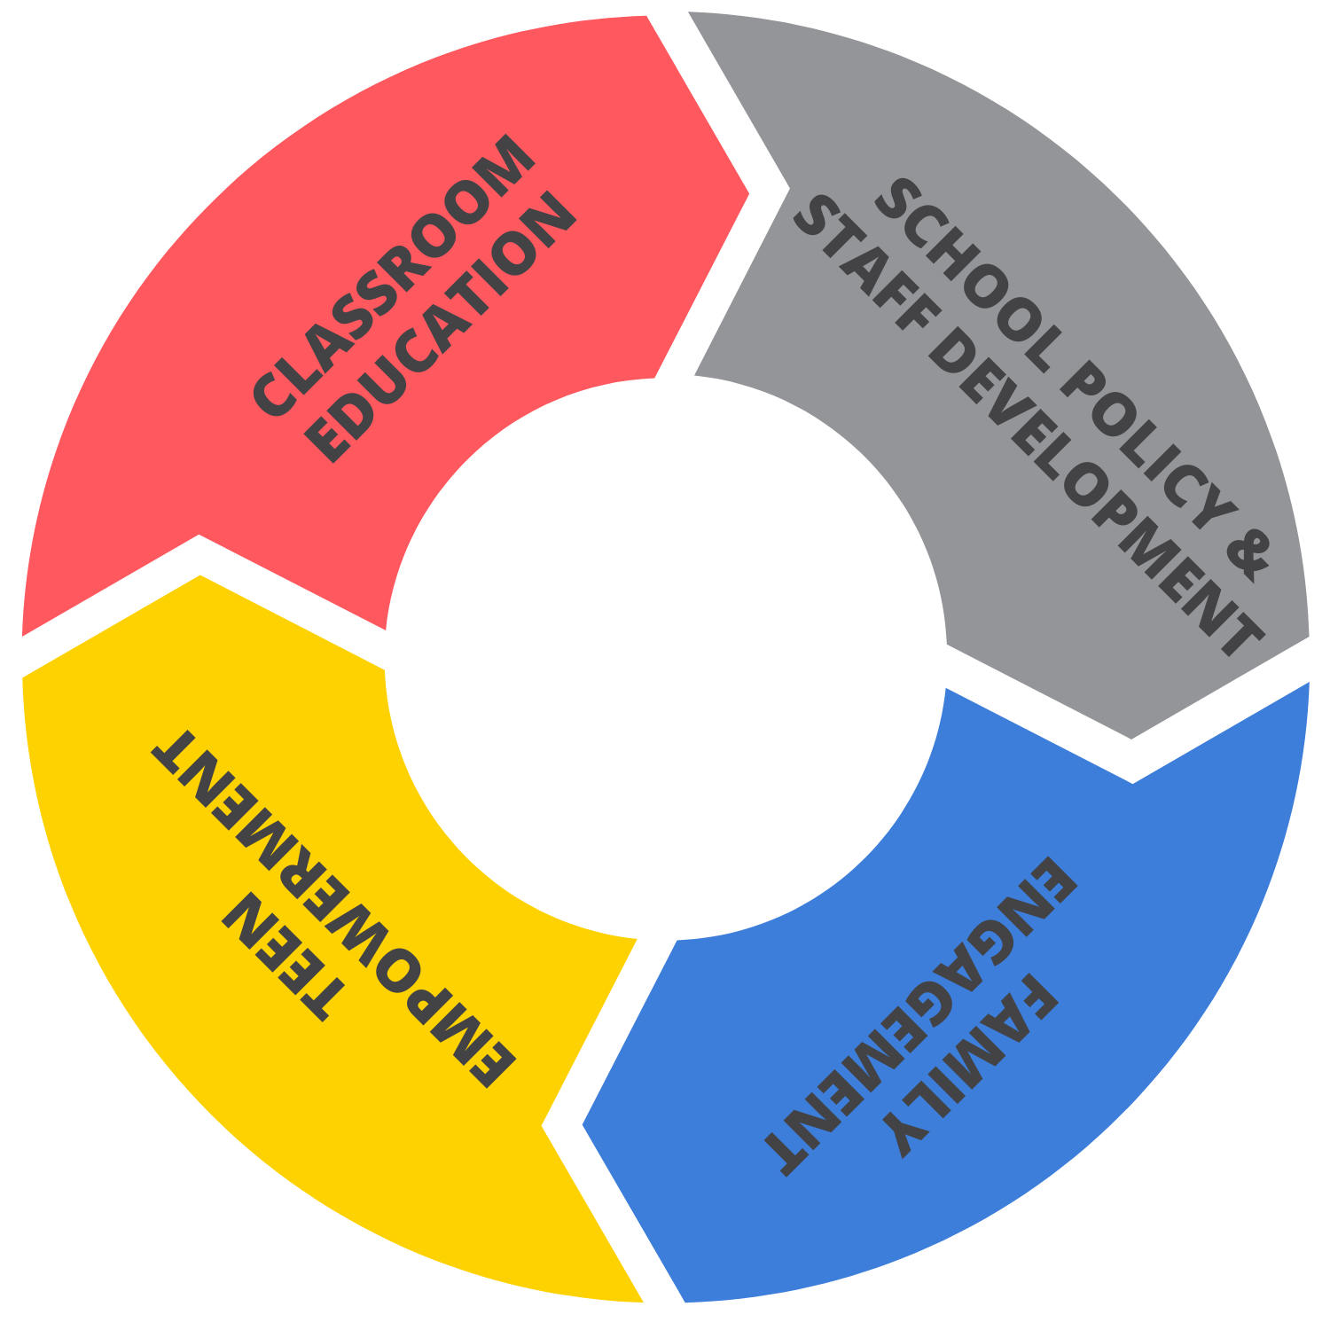
OUR FREE PROGRAMS
Level I: We All Have Mental Health
All Staff Training
Culture Change Framework
Level II: Depression Awareness
Strategic Partnerships
Level III: Depression Education & Suicide Awareness
On-Demand Support
Empowerment Clubs
EMPOWERMENT
CLUBS
Family Workbook Series
Affiliate Clubs
Family Workshops
Awareness into Action Activities
Family Activities for Home
School Wide Activities: Mental Health RECHARGE | Give Voice | Positivity Pledge
Notes:
“As an organization, Erika’s Lighthouse promotes inclusive school cultures around mental health by using a four-pillar approach to impact every stakeholder in a young person’s life. These four pillars include classroom education, student-led empowerment clubs, family engagement and school policy & staff training.”

Slide 28
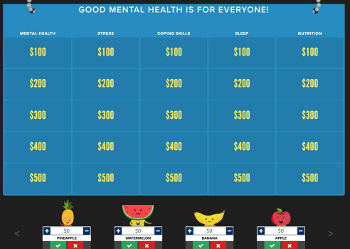
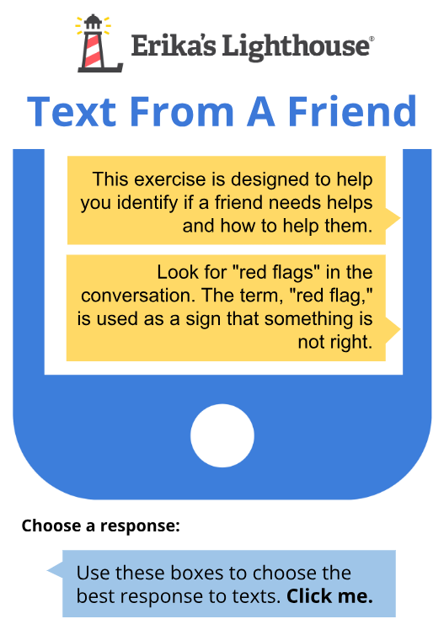
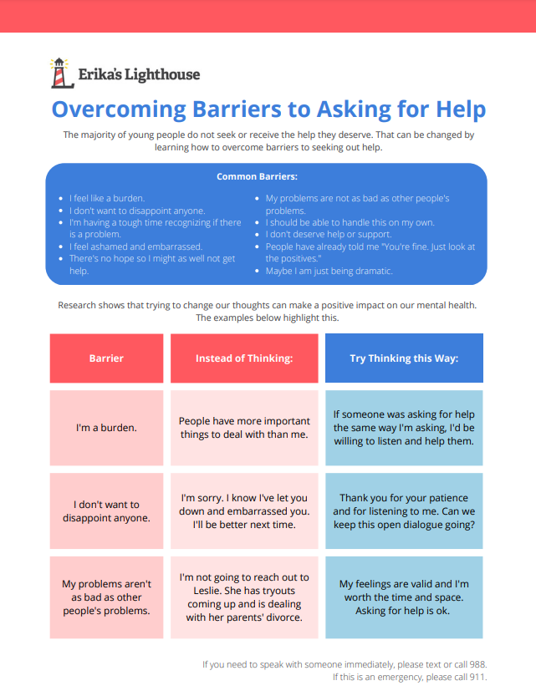
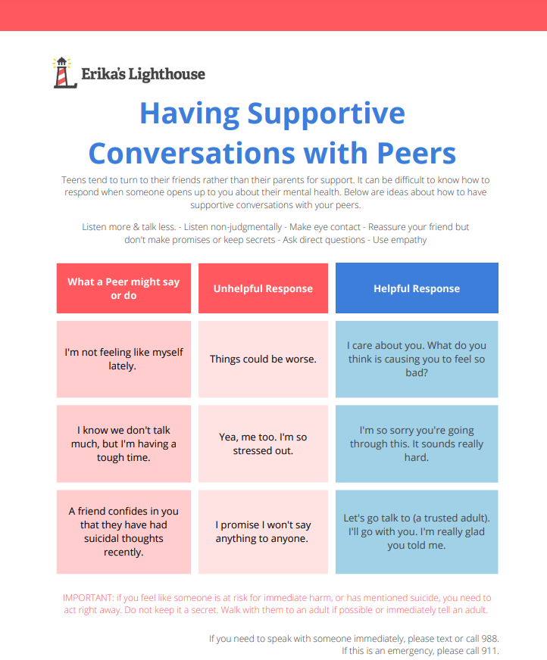
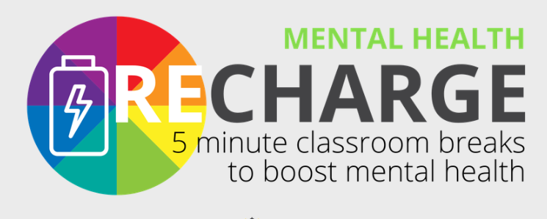
Optional Program Additions
Notes:
If you are interested and time allows, we offer many extension lessons to continue this important conversation with students. There’s a mental health jeopardy game that you can play, mental health Recharge, or worksheets to help students overcome barriers for asking for help. There are many resources that can help you continue the conversations with students.

Slide 29
ErikasLighthouse.org
We’re here to support you!
Program Support
ilana@erikaslighthouse.org
katie@erikaslighthouse.org
Notes:
Erika’s Lighthouse is here to support you. If you have any questions or thoughts, please feel free to reach out to us.

