Slide 1
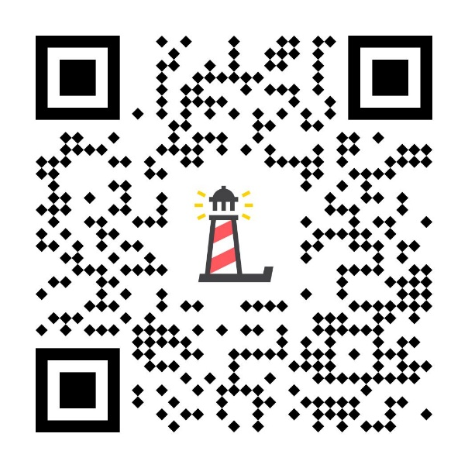
Level II:
Depression Awareness
LESSON ONE
Pre-Test:
http://elhms.info
To edit/customize this slideshow, please make a copy & save it to your computer.

Slide 2
You will...
Define that depression is a mood disorder
Describe the signs & symptoms, risk factors, and resources for depression
Access a reliable, trusted adult at school

Slide 3
Erika's Lighthouse Overview
This program was inspired by a young person named Erika. Erika was a bright light who, sadly, lost her battle with depression in 2004, at age 14.
Erika's Lighthouse was founded in her honor and is dedicated to helping other young people learn about depression and overcome the stigma surrounding mental health disorders.

Slide 4
Video Segment #1
Level II: Depression Awareness
Signs & Symptoms

Slide 5
Discussion Questions
How common is depression in teens?
Is depression a risk factor for suicide?
What are the signs and symptoms of depression?
Can you tell by someone's appearance that they have depression?
Does this mean that anyone who experiences stress will be diagnosed with depression?
If there is a history of depression in your family, does that mean you will develop it ?

Slide 6
Break into Small Groups
Using your Student Workbook, choose two student stories to watch.
As you watch, write down the signs and symptoms that the students experienced.

Slide 7
Discussion
What were the students’ signs and symptoms?
Did you notice any similarities or differences between the students’ experiences?

Slide 8
Symptoms
Depressed mood, sadness, or irritability
Loss of interest or pleasure in activities
Change in weight or appetite
Change in sleep
Feeling sped up or slowed down
Fatigue or loss of energy
Feelings of worthlessness or guilt
Trouble concentrating or making decisions
Thoughts of death or acts of self-harm
5 or more of these symptoms must be present every day for at least 2 weeks or more

Slide 9
When I say the words Trusted Adult, what characteristics or traits come to mind?
Valid & Reliable

Slide 10
Self-Referral Cards

Slide 11
Whatever time: Day. Night. Weekend.
Whatever the reason: Mental health distress. Thoughts of suicide. Worried about a friend or loved one. Would like emotional support.
The 988 Suicide & Crisis Lifeline is here for you.
Text or Call 988 | Chat 988lifeline.org |
For emergencies, call 911

