Slide 1


Level II:
Depression Awareness
Coping Strategies
LESSON THREE
To edit/customize this slideshow, please make a copy & save it to your computer.

Slide 2


You will...
Learn how to help myself or others when experiencing depression
Discuss how to take care of your mental health
Practice communication skills to take care of your health and well being

Slide 3
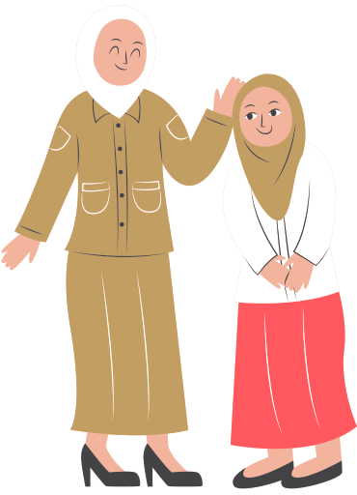

Talk to a Trusted Adult
How you FEEL
What you've TRIED
What they can do to HELP

Slide 4

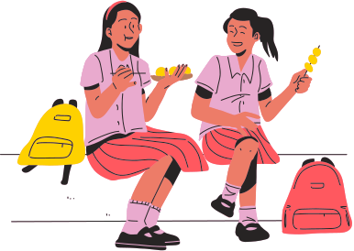
Scenario Activity:
Be sure to include:
  How your friend feels
  What they’ve tried to do to feel better
  What might you do to help
Your friend comes to you and shares that they have not been sleeping, have no appetite and don't have much energy. They are feeling down.
With another student, practice what you might say to your friend.

Slide 5

When helping yourself:
  What you feel
  What you tried to feel better
  How someone can help you see a mental health professional
Scenario Practice
Break into groups
Choose 1 student's story
Answer the questions about the story
When helping a friend:
  What you notice
  That you care
  How you can help get them to a trusted adult

Slide 6

Video Segment Part 3
Level II: Coping Strategies

Slide 7



Discussion
What are 4 ways to practice good mental health?

Slide 8




Mental health is balance, the ability to manage stress and achieve one's potential.
Is it possible to be free of mental illness, and yet, not mentally healthy? Why or why not?

Slide 9


Stress is normal. But too much stress increases the risk for health issues, like depression.
What is stress? What are some things that can cause stress?

Slide 10



How do you know you are stressed? How do you experience it in your body?
Why is it important to be aware of your own personal stress indicators?

Slide 11




Break into Small Groups
Using your Student Workbook, choose two student stories to watch.
As you watch, write down what coping strategies the student used to take care of their mental health.

Slide 12


Whatever time: Day. Night. Weekend.
Whatever the reason: Mental health distress. Thoughts of suicide. Worried about a friend or loved one. Would like emotional support.
The 988 Suicide & Crisis Lifeline is here for you.
Text or Call 988 | Chat 988lifeline.org |
For emergencies, call 911

Slide 13

Post-Test
http://elhmspost.info

