Slide 1


Level II:
Depression Awareness
LESSON TWO
Help Seeking
LESSON TWO
To edit/customize this slideshow, please make a copy & save it to your computer.

Slide 2


You will...
Define what stigma is
Learn that depression is treatable
Demonstrate how to reach out for help for yourself or a friend
Learn how to effectively communicate if you are concerned about yourself or a friend

Slide 3



Stigma Exercise
I enjoy music
I like math
Stand up if you agree.
Stay seated/Sit down if you disagree.
I participate in a sport or club
I know someone who experiences depression
I believe good mental health is for everyone

Slide 4

Stigma
Although depression is incredibly common, 80% of people with depression do not seek treatment. Why?
Depression is an illness that carries a stigma.
Stigma is a mark of shame associated with a particular circumstance, quality or person.

Slide 5

Lesson 2 Video Segment
Level II: Depression Awareness
Help-Seeking

Slide 6




Break into Small Groups
Using your Student Workbook, choose two student stories to watch.
As you watch, answer the following questions:
  Who did the students in the vignettes go to for help?
  Where could you find help in your school or community?

Slide 7
Group Activity
Find a station with chart paper and a marker
Write down as many trusted adults as you can think of
Write down as many resources in the school and the community that you can think of

Slide 8

Symptoms
Depression can happen to anyone.
  Depressed mood, sadness, or irritability
  Loss of interest or pleasure in activities
  Change in weight or appetite
  Change in sleep
  Feeling sped up or slowed down
  Fatigue or loss of energy
  Feelings of worthlessness or guilt
  Trouble concentrating or making decisions
  Thoughts of death or acts of self-harm
You deserve to
feel better
It is a common and treatable illness and nothing to be ashamed of.

Slide 9
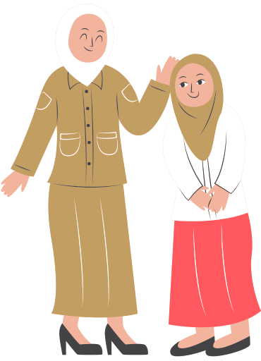

Talk to a Trusted Adult
How you FEEL
What you've TRIED
What they can do to HELP

Slide 10

YOU:
Hey, Mom, can we talk?
MOM:
Sure. What's going on?
YOU:
Lately, I haven't been feeling like myself. I feel sad and angry all the time. I'm constantly tired, and I can't focus in school.
MOM:
I've gone through periods like this when I was your age. Hang in there and I'm sure things will get better with a little time.
YOU:
Well, usually when I'm down I feel better if I go for a run or talk to someone. This time I can't seem to shake it. It's been like this for a few weeks now. I even took a depression test online and it reported that I should see a doctor to get it checked out.
MOM:
Really?
YOU:
Yeah, I think I need to talk to someone. Can you help me set up an appointment with my doctor?
MOM:
Sure. I think that's a great idea.

Slide 11

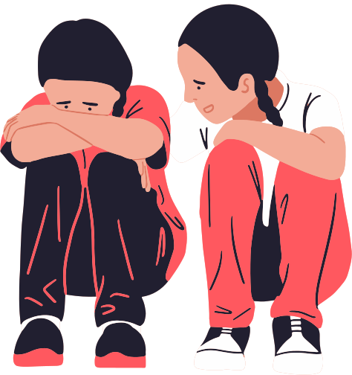
What if it is a FRIEND you are concerned about?
"I've noticed changes in you."
"I care for you."
"How can I help you?"

Slide 12
SAM: Hey, can we talk? Over the past few weeks, I’ve noticed you've been hanging back a lot – not calling or texting me much anymore and skipping out on me and our friends. Recently, you have even missed quite a few play practices. In general, you seem down. This isn’t like you. What’s going on?
FRIEND: I’m sorry; I’ve been feeling weird lately.
FRIEND: You don’t have to worry. I’m sure I’ll snap out of it, eventually.
SAM: I can tell something is different. I’m worried about you and I care.
SAM: You deserve to feel better now and, who knows, it could be something serious like depression. Have you told an adult yet?
FRIEND: No.
SAM: An adult should know so they can help you find a professional to check it out. Who do you feel comfortable talking to?
FRIEND: I guess, Mr. Clark.
SAM: I think he’s a great choice. Would you like me to come with you? It might make you more comfortable.
FRIEND: Uh, sure. Yeah, I'd like that

Slide 13

If your friend is hurting themselves or talking about suicide... tell an adult IMMEDIATELY

Slide 14

BE A GOOD FRIEND
...by listening, showing them you care, and helping them find help.

Slide 15


Whatever time: Day. Night. Weekend.
Whatever the reason: Mental health distress. Thoughts of suicide. Worried about a friend or loved one. Would like emotional support.
The 988 Suicide & Crisis Lifeline is here for you.
Text or Call 988 | Chat 988lifeline.org |
For emergencies, call 911

