Slide 1


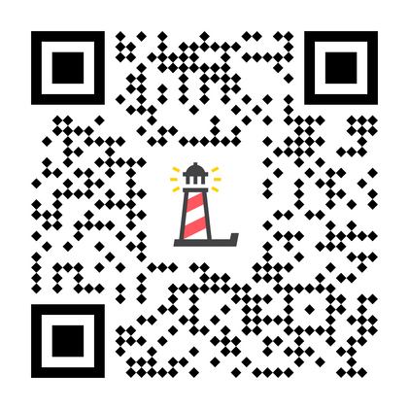
Level III:
Depression Education & Suicide Awareness
Lesson 1
Pre-Test: http://elhhs.info

Slide 2

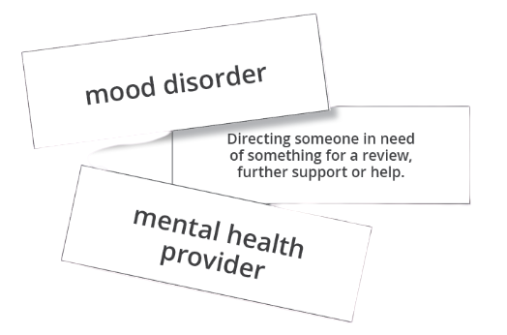
Term/Definition Matching Activity
  You will receive a card with a term or definition
  Find your "match"
  Stay with your "match" until we debrief as a class

Slide 3

Adapted Activity
In your groups, match the terms with the defintion

Slide 4

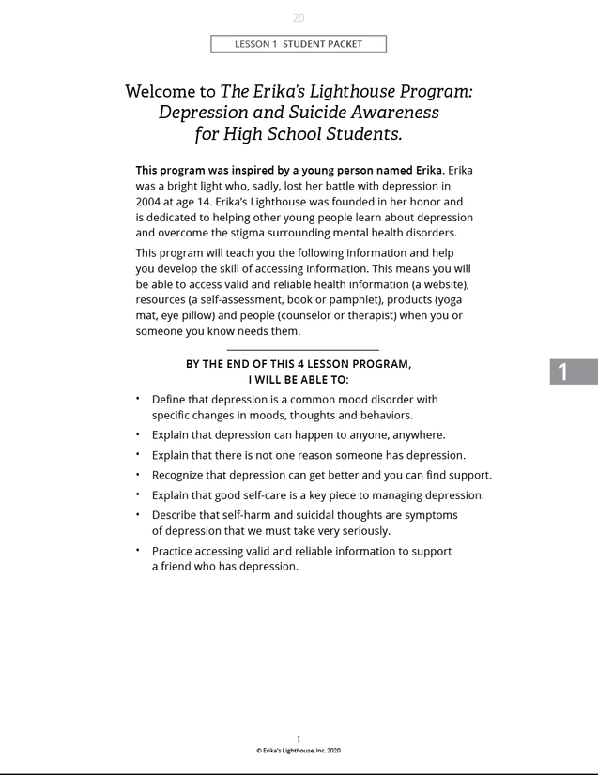
Student Packets
  Open your packet
  Read the Introduction and objectives
  Review the next page with the terms/definitions we just learned.

Slide 5

PROGRAM OBJECTIVES
By the end of this 4-lesson program, I will be able to...
  Define that depression is a common mood disorder with specific changes in moods, thoughts, and behaviors
  Explain that depression can happen to anyone, anywhere
  Explain that there is not one reason someone has depression
  Recognize that depression can get better and you can find support
  Explain that good self-care is a key piece to managing depression
  Describe that self-harm and suicidal thoughts are symptoms of depression that we must take very seriously
  Practice accessing valid and reliable information to support a friend that has depression

Slide 6
Video Part #1 (0:00-10:42)
Level III:
Depression Education &
Suicide Awareness

Slide 7


  What words or themes stood out to you?
  What information concerned you about what you heard?
  Do you think there are students in our school community that have depression?
  Knowing that students in our school may have depression, what does that mean for our school community?
  What are some mental health health resources (meaning information) or people in our community that can help someone that is feeling depressed?
  How do you think students with depression might be taking care of themselves?
Post Video Questions

Slide 8
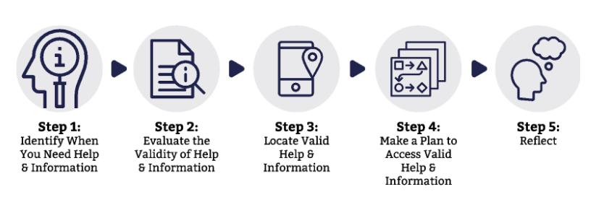
Access Valid & Reliable Resources
The ability to identify, obtain and make use of information effectively.

Slide 9
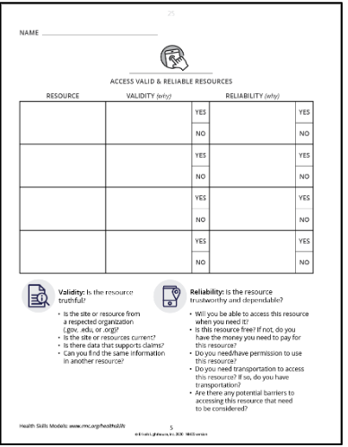

Validity & Reliability
Validity:
Is the resource truthful?
Reliability:
Is the resource trustworthy & dependable?

Slide 10
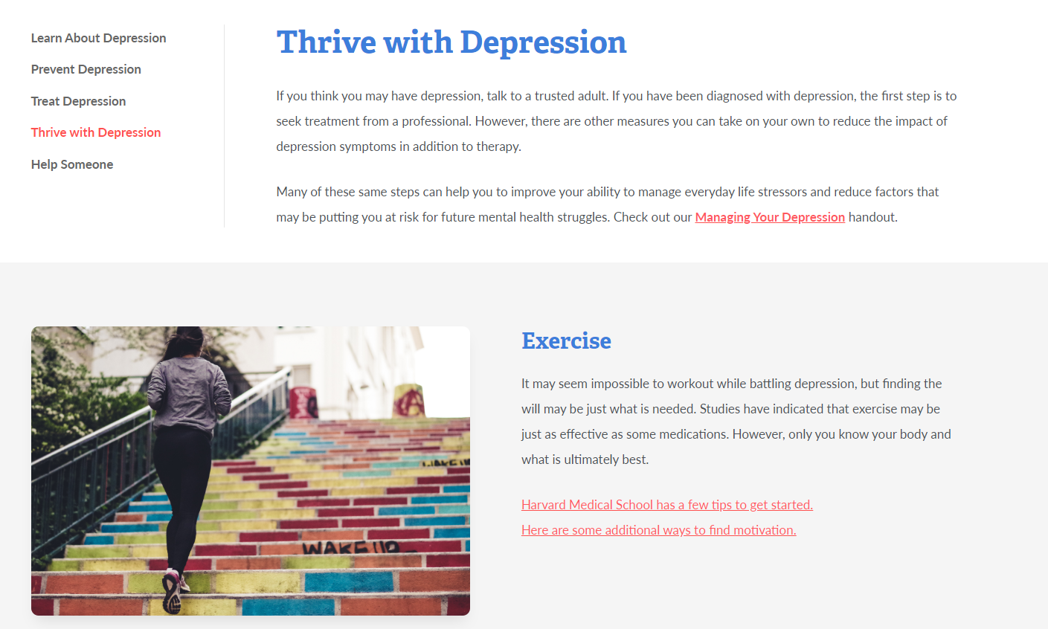
www.erikaslighthouse.org

Slide 11


Why is this Page Valid & Reliable?
VALID
  Information on the page is up-to-date.
  There is a lot of information including: exercise, nutrition, sleep, avoiding other drug use, being mindful, practicing STOP and doing what you love
RELIABLE
  The purpose of Erika's Lighthouse is clear; They are not selling anything/not an advertisement
www.erikaslighthouse.org

Slide 12





Closure
Today we:
Defined depression as a common mood disorder with specific changes in moods, thoughts and behaviors
Explained that depression can happen to anyone, anywhere
Learned how to use validity and reliability checklists to access information on depression
Recognized that depression can get better and you can find support
Explained that there's not one reason someone has depression
The valid and reliable trusted adults in our school are:
(Type your school counselor, social worker and/or psychologist's names here)

Slide 13

Whatever time: Day. Night. Weekend.
Whatever the reason: Mental health distress. Thoughts of suicide.
Worried about a friend or loved one. Would like emotional support.
The 988 Suicide & Crisis Lifeline is here for you.
Text or Call 988 | Chat 988lifeline.org |
For emergencies, call 911

